Slide 1
Customer Service Training
Gina Delgado - AVP

Slide 2
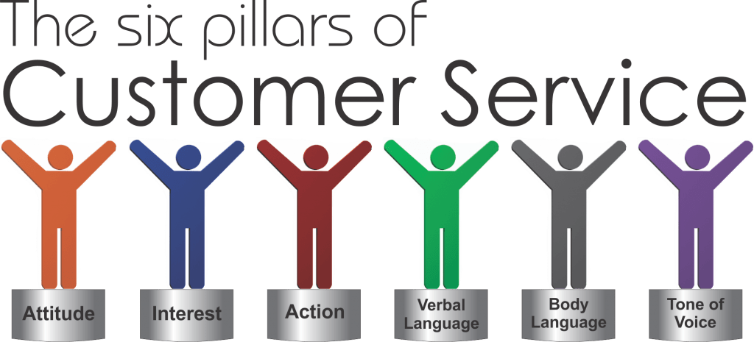

Slide 3

Top 5 Tips of Customer Service
The Customer is Always Right
Always Stay Professional
Care About the Customer
Answer Every Request
Try to go the Extra Mile

Slide 4

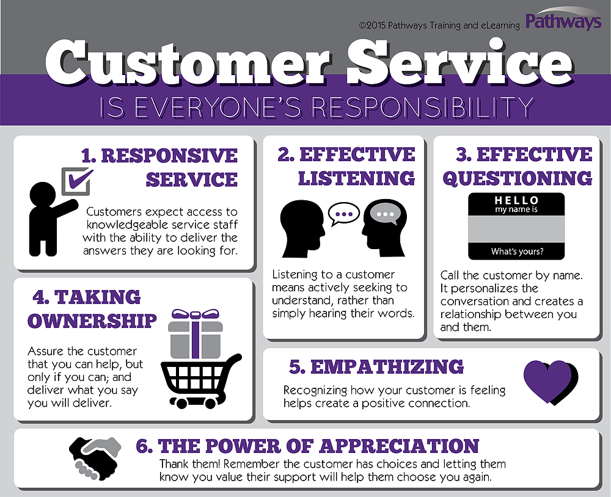


Slide 5
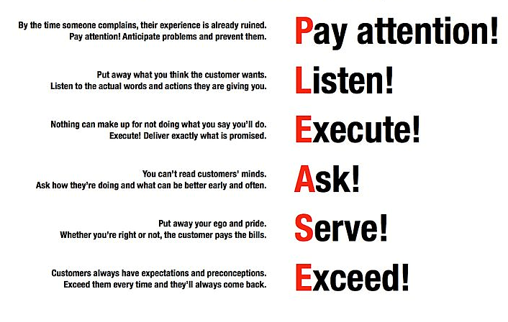

Customer Service Steps

Slide 6
Customer Service Phases
Giving Instructions
A simple way / method to change it will be …
As soon as you receive …
Being Courteous
Would you please allow me to place you on hold for a minute or two, while I …
I will send over the link to the email address that we have in our system and, if you would like, I can also send over a guide
Building a Rapport
What I’m doing for you now is ___
How is the weather where you are at today?
Handling Angry Customers
We appreciate your feedback. I will be sure to pass on what you have told me to our leadership team
I understand your ____, Can you please try ___, so I can take further action without delay
Closing the Call
Is there anything else I can assist with? Thank you for calling Vensure, have a great day!
Greeting your caller
Thank you for call Employee Relations. My name is ___. How can I help you?
When more information is needed
What I’m understand is ___it would be great if you can tell me a more about it
In order for me to assist with ___ can you please give me a few more details
Acknowledging the caller
I would feel the same in your situation, but we will sort this out
I apologize you are having this problem. Let’s see if there is anything we can do to help this situation
Reassuring the caller
You are absolutely correct. Let’s look into this
Definitely, I will make sure that this gets resolved for you

Slide 7
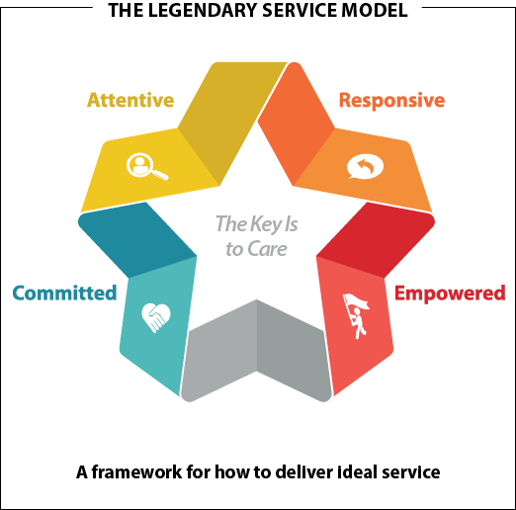
C is Committed to customers: Creating an environment that focuses on serving customers—both internal and external—at the highest level.
A is Attentiveness: Listening in a way that allows you to know your customers and their preferences.
R is Responsiveness: Demonstrating a genuine willingness to serve others by paying attention to and acting on their needs.
E is Empowerment: Sharing information and tools to help people meet customer needs or exceed customer expectations.
CARE

Slide 8

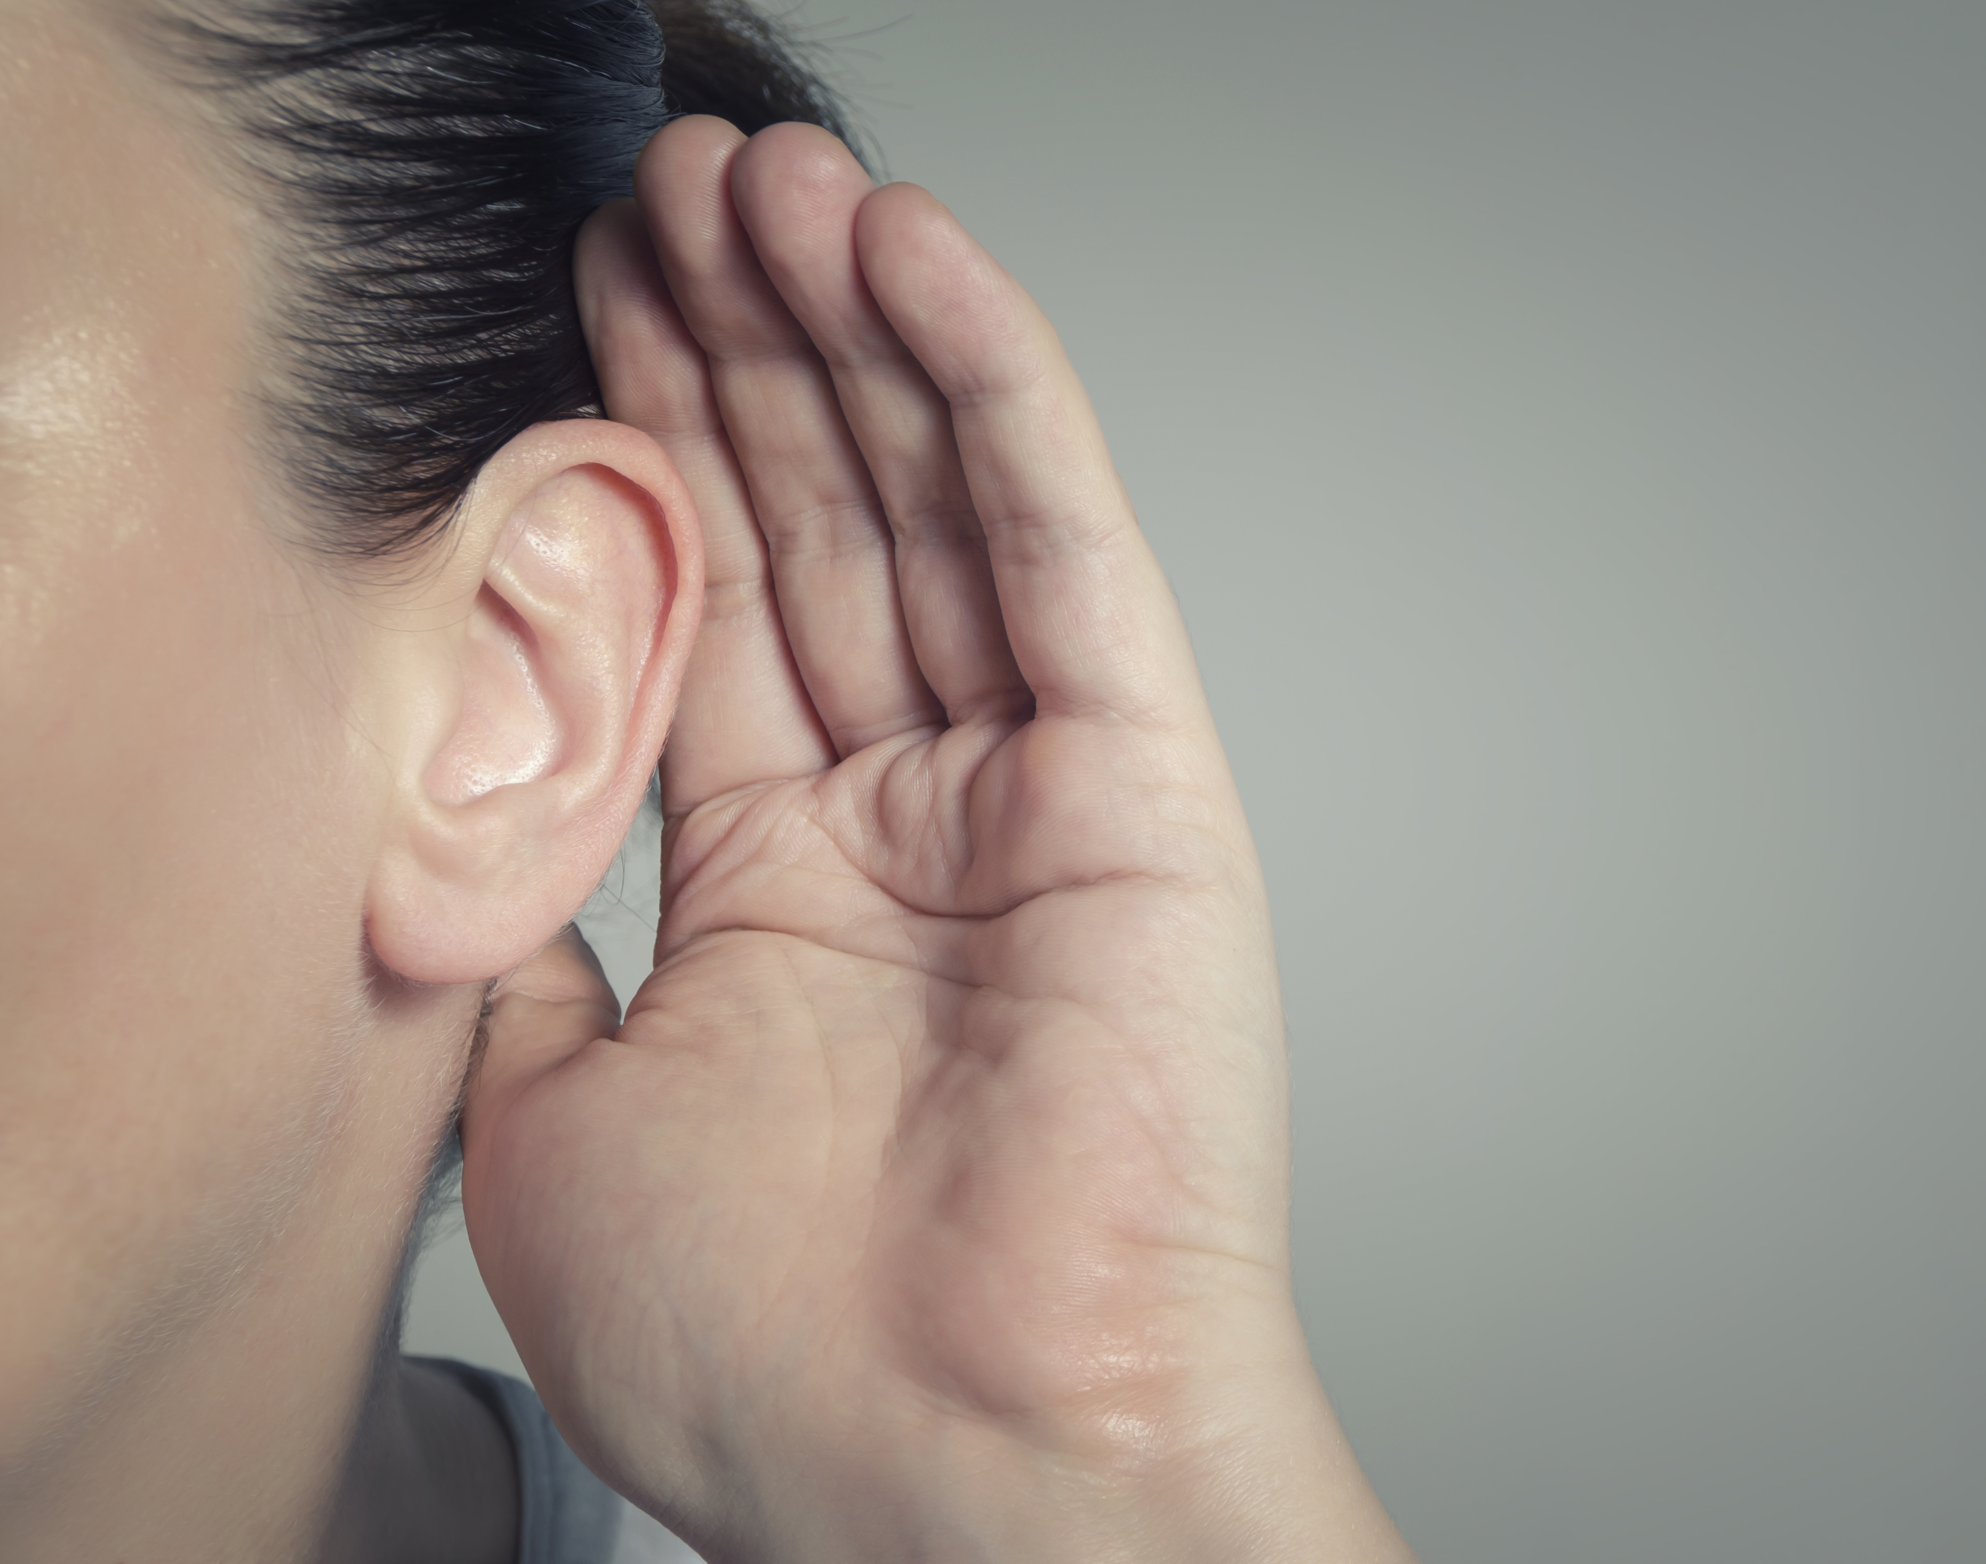
You Can AFFORD
to Listen Fully
ATTENTION. Give the caller your full attention. Do not multitask. Give indication you’re listening.
FOCUS. Focus on what the caller is saying. Don’t think about your argument, what you’re going to say nest, or anything else but the message you’re receiving.
FEELINGS. Identify the feelings behind the message. If the topic is sensitive or involve emotions, listen for what those feelings are. Identify how the caller feels about the topic they’ve sharing with you.
OBSERVE. Watch your body language
RESTATE OR REPHRASE. If you want the caller to feel heard, and you want to reinforce you’re hearing correctly, rephrase the message.
DETERMINE. Verify you understand correctly if you’re unclear. After paraphrasing back, simply ask, “do I understand correctly?” If you’re still not clear, ask for more clarification.

Slide 9


Smile and the World
Smiles with you!
There are many characteristics
that come across the phone
Body Language | Pleasantness | Courteousness
Responsiveness | Friendliness | Articulate
Attitude | Helpfulness | Confidence
Rate of speech | Good listener | Posture
Demeanor | Name | Smile
Informative | Greeting | Vocal tone

Slide 10


Assistance Etiquette Tips
Make sure you identify yourself and speak clearly
Ask for your caller's permission before putting them on hold
It’s better to return a call than to keep the caller on hold for long
Do not let the phone ring more than three times
Do not interrupt the person while he/she is talking
Never engage in an argument with a caller
Do not answer the phone if you are eating
Try not to sound rushed. It is better to return the call when you can give the person the time they need
Always ask for the best time to have a call returned to the caller
Do not call before 8am the caller's time
When hanging up the phone make sure the caller hangs up first.

Slide 11

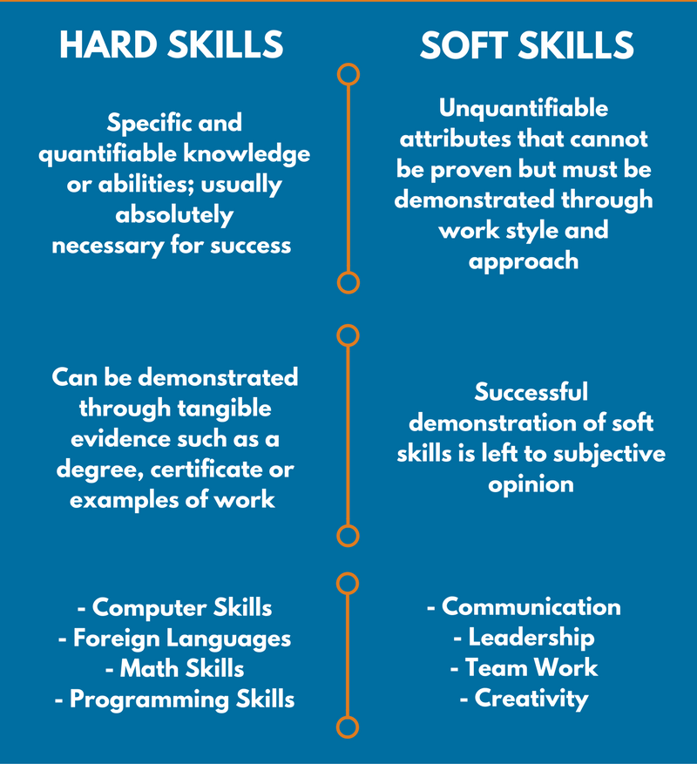
Hard Skills vs
Soft Skills

Slide 12

Top Soft Skills to Master
Soft Skills
Active Listening
Clear Communication
Persuasive Speaking
Confidence
Positive Attitude
Decision Making
Self-Motivation
Leadership Skills
Self-control
Conflict resolution
Empathy
Taking Responsibility
A Sense of Humor

Slide 13

Thick Skin
Receiving tough feedback or criticism and not allowing yourself to get upset or offended by it. Being tough, committed, or resilient.
Don’t take things personally
Know your persona emotional cues
Don’t run away from confrontation
Think about others

Slide 14


Ownership
The act of possessing a situation, problem, or challenge and seeing it through to resolution; taking control and taking responsibility.
Steer the conversation
Keep it actionable
Follow up proactively
Explain, but don’t excuse

Slide 15

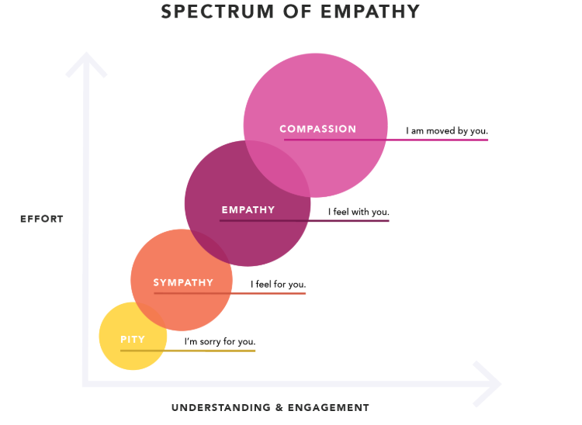


Slide 16



Saying “No” Positively
Don’t Say
Use Instead
Call back tomorrow
It’s not ready
You should have called sooner
That’s not our fault
I’ll call you back tomorrow
It will be ready on …
I understand why you called
Let’s see what we can do

Slide 17
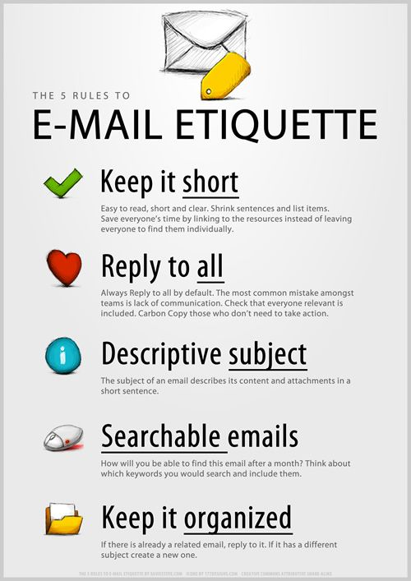

Draft a clear, simple subject line
Use a standard font
Address your recipient formally
Use CC and BCC appropriately
Structure your message clearly
Make it short, meaningful, complete
Provide a call to action at the end
Include a professional closing
Proofread your email carefully
Follow-up after a considerable time

Slide 18
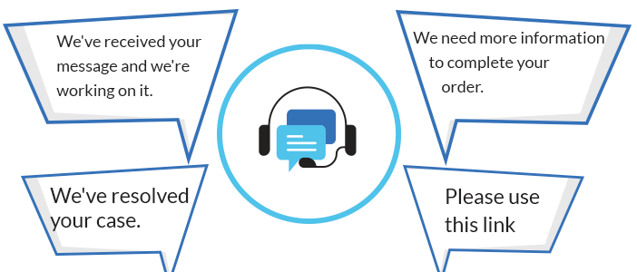


Chat Etiquette Best Practices
Always be courteous
Use titles
Introduce yourself
Watch your tone
Think before responding
Be brief
Don’t use CAPS
Proper grammar and punctuation
Review your message
Proofread
Spell check
Don’t use jargon
Don’t use offensive language

Slide 19


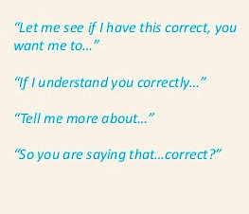
How to ask for more information or verify your understanding
To avoid any confusion and a long chat, make sure you understand the customer’s issue before giving your instructions or offering solutions. There are many ways you can ask for clarification politely.

Slide 20
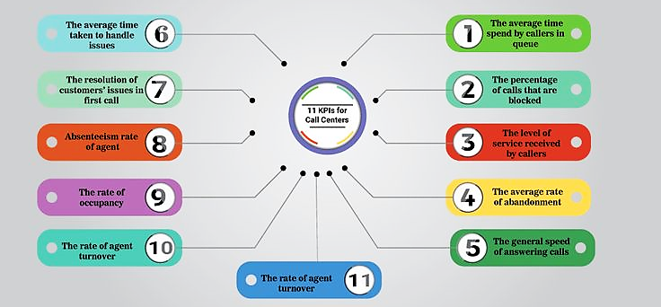
Why are these KPI’s important?

Slide 21
Questions?
Thank you for listening!

