Slide 1
Employee Relations
Andy Frain - Review

Slide 2

The goal of this presentation
Andy Frain processes are different than other clients, we need to keep in mind what is our role and understand our limitations, at then end of the training we should:
Understand the way Andy Frain operates with PEOPLE
Have a clear idea of how to address most common requests
Provide confidence to the team and accurate guidance to employees
Have more material to consult when assisting Andy Frain’s Calls

Slide 3

Pay Period
Pay Period
Pay Period
Sun
Mon
Tues
Wed
Thurs
Friday
Sat
Checks
Sent via USPS
PayCards
ADP
Pay Date
Best time for DD update
MB Financial
Pay Cards ADP: Allows EE to get paid 1 day before if possible.
Checks: Cannot be tracked, Talk to leadership.
Daily Pay: Different from ADP PayCard / Daily Pay Assists

Slide 4



Update information?
Important tips to considerate
For security purposes we are not allowed to manually update Employee’s Address , Tax Fillings or Direct Deposit unless the request comes form AF Payroll/ HR.
Employees can and should use the ESS Portal to do these updates
The employee can talk to Payroll /HR at AF and have them submit an update request

Slide 5

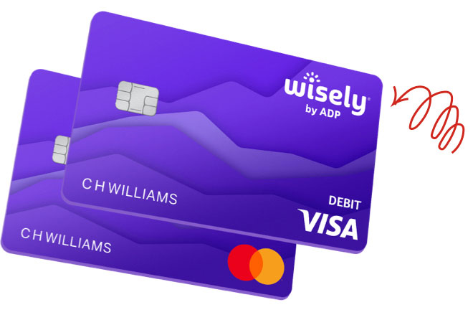

ADP Cards VS DailyPay
ADP Cards (PayCards)
DailyPay
These employees may be paid on Tuesday if payroll is submitted early (not a condition, we must remind them that pay day is Wednesday)
Is a special Service provided to AF Employees allows them to get paid before time among other Benefits.
Most Request are handled by DailyPay 866.432.0472
They appear on PRISM as MB finantial

Slide 6

Andy Frain - DailyPay
Pay Period
Employees with DailyPay will have their DD accounts Changed on Friday by the payroll processor, this is to pay for the advance granted by Daily Pay.
Thurs
Friday
Sat
Employees will receive a message like this:
"The recent notification you received about an update on your direct deposit account is due to the usage of daily pay services, this is an internal workaround process to complete payback of your payment advancement, if you did not add daily pay services, please contact 866.432.0472"
DD changed by the payroll processor
Once the payment is done , the employee will have to go back and change the Direct Deposit information again.

Slide 7




Payroll Concerns
Direct Deposit Changes
Process a “Reversal”, Re issue the money to us so we pay into the new account.
Changes of DD in the middle of a PayPeriod and deposited to old acc.
Employee
Supervisor
Check Verification
Authorized signature: John Hardin
Payroll Hours/Rates
Employee must escalate with the supervisor, and they will submit the request to us.

Slide 8



HR / Verifications of Employment
Complaint about AFS staff
Professional Resolution Process (PRP)
Call AFS Corporate HR manager Patti.
Andy Frain Corporate | 630.820.3820
PRP Hotline | 813.259.2203
I do not know who my supervisor or manager is
Call AFS Corporate Office
Andy Frain Corporate | 630.820.3820
Employee Verifications of employment
If the requester is:
EMPLOYEE
AGENCY/ GOVERNMENT ENTITY
voe@vensure.com

Slide 9


Benefits Questions
PTO/Sick/Vacation Time available
Enroll/ Un- Enroll / Benefits questions
Life insurance email
10k Life insurance
Benefit for only Full Timers
Go to the ESS > Benefits > Benefits enrollment
www.theamericanworker.com
866.866.3424
Reach out SUPERVISOR, PEOPLE does not administer
We do not handle

Slide 10
Scheduling / AFS – Website Questions
What is my work schedule?
PEOPLE does not handle scheduling on behalf of AFS
The employee must contact the direct supervisor
Employee
Supervisor
What is my login for the scheduling system/e-time/ABI mastermind
The employee must contact the direct supervisor
We do not administer these websites
Employee
Supervisor

Slide 11

Summary
Direct Deposit Change (Reversal)
ADP (PayCards)
Daily Pay
Check Verification
Hours/ Pay Rate disputes
HR Verification
Benefits
Scheduling / AFS Website Questions
Any other request must be consulted with leadership.

Slide 12
Questions?

