Slide 1
Employee Relations
Benefits Season 2022 - Preparation

Slide 2
Benefits Season 2022
Preparation

Slide 3

Benefits Open Enrollment Season
Here we have a quick guide to better look up for information during the Benefits Enrollment Season. This will help us to:
Provide smooth assistance to Employees
Avoid call time and unproductive time during the call (long holds, dead airs, transfers)
Give confidence to associates when assisting these types of requests
Better understanding of the business and improvement opportunities

Slide 4




Benefits Enrollment Season – Useful Information
Useful Information
Should I call or create a case to Benefits?
All MetLife services will be replaced by Guardian
Calling is always our 1st choice.
Case Will be the second one.
Confirm with the EE if willing to wait
How to retrieve the GroupID?
In the Master Benefits Plan section of SP
>
Carrier Quick Reference Sheet 2022
The employee is asking me about something I do not know?
If it is something not addressed in the Benefits material, we should create a case.
Employee wants to cancel Benefits
Only with a Life Changing event – Consult with Benefits

Slide 5

Benefits Enrollment Season – Verbatim ideas
Verbatim ideas
Contacting Benefits
“Mr/Ms___ In order to Help you with your request I Will need to contact the department of Benefits. As we are in the middle of the open enrolment season this may take longer than expected, if you do not wish to remain on the line for too long, we can create a ticket and get back at you.
Explaining Response Times
“…Here is your case number____ Your request Will be addressed as son as we can, we usually offer a 24hrs response window, but it may take longer as we are experiencing a high volume of Benefit’s request. We appreciate your patience.
Qualifying Life Events
Is a change in your situation — like getting married, having a baby, or losing health coverage — that can make you eligible for a Special Enrollment Period, allowing you to enroll in health insurance outside the yearly Open Enrollment Period.

Slide 6
Benefits Enrollment Season - Overview
Key Points
Benefits Timeline
Before OE
During Open Enrollment
After submission
Login Problems
OE dates
ESS Portal Guidance
General information
Portal does not Work
  General Troubleshooting
  PS Ticket if Applicable
Assistance during Enrollment
  Adding Dependents
  Editing Dependents Info
  Domestic Partner
  SBC Files
  Proxy Tool
  Confirmation Statement
  Not able to confirm elections
When to Create a case/ Call to Benefits
OE Dates – Status of Submission
Change election of benefits
Pay Period Explanation
How to Waive
Slavic 401K / HSA / FSA
Benefits Card
COBRA
Plan does not appear / Not offered
Plan questions
OE Extension
  Extension by ER
  Extension by Benefits Team
Qualifying life changing events
When are Benefits effective
Login into the carrier’s portal (group ID)

Slide 7


Benefits Enrollment Season - Overview
General information
Benefits Card
Key Word: Cards
Not able to confirm elections
COBRA
Key Word: Name is wrong
Key Word: COBRA
Pay Period
Slavic 401K / HSA / FSA
Key Words: Pay Period
Key Word: Slavic
Confirmation statement
Benefits Effective Dates
Key Word: Statement
Key Word: Effective
Plan does not appear for election
OE Extension
Do Proxy also check:
Key Word: Window
OE Workflow – Benefits
BE Workflow - ER
Carriers Web Site
Key Word: Plan Details
OE Dates / Status of Submission
TypeofRequest
Key Word: Status - Workflow
OpenTheSOP
Life Changing events
KeywordLookup
When to create a Case/Call Benefits
Key word: Life
Call is #1 Option – Then case
SBC File
Plan questions
Key Word: Plan Details
Key Word: Details

Slide 8

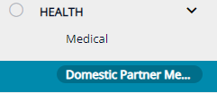
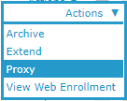
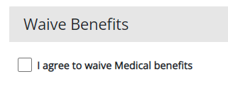
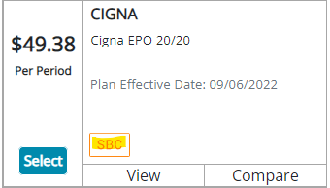
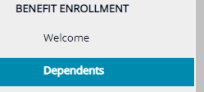
Benefits Enrollment Season - Overview
Domestic Partners
>Proxy
Proxy
>Key Word: Proxy
How to waive Benefits
Scenarios
>Proxy
Proxy
For
How to find SBC
Dependents
>Proxy
Adding
Editing
>Proxy
>Key Word: Dependents

Slide 9
Practice Time
Benefits Season 2022 - Preparation

Slide 10

Benefits Practice
Benefits Enrollment Season - Practice
Read the scenario given and find the answer using the information given during this training, identify :
SOP Used
Keyword Used
Section where the answer is located

Slide 11

Benefits Enrollment Season - Practice
Scenario 1
Hello, this is Andrew! I just finished with my Benefits election, and I wanted to know when will I receive my medic card?

Slide 12
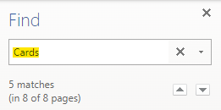

Benefits Enrollment Season - Practice
Scenario 1
Hello, this is Andrew! I just finished with my Benefits election, and I wanted to know when will I receive my medic card?
Resolution

Slide 13

Benefits Enrollment Season - Practice
Scenario 2
Hello, this is Amanda! Can I get a copy of the Benefits I selected sent to my email?

Slide 14
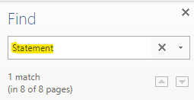

Benefits Enrollment Season - Practice
Scenario 2
Hello, this is Amanda! Can I get a copy of the Benefits I selected sent to my email?
Resolution

Slide 15
Benefits Enrollment Season - Practice
Scenario 3
Hello, this is Nick! Every time I put my signature on the last page of my Benefits. It says that is not correct, I cannot submit my elections, can you assist?

Slide 16
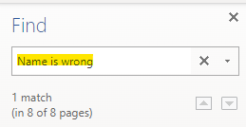
Benefits Enrollment Season - Practice
Scenario 3
Hello, this is Nick! Every time I put my signature on the last page of my Benefits. It says that is not correct, I cannot submit my elections, can you assist?
Resolution

Slide 17
Benefits Enrollment Season - Practice
Scenario 4
Hello, this is Michelle. My husband was fired from his job, and I wanted to cover him with my health insurance, can I do that?

Slide 18
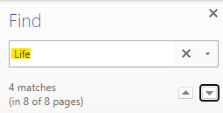

Benefits Enrollment Season - Practice
Scenario 4
Hello, this is Michelle. My husband was fired from his job and I wanted to cover him with my health insurance, can I do that?
Resolution

Slide 19
Benefits Enrollment Season - Practice
Scenario 5
Gustav is calling to get some instructions on how to add his dependents on the portal, how would yo assist?

Slide 20
Benefits Enrollment Season - Practice
Scenario 5
Gustav is calling to get some instructions on how to add his dependents on the portal, how would you assist?
Resolution

Slide 21
Benefits Enrollment Season - Practice
Scenario 6
Hello, Brenda here. I was trying to get the Dental plan but when looking into the options it does not appear, why is that?

Slide 22
Benefits Enrollment Season - Practice
Scenario 6
Hello, Brenda here. I was trying to get the Dental plan but when looking into the options it does not appear, why is that?
Resolution

Slide 23
Benefits Enrollment Season - Practice
Scenario 7
Hello, I am Rick, I wanted to know what are the specifics of the Vision Plan, how can I look for that information?

Slide 24
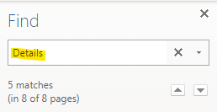


Benefits Enrollment Season - Practice
Scenario 7
Hello, I am Rick, I wanted to know what are the specifics of the Vision Plan, how can I look for that information?
Resolution

Slide 25
Benefits Enrollment Season - Practice
Scenario 8
Hello, I have an employee here with me and wants to know how to enroll into the 401k plan.

Slide 26
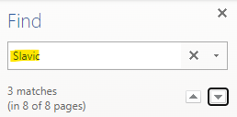

Benefits Enrollment Season - Practice
Scenario 8
Hello, I have an employee here with me and wants to know how to enroll into the 401k plan.
Resolution

Slide 27
Benefits Enrollment Season - Practice
Scenario 9
Hello, this is Frank. I do not need Benefits for this year, I might need to skip the enrollment.

Slide 28
Benefits Enrollment Season - Practice
Scenario 9
Hello, this is Frank. I do not need Benefits for this year, I might need to skip the enrollment.
Resolution

Slide 29
Benefits Enrollment Season - Practice
Scenario 10
Tiffany added her son with the wrong SSN she is calling in to have fixed…

Slide 30
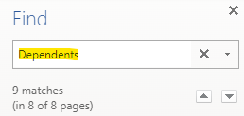
Benefits Enrollment Season - Practice
Scenario 10
Tiffany added her son with the wrong SSN she is calling in to have fixed…
Resolution

Slide 31
Questions?
Let us know!

Slide 32
Benefits Timeline
Benefits Enrollment Season - Overview
Onboarding process completion
Benefit enrollment window
30 days grace period
Out of grace period
WSM approves paperwork
Full Access to ESS
Benefits option will be available for Enrollment
EEs can make changes to their benefits anytime
Dependants can be added but NOT modified. ER assists
EEs can download SBC for plans
Window is closed but the EE can make updates if needed – Benefits Assist
Extensions can be granted by ER (BE workflow) or Benefits (OE workflow)
Cannot download SBC for the plans, Benefits assist through a case
Benefit changes can only be done because of a life changing event
Extensions can only be granted by Benefits IF aplicable
Employee must provide supporting documentation of Life changing event (Benefits@vensure.com)

