Slide 1
EEmployee Relations
Training Session – Cashing Check Issues

Slide 2


Cashing Checks – Common Requests
During this training we will cover most commons scenario when employee Cash their checks
But first, lets review the key points
Timeframe
Damaged checks
Cannot Verify funds on the check
Using Walmart or check cashing facilities
Treasury VS Payroll

Slide 3
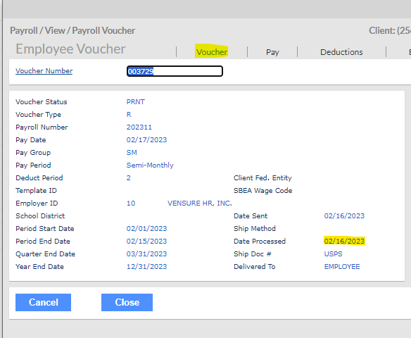

Cashing Checks – Timeframe
Employees will have 90 days once the check is processed to cash it, we can review this information in PRISM > Payroll Vouchers >Voucher tab > Date Processed
If the check is past 90 days, will not be valid and payroll will have to re-issue once they confirmed it was never cashed.
Case to Payroll + Affidavit

Slide 4

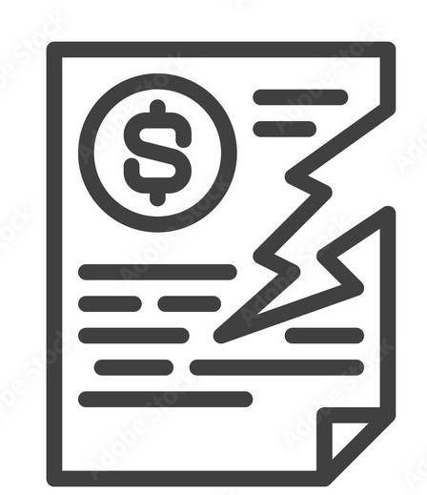
Cashing Checks – Damaged Checks
If the employee claims that the check is damaged or in a condition where it cannot be cashed. We will have to send the affidavit form and create a case for payroll to re-issue
Treasury will be involved in this as they need to confirm that the check has not been cashed out.
Consult your supervisor for Case set up + Affidavit

Slide 5
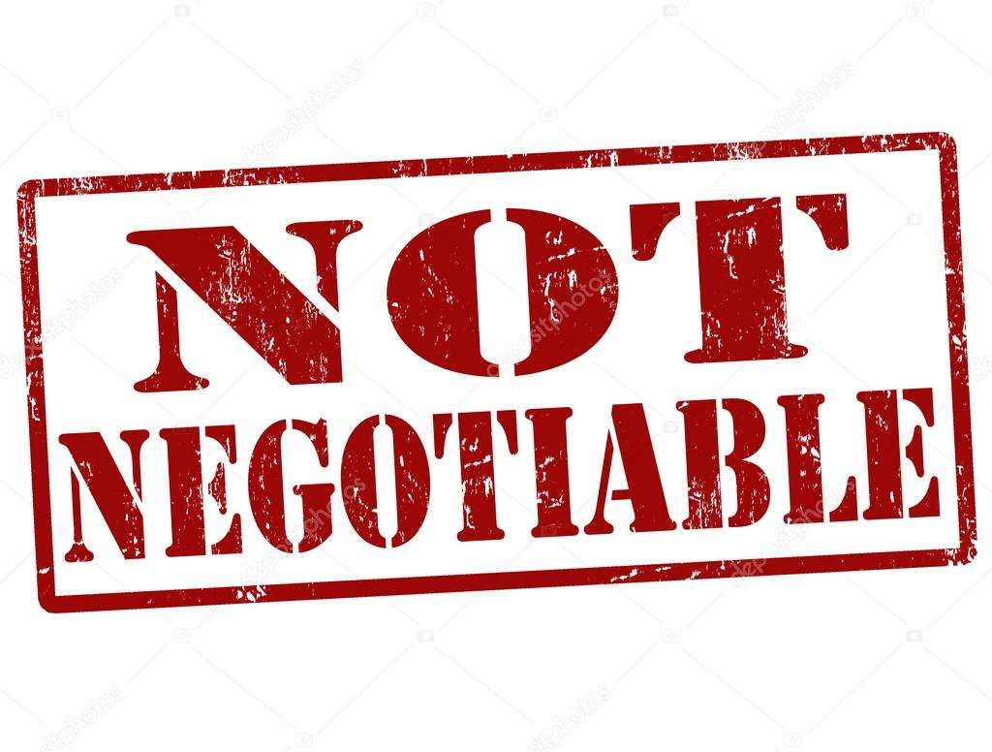

Cashing Checks – Non-negotiable Check
A non-negotiable check is a check that cannot be deposited, transferred, or exchanged for cash. An example of a non-negotiable check would be when an employer pays an employee via direct deposit but issues a non-negotiable check outlining the details of the payment.
Usually this means the check the employee received is just a copy, the payment was already done.

Slide 6
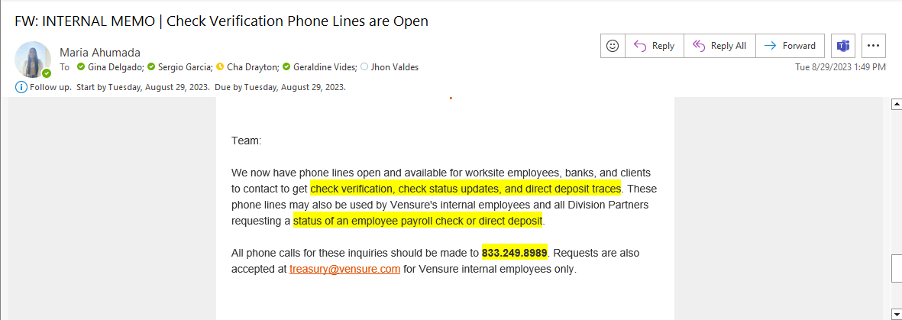

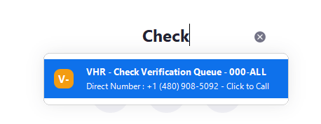
Cashing Checks – No funds
If the employee claims that the check does not have funds, we can verify with treasury at
833.249.8989 or email treasury@vensure.com
If you do not have this email, please advise your supervisor.

Slide 7
Cashing Checks – No funds
If the employee claims that the check does not have funds, we can verify with treasury at
833.249.8989 or email treasury@vensure.com
Before calling Treasury get ready with the following info
EE name
Client name
Check number
Issue date
Account number
Amount
Bank name
Name of the place where the check is going to be cashed

Slide 8

Cashing Checks – Store / Bank Problems
Employee is having issues cashing a check in a store / bank
This could be because of different factors:
Policies
They do not cash certain checks due to the bank alliance
They have received fraudulent checks and now they refuse to cash them.
If this is the case, refer the employee to their bank if they have one otherwise refer the employee to the bank in the check.
If they state is because the check does not have funds, refer to previous slide.

Slide 9
Cashing Checks – Treasury VS Payroll
Treasury
Payroll
in charge of economic operations internally.
helps making the payments approved by the client
Can trace transactions and determine where the money went
Review payroll (amount to be paid)
Can confirm if the check was cashed
Shipping information
Can Trace DD transactions
Re issue checks

Slide 10
Practice Time
Be Prepared!

Slide 11

Cashing Checks – Most Common Scenarios
Sara Calls in because she never received one of her checks, it’s been more than 90 days, what can we do?

Slide 12
Cashing Checks – Most Common Scenarios
Sara Calls in because she never received one of her checks, it’s been more than 90 days, what can we do?
Checks are only valid for 90 days, if it is past than that, we can create a case to payroll so they confirm with treasury if the check was never cashed , then will re-issue.
Do not Forget Affidavit, this form will help us to stop and void the transaction

Slide 13
Cashing Checks – Most Common Scenarios
Helen called in because she was playing with her dog and he ripped off the check, what can we do in this case?

Slide 14
Cashing Checks – Most Common Scenarios
Helen called in because she was playing with her dog and he ripped off the check, what can we do in this case?
Send affidavit and create a case for payroll so they can re issue, most likely they will confirm with treasury that the check has not been cashed and re issue a new one.

Slide 15
Cashing Checks – Most Common Scenarios
Caleb is calling because he did not receive the check for last week, Amanda our ER Rep is wondering if she should call treasury…

Slide 16
Cashing Checks – Most Common Scenarios
Caleb is calling because he did not receive the check for last week, Amanda our ER Rep is wondering if she should call treasury…
Before calling treasury, we should confirm with the payroll processor the tracking number (Teams or Case) and track the check.

Slide 17
Cashing Checks – Most Common Scenarios
Sarah Called in because she is at Walmart and they say they cannot cash the check because of a company policy…

Slide 18
Cashing Checks – Most Common Scenarios
Sarah Called in because she is at Walmart and they say they cannot cash the check because of a company policy…
Refer the employee to another place / branch / bank on the check.

Slide 19
Cashing Checks – Most Common Scenarios
Lucy Called in because she was supposed to fill out something in order to get a new check sent to her… what she could be talking about?

Slide 20
Cashing Checks – Most Common Scenarios
Lucy Called in because she was supposed to fill out something in order to get a new check sent to her… what she could be talking about?
Affidavit, this form is necessary for processing a new check.

Slide 21
Cashing Checks – Most Common Scenarios
Matthew has an employee on the line asking for someone to re issue a check in 24 hrs. for an emergency, the check is lost…

Slide 22
Cashing Checks – Most Common Scenarios
Matthew has an employee on the line asking for someone to re issue a check in 24 hrs. for an emergency, the check is lost…
Matthew will have to send the affidavit form and create a case. We cannot guarantee any re issue in 24 hrs.

Slide 23
Cashing Checks – Most Common Scenarios
Zack has a Bank representative on the line stating that the EE check does not have funds…

Slide 24
Cashing Checks – Most Common Scenarios
Zack has a Bank representative on the line stating that the EE check does not have funds…
Call treasury and confirm if the check has funds, follow next steps from them.

Slide 25
Cashing Checks – Most Common Scenarios
Lupe is very happy because she found her paycheck for last week that was lost, she is wondering what she can do to cash it…

Slide 26
Cashing Checks – Most Common Scenarios
Lupe is very happy because she found her paycheck for last week that was lost, she is wondering what she can do to cash it…
If the check is not past 90 days, she can cash it as usual.

Slide 27
Questions?

