Slide 1
Employee Relations
EmPower- Review

Slide 2

The goal of this presentation
Andy Frain processes are different than other clients, we need to keep in mind what is our role and understand our limitations, at then end of the training we should:
Understand the way EmPower operates with Vensure
Have a clear idea of how to address most common requests
Provide confidence to the team and accurate guidance to employees
Have more material to consult when assisting EmPower’s Calls

Slide 3

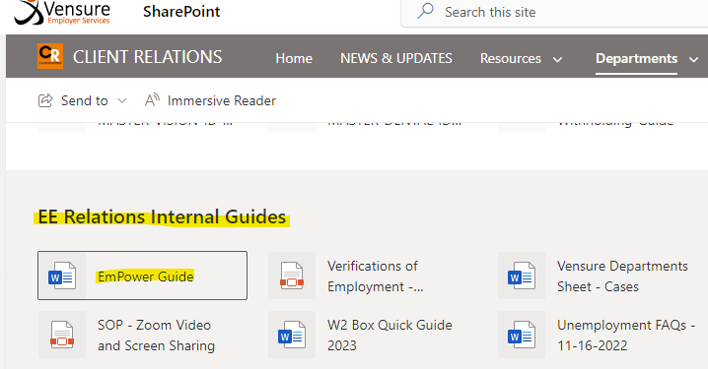
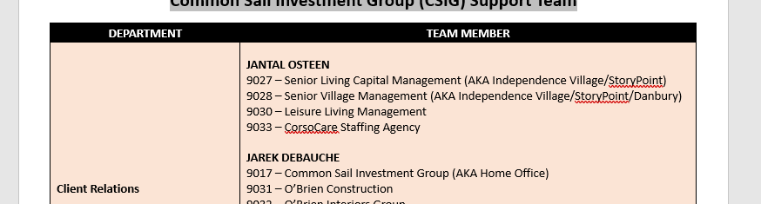

CSIG - Common Sail Investment Group
Support Team
Is a group of clients that have specific team members assigned to assist with different matters in case we cannot resolve.
Make sure that you know where to locate the EmPower guide document.
Confirm if the client is listed in the document, if so, identify who will be assisting with our case if needed.
Do not reach out these members on Teams, we must create a case

Slide 4


EmPower - Benefits
Reaching out Members
Plans
EmPower’s Benefits questions, must be addressed via case, do not reach the specialists via Teams.
EmPower’s some of the Benefits Plan SBCs are in the SP
Plan CSIGV4
Carrier Name VSP
They don’t provide any type of cards.
Employees usually go to www.VSP.com, register, and they can get all their coverage information there.

Slide 5

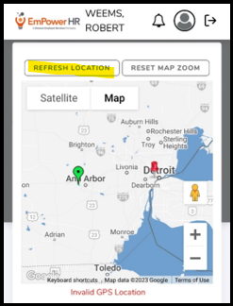

EmPower – TimeKeeping Calls
GPS Errors – Invalid GPS Location
For "INVALID GPS LOCATION“ error, They need to click on Refresh Location
Clock In/Out
CSIG Clients
Type: Payroll Other
Assigned To: Payroll Processor according to CSIG guide
Subject line: Include NOVAtime
For all other clients we use the timekeeping@vensure.com email.

Slide 6


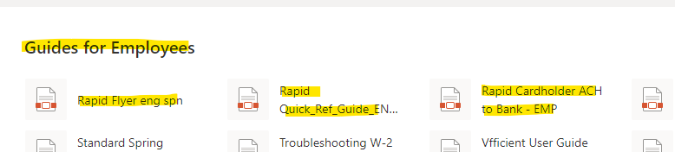
EmPower - PayCards
Set up between Client – Employee
All issues must be direct to rapid Customer service line or Web
All support Files can be found in the ER – SharePoint Page

Slide 7

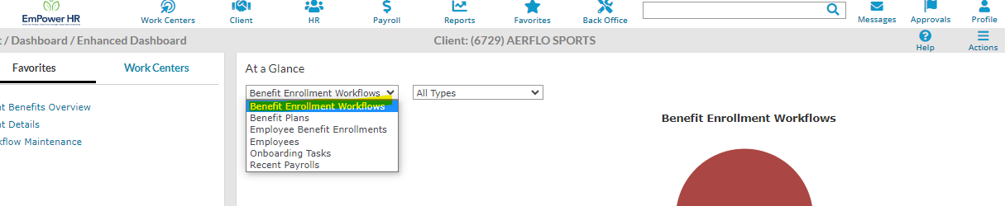
EmPower – Other Tips
Benefits Workflow View
When working with EmPower clients the home page may look a bit different from other instances. If you want to see the Benefits Workflow of a client use the following filter.
Pay Period
Pay Period
9017 – Common Sail Investment Group (AKA Home Office)
The only people that have access to this client are our Supervisors Maria, Geraldine, and Jhon. When you search for the WSE they will only show in Users. Advise your supervisor, they will help you assist the WSE.

Slide 8

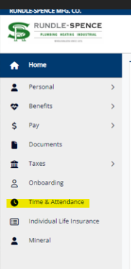
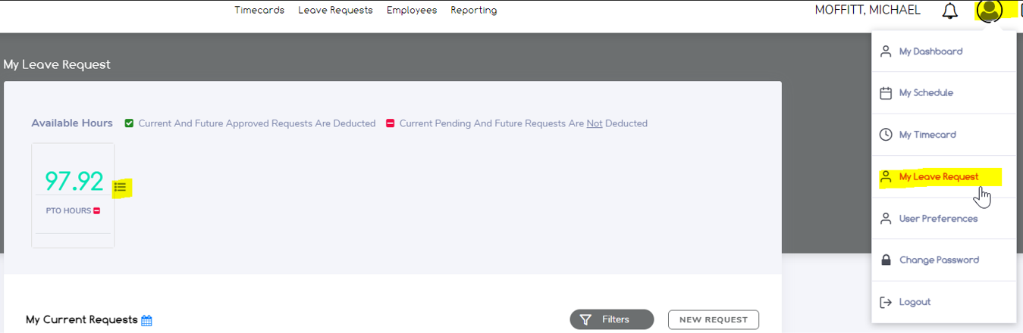
EmPower – Requesting PTO
How to Request PTO in the ESS
1
2
Empower employees request Paid Time Off by going into the ESS > Time & Attendance, Once they are directed to TimeCo, they will need to click New Request.
If they want to check their historical of PTO, they need to click in the upper right-hand corner and then My Leave Request.

Slide 9

Summary
When working in the EmPower Instance, confirm if the client belongs to the CSIG Group, if not, assist as usual.
GPS errors can be troubleshot by refreshing the location.
If the Client Belongs to CSIG and we cannot resolve, create a case and assign it to the person in the EmPower Guide.
Issues with clock in/out
  if CSIG Client:
Case to Payroll > Subject line: NOVATime
  If other Client:
    Timekeeping@vensure.com
Relly on Cases when getting help from other departments
9017 – Common Sail Investment Group (AKA Home Office) – Ask Supervisors for help
rapid! Issues : Customer support line 1.888.727.4314

Slide 10
Questions?

