Slide 1
Employee Relations
Call / Chat Handling – Soft Skills Training

Slide 2

We Are Assisting Employees But We Are Also Helping People
As we are assisting people, we must understand that not everybody is willing to cooperate or is in the best mood when calling for help. With that being said we should keep in mind the following aspects:
Every interaction is a challenge that helps us to improve our skills.
There are employees that cannot be assisted and that is ok.
There are multiple aspects that affect our interaction handling, make adjustments.
Every interaction is different, so avoid going automatic mode.

Slide 3






What are Soft Skills?
Soft skills are the interpersonal attributes you need to succeed in the workplace. They are how you work with and relate to others—in other words: people skills.
They include:
Personality
Attitude
Flexibility
Motivation
Manners

Slide 4






So how can we improve?
Important tips to considerate
An interaction is a conversation between You and the Employee, so, how do you talk to other People?
Listen and Comprehend
Be in another person’s shoes
Be creative
Practice
Understand the difference
How would you like to be treated if it was you?
Adapt and be flexible.
Failure is part of the process
Read between the lines
What would you like to hear?
Be authentic and professional
Learn and grow

Slide 5
Common Scenarios
Let's Check Them Out! – Call / Chat

Slide 6


Handling Irate People
Agressive
Our Focus
-Balance the communication by using the best wording.
-Resolve
Neutral
Our Actions
Passive
How it Starts
Our Goal
-Be effective
-Do not hesitate
-Be confident / show confidence
-Explain the processes / Explain what is going on
-Manage your voice (neutral)
-Ask proper questions
This is not the final receipt to handle all calls and chats, every interaction is different, just do your best and learn from that.
Do Not Take It Personal

Slide 7

Interaction Handling
Scenario: Irate People
Hello this is Steve, If you wanted to make things harder for us as employees, you DID IT RIGHT, this is the seventh time I try to login into your app and the code you are sending does not work.
I am spending my whole lunch time trying to access and the codes you are sending do not work. It always says is invalid.
I do not have a computer at home, and I am in the field doing the hard work.
First problem was resetting the password which worked yesterday for me but now all I have is a bunch of codes and none of them work. WHAT IS GOING ON?
Keep In Mind:
What was your focus?
How was your tone of voice?
How did you balance the communication?
How did you display confidence?
How good was your explanation?

Slide 8
Interaction Handling
Scenario: Irate People
Hello this is Steve, If you wanted to make things harder for us as employees, you DID IT RIGHT, this is the seventh time I try to login into your app and the code you are sending does not work.
I am spending my whole lunch time trying to access and the codes you are sending do not work. It always says is invalid.
I do not have a computer at home, and I am in the field doing the hard work.
First problem was resetting the password which worked yesterday for me but now all I have is a bunch of codes and none of them work. WHAT IS GOING ON?
I understand this must be frustrating for you Steve, Let me help you fix this as soon as we can so you can go back to your duties (…)
Great! In order to pull up your profile may I have your (…).
I was reviewing your profile and some information was not up to date, I have made some changes to your account so, please login again and request the code via SMS. (…)
We know the codes can be upsetting but is the best way to protect your information against hackers, just keep in mind the system will send you a code only the first time you login during the day. If you happen to have more issues let us know so we can request our Tech dept to step in.
Empathy Statements, connection.
Explanation of why the issue happened.
Expectations

Slide 9
Interaction Handling
Scenario: Irate People
Hello, this is the 3rd time I am calling your company because I have not received my pay, I have a 2 years old kid who needs diapers and a demanding wife who needs money to get the food for our family and guess what... I cannot do any of that because you think my payment is something you can play with whenever you feel like! Last guy I talked to said that it would be deposited In the next hours, and nothing has happened!
Keep in mind:
What was your focus?
How was your tone of voice?
How did you balance the communication?
How did you display confidence?

Slide 10
Interaction Handling
Scenario: Irate People
Empathy Statements, connection.
Explanation of why the issue happened.
Expectations
Hello, this is the 3rd time I am calling your company because I have not received my pay, I have a 2 years old kid who needs diapers and a demanding wife who needs money to get the food for our family and guess what... I cannot do any of that because you think my payment is something you can play with whenever you feel like! Last guy I talked to said that it would be deposited In the next hours, and nothing has happened!
I understand that as the head of the household you must have your payment on time , Lets get to work right away so that we can see what is going… ()
You said that you called earlier, in that call, did you receive a ticket number?
Ok, let me find out more details of what has been done into your account, I want to confirm this information quick, your Bank Acc # is ____ and the routing number is_____
Allow me to place you on a brief hold while I confirm some information with Payroll.
Hold 1 – Refresh - Hold 2
Thank you for holding, validating with the Payroll Processor the transaction was successful meaning that the payment will be reflected today. The payroll processor also confirmed that the payment may be received early in the morning and sometimes it happens later on the same day. We counted on you receiving the payment in a couple of hours as the last rep explained but since today is your pay date it can happen any time during the evening. Please give it today for the bank to reflect the payment, if it does not happen give us a call tomorrow first time in the morning so we can escalate immediately.

Slide 11


How To Explain / Deliver Information
Our Focus
*Be clear as possible and simple
*Differentiate: What do you mean and Say that again.
*Understand the processes and system tools
What Do You Mean / Say That Again
Our Actions
Paraphrase or provide a better explanation
Repeat again but slowly and focus on pronunciation
-Avoid mumbling (mmm, egh, phew)
-Proper wording
-Avoid slang – Technical jargon
-Paraphrase
-Improve you tone of voice
Did he understand or not like the answer?

Slide 12

Interaction Handling
Scenario: How To Explain / Deliver Information
Hello this is Hannah, I am very confused when I was checking on my PTO balance on the website, it says that I have available 24 hours of PTO when I should have 48, I am always here at work, comply with my schedule and help my teammates staying up late. This is something you should be able to fix with a click I do not understand why you guys keep on sending me to Tom my HR as he is always busy and take ages to reply my emails. Moving to you guys was an absolute loss for the company, get it fixed NOW!
Keep In Mind:
What was your focus?
How was your wording?
How good was your explanation?
How did you sound confident?

Slide 13
Interaction Handling
Scenario: How To Explain / Deliver Information
Hello this is Hannah, I am very confused when I was checking on my PTO balance on the website, it says that I have available 24 hours of PTO when I should have 48, I am always here at work, comply with my schedule and help my teammates staying up late. This is something you should be able to fix with a click I do not understand why you guys keep on sending me to Tom my HR as he is always busy and take ages to reply my emails. Moving to you guys was an absolute loss for the company, get it fixed NOW!
Thank you for sharing the details of the problem with me Hannah, let me take a look into your profile and confirm some information (…)
You are correct Hannah, I see in the system your PTO available is 24 hours, now, the PTO time is uploaded by the WSM / employer, meaning that Vensure is only showing what they upload. To be honest with you, the fastest way to get this resolved is by escalating it with your employer. If the WSM is not responding you should follow the internal escalation process. We can also open a ticket here for our Client Relations Dep so they can communicate with the WSM or HR and clarify the true balance of your PTO Hours. (…)
As we need to confirm the information with your employer this may take a couple of days to be resolved, I want you to take notes of the case created so we can follow up with you and check for updated during the next couple of days ____ Provide Ticket #.
Wording
Understanding of process
Expectations

Slide 14
Interaction Handling
Scenario: How To Explain / Deliver Information
Hello this is Sam, I just started my new job, and I was told by my HR to contact you guys and start the paperwork, I made it to login in the system but now I must answer a bunch of questions, why do I have to do this whole thing, my father who is an elder person told me to be aware of my taxes but I do not see any of that in here. He is worried about me not paying taxes, this is all confusing…It makes me want to quit this job. Can you do the form for me?
Keep In Mind:
What was your focus?
How was your wording?
How good was your explanation?
How did you sound confident?

Slide 15
Interaction Handling
Scenario: How To Explain / Deliver Information
Hello this is Sam, I just started my new job, and I was told by my HR to contact you guys and start the paperwork, I made it to login in the system but now I must answer a bunch of questions, why do I have to do this whole thing, my father who is an elder person told me to be aware of my taxes but I do not see any of that in here. He is worried about me not paying taxes, this is all confusing…It makes me want to quit this job. Can you do the form for me?
Wording
Understanding of process
Expectations
Sam, I understand how confusing this process may be let me take a look into your profile and confirm some information(…)
Ok Sam, Since the tax information is very important along with the rest of the onboarding, I am going to share with you a PDF file that will give you a better understating of the onboarding process.
Regarding the tax questions, we assist employees with questions related to the use of the portal, if your doubts are related to taxes I can send the IRS link for further assistance, or you can talk to a tax advisor or WSM for help.
Let me confirm your email so I can send you the information to finish with the onboarding…

Slide 16









Empathy And Rapport
To create a relationship
Use the Employee’s name
Mirror effect - Positive
Sound unique and legit
Find a way to connect
To enter the other person’s world and make them feel understood and appreciated.
Empathy helps building rapport with the client.
Create a sense of trust
Be an optimist
Be patient
Practice

Slide 17

Interaction Handling
Scenario: Empathy And Rapport
I am Nancy. My son Caleb is sick, he is on a medical treatment, and we are at the hospital right now, the nurse said that we are not active in the system, and they cannot proceed with the medical appointment, I am paying for the medical benefits every month and just when I needed this service the most ends up being a total fraud, I am very worried about my kid, please help me getting this taken care of ASAP.
Keep In Mind:
What was your focus?
How was your wording?
How did you express empathy?
How was your timing?
What was your voice reflecting?
If it was you, how would you like to be assisted?

Slide 18
Interaction Handling
Scenario: Empathy And Rapport
Wording
Understanding of process
Empathy / Rapport
I am Nancy. My son Caleb is sick, he is on a medical treatment, and we are at the hospital right now, the nurse said that we are not active in the system, and they cannot proceed with the medical appointment, I am paying for the medical benefits every month and just when I needed this service the most ends up being a total fraud, I am very worried about my kid, please help me getting this taken care of ASAP.
I understand Nancy, let's find out what may be the problem, do you mind spelling your last name for me and the last 4 of your SSN? (…)
Thank you, I am looking into the health benefits active in your account please bare with me (…) If you don’t mind me asking, how is your son doing Ms. Tucker? (…)
It looks like the Benefits are active and the paperwork was approved, let me place you on a brief hold while confirm something with our Benefits team. (…)
Thank you for holding on the line Ms Tucker, Benefits is contacting Guardian to have you uploaded in their system, the paperwork was sent and approved on 6/15/2023 you must be in the system by now. At this moment we may have to ask you to cover the expenses of what's needed and submit a claim for reimbursement. Will it be possible? (…)
I apologize for the inconveniences this caused and thank you for letting us know immediately. I hope Caleb gets better. Thank you for calling Vensure, Goodbye.

Slide 19
Interaction Handling
Scenario: Empathy And Rapport
Hi there, I am tired of trying to login into your system, when I called earlier, I was told to clear the cache and cookies and still does not work, I’ve tried several times and I am really exhausted I wanted to download the paystubs from June so I can get a loan approved. Today is the last day I can send that information and the way this is going I am afraid I am going to lose that opportunity, very disappointed of your company and your service…
Keep In Mind:
What was your focus?
How was your wording?
How did you express empathy?
How was your timing?
What was your voice reflecting?
If it was you, how would you like to be assisted?

Slide 20
Interaction Handling
Scenario: Empathy And Rapport
Hi there, I am tired of trying to login into your system, when I called earlier, I was told to clear the cache and cookies and still does not work, I’ve tried several times and I am really exhausted I wanted to download the paystubs from June so I can get a loan approved. Today is the last day I can send that information and the way this is going I am afraid I am going to lose that opportunity, very disappointed of your company and your service…
Wording
Understanding of process
Empathy / Rapport
I cannot imagine how frustrating this situation is but let me pull your profile and send you the paystubs you need so you do not miss the deadline (…)
Thank you for that information, Mr. Brown, I am getting the paystubs for May and June, in the meantime, do you mind telling me what happens when you login into the portal?
Oh! I see, Have you tried with Google Chrome? Usually that problem happens when using Safari.
Great, glad to hear that. I also finished sending you the email with your paystubs, let me know if you got it before I let you go.
Wonderful, thank you for calling Vensure have a great day.

Slide 21









Chat Handling
8 Tips To Handle Angry Employees
Proactively acknowledge the business-wide issue
Apologize
Respond quickly
Don’t get passive or aggressive
Understand why they are angry
Understand the text
Understand the subtext
Resolve the issue
Either resolve the issue
Or promise a resolution
Show empathy
Don’t take it personally

Slide 22

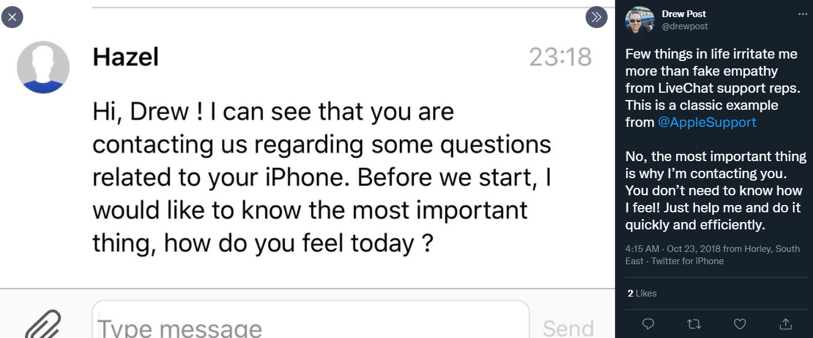

Chat Handling
Empathy Examples
DO NOT fake empathy or sound generic, be genuine and creative.
From: Apple team – Support Chat
Empathy without focusing on the matter at hand.

Slide 23

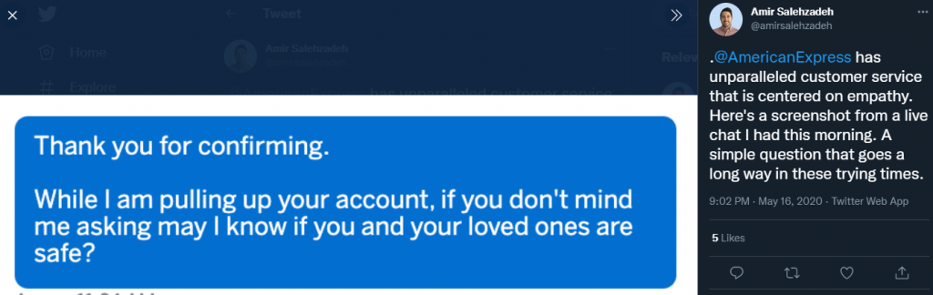
Chat Handling
Empathy Examples
Prioritize customer needs and then display empathy.
From: American Express– Support Chat
Employees will call because they are in need of something

Slide 24


Chat Handling
HowITWent…
Empathy Examples
Hi, I just want to know when my Benefits will end once I quit.
Sure, let me validate the following information…( )
My company is Huston Fabrics, I am Just looking for a quick answer
I need to validate all the information , is part of the process
I think you can answer that general question without my information, can you investigate the company’s profile?
Benefits can end after you quit, in 30 days or the very next month it all depends on the set up of the company, you can talk to your WSM.
I do not know who my WSM is, my company gave me this number to get help, but I am not getting anywhere with you
Well, try calling benefits yourself 1888 636 9497, anything else?

Slide 25
Chat Handling
HowITSHOULDbe…
Empathy Examples
Hi, I just want to know when my Benefits will end once I quit.
Sure, let me validate the following information…( )
My company is Huston Fabrics, I am Just looking for a quick answer
Oh! I see, let me Pull up that company’s profile and see what I find out, I will be back in 2 minutes
Sure…
Thank you for holding, The Benefits for that company will end on the last day of the current month upon leaving the company. Meaning until 7/31/2023.
I see, this helps me figure out what to do, thank you.
Anytime! Remember to get back to us if you happen to need further assistance. ☺

Slide 26
Chat Handling
HowITWent…
Empathy Examples
Hi, want to change my 401k contribution
Sure, let me validate the following information…( )
Sure, it is, Marco Belaire, 4/21/1989 / 4486
Thank you for that information, for this matter you will have to contact the carrier of your 401k
Who is that? I do not have that info
We neither, you can talk to your employer
My employer gave me your number so you guys could help, what’s the point of your service?
Is there anything else I can help you with?

Slide 27
Chat Handling
HowITSHOULDbe…
Empathy Examples
Hi, want to change my 401k contribution
Sure, let me validate the following information…( )
Sure, it is, Marco Belaire, 4/21/1989 / 4486
Thank you for that information, for this matter you will have to contact the carrier of your 401k do you know who that is?
Who is that? I do not have that info
Mr. Belaire your employer contracted the 401k plans outside Vensure’s services. Talking to your employer will be the best way to resolve your concern, also if you registered for them, you should have a confirmation email or a document with their information. Have you checked for it?
I will figure it out, my WSM did not know what to do, sorry for taking your time. Goodbye

Slide 28
Questions?
Let us know!

