Slide 1
Employee Relations
Know it all Contest

Slide 2
Know It All Contest
Test Your Knowledge

Slide 3

Rules Of The Game
Each region will be 1 team, divided by pairs.
Each pair will have the chance to answer 2 questions
Each team starts with a score of 100%
If the team fails to answer one question, the percentage will be reduced by 10%
Each pair can ask other pairs for help, but that will cost 5%
Each question will have 1:30 minutes for discussion and resolution, once the time is done they must give a complete answer, if not the points will get lost.
The team with the highest score WINS

Slide 4



Dos and Don’ts
Team members that want to help can raise their hand and answer BUT using their help will cost 5%
If any team member talks or helps without raising their hand or permission will cancel the question
Talk to your partner and take advantage of the time provided
Request help off chat, share questions with other regions.
Can share screen if the questions gives you the opportunity.
Have your camera turned off.

Slide 5

Question 1 - Onboarding
Hi, This is Heather Jennings, I am currently working for GRAIL, LLC. My worksite manager advised to call you guys if I had issues with the onboarding section, so…
I am in the Taxes section but all I see is the option for Federal and Arizona, But I do not live in Arizona, I live in Alabama. It won’t give me the option in that screen to update or anything, I do not want to continue with that information. Any Ideas of what can I do?
Employee’s Information:
Heather Jennings SSN 7151 – DOB 5/26/87
Address 123 Happy ST
Alabama
85009

Slide 6

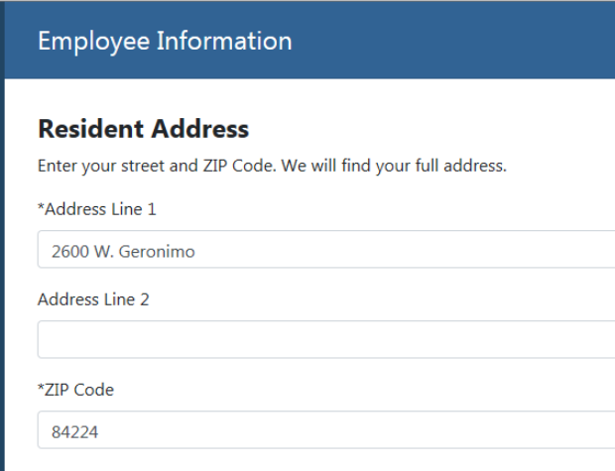
Question 1 - Onboarding
1. State tax forms are provided by the system depending on the address added previously by the employee, if the state is not the correct one, the first step would be checking on the address that was put into the system and confirm with the EE.
2. You can use external tools like Google to confirm if the address is the correct one, verify Zip code and City.
3. If the address is incorrect, have the employee to go back and correct it in the Employee Information section.
4. If the address is correct in the system and is not bringing the right form, we should open a PS ticket.

Slide 7

Question 2 - Payroll
Hi, This is Sanjay Adhikari. I am currently working for GRAIL LLC. Upon reviewing my last paystub 8/26/2022, I came across an item called SIGN ON Bonus, is weird, I am wondering if it deducted money or I was paid more just because of that. To me this is very fishy, can you clarify what is going on?
Employee’s Information:
Sanjay Adhikari SSN 9171 – DOB 9/16/1975
4173 Healdsburg Way

Slide 8
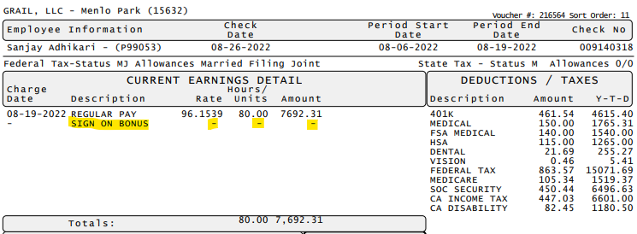
Question 2 - Payroll
1. First, we must pull up the Voucher and identify what is the item that the employee is talking about:
2. As we can see here, the item is there but it does not have any amount on Rate/Units meaning that nothing was done with that item. therefore, it did not affect the EE’s Earnings
If you check the total, the item did not affect.
3. So we can explain the EE that the item did not affect his payment, however if he wants to know why is that item there, we can reach out the payroll processor via teams and get more details.

Slide 9

Question 3- Onboarding
Hi, This is Marilou Vongunden. I was trying to access the portal but for some reason is not allowing me to do so, when I login I see the screen: Onboarding complete, but it won't let me do anything, I am worried because I submitted my Direct Deposit information, but I am not sure if I am going to get paid on that account, how and when. Can you assist?
Employee’s Information:
Marilou J Vongunden SSN 7260 – DOB 02/20/63
GRAIL LLC

Slide 10

Question 3 - Onboarding
1. First, since the employee stated that sees onboarding complete, we need to confirm if WSM approved the paperwork. It has not been approved. Keep in mind to check Section 2 filter of the onboarding window.
2. After referring the EE to the WSM for approval, we can check the set up of the Direct Deposit and confirm the payment.
3. Account in prenotification will go active after 5-7 business days, so the employee will receive a live check while the account goes active.

Slide 11

Question 4- Payroll
Hi! I am Muinat Tosin Adenihun, I am employee for GRAIL, I am checking on my paystub and I see the SIGN ON Bonus item there but no payments or whatsoever, still at the bottom part of my paystub it says that I was paid for it USD$19.200, where did the money go?
Employee’s Information:
Muinat Tosin Adenihun SSN 9975 – DOB 04/30/92 GRAIL LLC

Slide 12
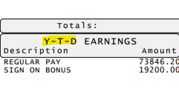
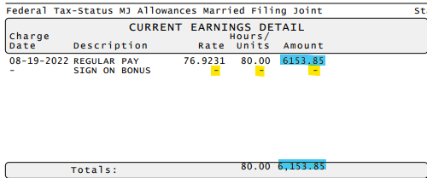
Question 4 – Payroll
1. First, we must educate the employee on the meaning of Y-T-D (Year To Date), this values stores the total amount paid so far during the year for that specific item.
2. Also remember that the item SIGN ON Bonus Appears in the voucher without amount so it did not affect the EE’s pay check.
3. Explain the EE that he is looking at the Total amount paid for that item, so he was paid for it in the past.

Slide 13

Question 5 - Onboarding
Hi! I am Heather Jennings, I was trying to register into the portal and for some reason is not working, is giving me, an error that my information does not match, and I cannot create my account. Can you please assist?
Employee’s Information:
Heather Jennings SSN 563-98-7151– DOB 05/24/1987 GRAIL LLC

Slide 14
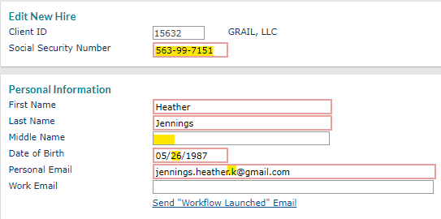

Question 5 – Onboarding
1. When the EE states that the error is due to the information not matching, we must confirm all data to ensure is right in the system.
2. We must ask if the employee is entering the same information we have in the system, they both must match otherwise we will have to update accordingly (following the SOP guidance)
3. If the information is still the same but the error is still happening, please create a Case to CS so they can create the credentials for the EE

Slide 15

Question 6- Payroll
Hello, This is Charles Patrick ID T49906 , I am calling because I did not receive the payment on 8/26/2022, I called the bank and they said the transaction was never done, the paystub on the portal does not have the account number where the money was sent to? How can I know if you guys paid me my money?
Employee’s Information:
Charles Patrick Amerena SSN 7156 – DOB 12/04/1990 GRAIL LLC

Slide 16

Question 6 – Onboarding
Did you check the EE’s Information? We should not assist employees that do not validate the right info.

Slide 17
Question 7- Payroll
Hello, This is Charles Patrick, I am calling because I did not receive the payment on 8/26/2022, I called the bank and they said the transaction was never done, the paystub on the portal does not have the account number where the money was sent to? How can I know if you guys paid me my money?
Employee’s Information:
Charles Patrick Amerena SSN 7158 – DOB 12/03/1990 GRAIL LLC

Slide 18

Question 7 – Payroll
1. First, we must confirm the information we have in the payroll voucher for the EE. We should be looking at the Direct Deposit Section as it is the one that shows the account where the money was sent to.
2. We compare the account numbers, and they must match, the status is active so from our end everything is correct.
3. We contact the Payroll Assigned to the client via teams to see where the money went, if he does not reply we can create a case and assign it to him/her.

Slide 19

Question 8 - Onboarding
Hello, this is Jesus Mendez from GRAIL LLC.I am trying to register into the portal for an account but all I see is a blank Web Page, does not do anything, I am stuck in a white web page for about 30 minutes now. Can you do something for me?
Employee’s Information:
Jesus Mendez-Moreno SSN 8419 – DOB 06/18/1993 GRAIL LLC

Slide 20
Question 8 – Onboarding
1. Before we confirm with the employee any information, we should understand why is the employee not able to access or see the web page, by asking probing questions.
2. With the information we have, it seems like the problem is not in our end (the EE is not getting any error) rather is a device issue.
3. We can provide the basic troubleshooting options for the EE but do not engage into the troubleshooting yourself, rather explain that switching devices if possible.
4. At this point is a matter of controlling the call, as the problem is not the system.
Make sure you:
Explain the reason of the problem + explain why is not something related to our system + provide options to resolve

Slide 21

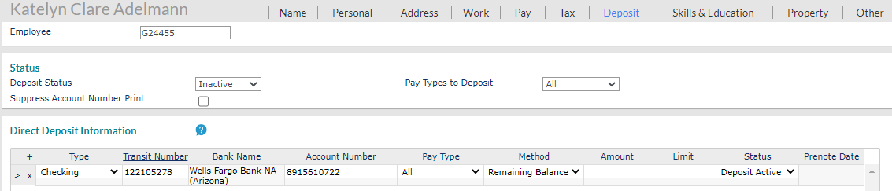
Question 9 - Payroll
Hello, This is Kate Clare Adelmann, I am calling because today is my paydate but I have not received any money into my account. I talked to the WSM but he referred me to you guys.
This is what you see in the EE’s profile. How can we assist the employee?
Employee’s Information:
No need for information

Slide 22
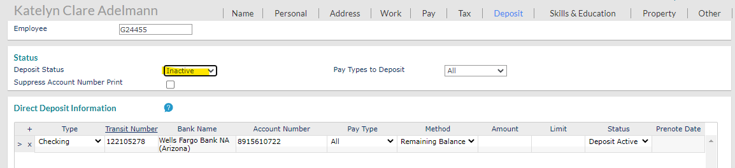
Question 9 – Payroll
1. Before we do anything we should always ask probing questions to gain a better understanding but in this case We know the problem is related to this set up on the employee’s profile:
2. As it appears inactive, we SHOULD NOT modify the settings for the employee, even if the information is correct, we should not change it, we must talk to the payroll processor.
3. So, business as usual. Contact the payroll processor via teams and follow their instructions if they do not reply offer a case creation.

Slide 23

Question 10 - Onboarding
Part 1. Hello this is Lia McNeal, I am applying for a job at GRAIL LLC. So, I would like to know how to declare exempt from the Federal Taxes, I navigated through your system but is kind of confusing could you please assist?
Part 2. Ok I see what you are telling me, but I do not understand why I need to comply with it, what does that mean?
Employee’s Information:
No need for information

Slide 24
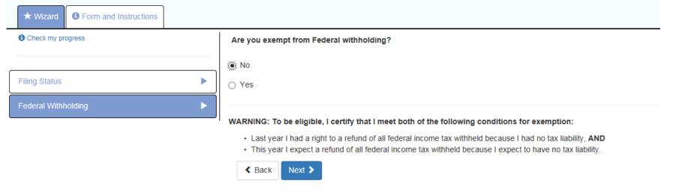
Question 10 – Onboarding
Part 1. By looking at the ESS Electronic Onboarding User guide - Page 8 We can see the part where the EE can claim exempt:
Part 2. The employee should be able to mark the option that describes best his/her situation. These are the guidelines offered in the form to claim exempt from taxes. If the EE does not understand or does not agree, we should refer them to their tax professional. Do not advise what to check.

Slide 25
Questions?
Let us know!

Slide 26
Questions?
Let us know!

