Slide 1
Employee Relations
Know it all Contest – VOL 2

Slide 2
Know It All Contest VOL.2
Test Your Knowledge

Slide 3

Rules Of The Game
Each team starts with a score of 100%
If the team fails to answer one question, the percentage will be reduced proportionally
Each question will have 1:30 minutes for discussion and resolution (must share screen) , once the time is done, they must give a complete answer, if not the points will get lost.
The team with the highest score WINS

Slide 4



Dos and Don’ts
Can share screen if the questions gives you the opportunity.
If any team member talks or helps without raising their hand or permission will cancel the question
Use Sharepoint.
Request help off chat, share questions with other regions.
Pay attention to the instance on each scenario.
Have your camera turned off.

Slide 5



Scenario 1
Amina from Capital Health Primary Care Is calling asking questions about her last payroll, she is missing 250USD.
Employee’s Information:
Name: Amina Abdullahi
Last 4SSN: 3197
DOB:10/07/1995
How would you proceed?

Slide 6

Scenario 1
How would you proceed?
Employee’s Information:
Name: Amina Abdullahi
Last 4SSN: 3197
DOB:10/07/1995
We assist only HSCG employees with password resets and updates of email or phone. For all other inquiries, please refer to the employee's district manager.
Amina from Capital Health Primary Care Is calling asking questions about her last payroll, she is missing 250USD.

Slide 7


Scenario 2
The employee is calling because wants to set up her Rapid Pay card.
Employee’s Information:
Name: Julia Downing
Last 4SSN:1124
DOB: 08/07/1995
How would you proceed?

Slide 8


Scenario 2
How would you proceed?
Empower Employees use Rapid for Pay Cards, so must send the email and attach the forms found in the SP.
Employee’s Information:
Name: Julia Downing
Last 4SSN:1124
DOB: 08/07/1995
The employee is calling because wants to set up her Pay card.

Slide 9


Scenario 3
The employee is looking for a 2021W2.
Employee’s Information:
Name: Juan Barajas
Last 4SSN: 2161
DOB: 07/22/1996
How would you proceed?

Slide 10
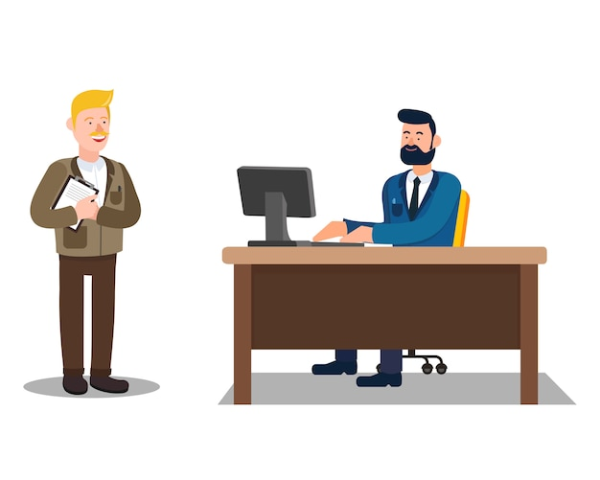
Scenario 3
How would you proceed?
The employee was working for AVITUS. Those W2s are accessible for our Leadership.
Employee’s Information:
Name: Juan Barajas
Last 4SSN: 2161
DOB: 07/22/1996
The employee is looking for a 2021W2.

Slide 11
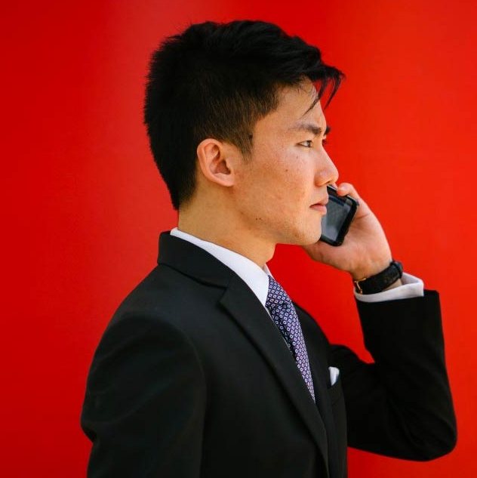

Scenario 4
The employee is calling because wants to confirm his health coverage is still active
Employee’s Information:
Name: Anthony Abbene
Last 4SSN: 3892
DOB: 04/04/1990
How would you proceed?

Slide 12

Scenario 4
How would you proceed?
Andy Frain employees must go to the American Worker and confirm that information:
Employee’s Information:
Name: Anthony Abbene
Last 4SSN: 3892
DOB: 04/04/1990
The employee is calling because wants to confirm his health coverage is still active

Slide 13

Scenario 5
Hello, This is Lakeisha from Matrix One Source I need to reset my password. Can you help?
Employee’s Information:
Name: Lakeisha Brown
Last 4SSN: 5562
DOB: 03/04/1992
How would you proceed?

Slide 14
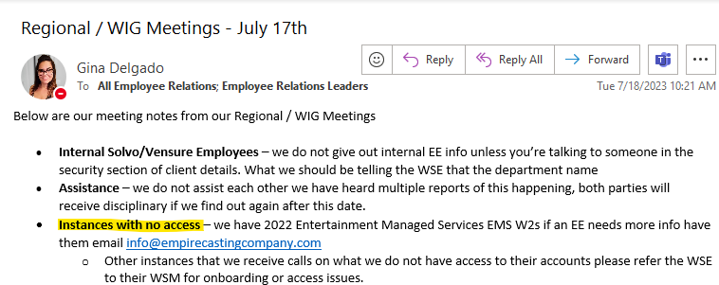
Scenario 5
How would you proceed?
We do not assist employees from Matrix One Source, we must refer the employee to their WSM.
Employee’s Information:
Name: Lakeisha Brown
Last 4SSN: 5562
DOB: 03/04/1992
Hello, This is Lakeisha from Matrix One Source I need to reset my password. Can you help?

Slide 15
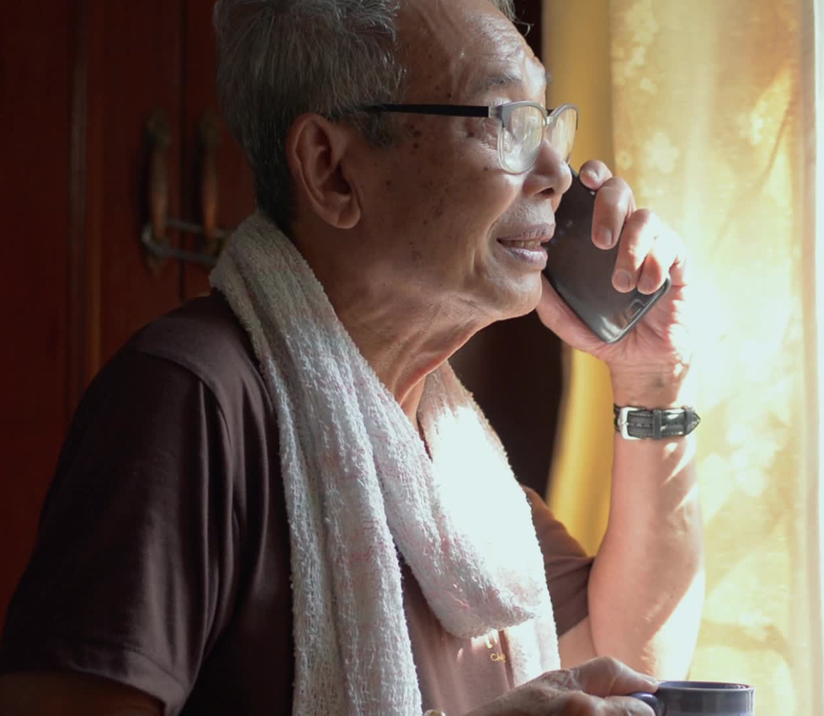

Scenario 6
The employee is calling because wants to know the basic instructions and enrollment for Retirement plan.
Employee’s Information:
Name: Agon Ago
Last 4SSN: 9883
DOB: 09/24/1965
How would you proceed?

Slide 16

Scenario 6
How would you proceed?
Employee’s Information:
Name: Agon Ago
Last 4SSN: 9883
DOB: 09/24/1965
Locate the 401k Empower Retirement plan Template in SP and send to the employee.
The employee is calling because wants to know the basic instructions and enrollment for Retirement plan.

Slide 17


Scenario 7
Employee wants to enroll into the 401k Provided by the client.
How would you proceed?
Employee’s Information:
Name: Gladys Abzum
Last 4SSN: 5093
DOB: 12/28/1997

Slide 18
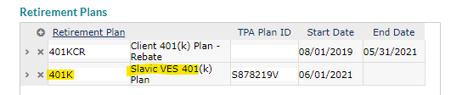

Scenario 7
How would you proceed?
The client offers Slavic401k, we can send the Flyer in SP.
Employee’s Information:
Name: Gladys Abzum
Last 4SSN: 5093
DOB: 12/28/1997
Employee wants to enroll into the 401k Provided by the client.

Slide 19

Scenario 8
The employee cannot clock in on the app (NOVA Time)and is not taking the right time.
How would you proceed?
Employee’s Information:
Name: Mindi Angelbrandt
Last 4SSN: 0499
DOB: 08/09/1991

Slide 20
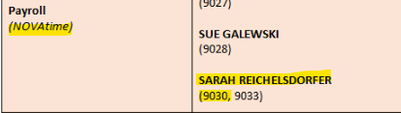
Scenario 8
How would you proceed?
We must contact Payroll Assigned according to the EmPower Guide, Via TEAMS.
Employee’s Information:
Name: Mindi Angelbrandt
Last 4SSN: 0499
DOB: 08/09/1991
The employee cannot clock in on the app (NOVA Time)and is not taking the right time.

Slide 21


Scenario 9
Employee called in because his Direct Deposit information was changed last Friday, he does not recognize the account in the system.
Employee’s Information:
Name: Christopher Acosta
Last 4SSN: 5479
DOB: 04/14/1997
How would you proceed?

Slide 22
Scenario 9
How would you proceed?
Employee’s Information:
Name: Christopher Acosta
Last 4SSN: 5479
DOB: 04/14/1997
Employees that use Daily Pay, will have their DD information updated by the payroll every Friday to deduct any advanced money granted to the employee. Employees will have to go back into the ESS and update the DD info.
Employee called in because his Direct Deposit information was changed last Friday, he does not recognize the account in the system.

Slide 23

Scenario 10
Jessica is calling because this is the 3rd time she has set up the contributions on the Transamerica portal and is not saving the changes, she already contacted the TransAmerica support line but is not getting any help.
Employee’s Information:
Name: Jessica Areaux
Last 4SSN: 9673
DOB: 03/25/1993
How would you proceed?

Slide 24
Scenario 10
How would you proceed?
We can create a case for Retirement, assign it to 401k Rep assigned for EmPower.
Employee’s Information:
Name: Jessica Areaux
Last 4SSN: 9673
DOB: 03/25/1993

Slide 25
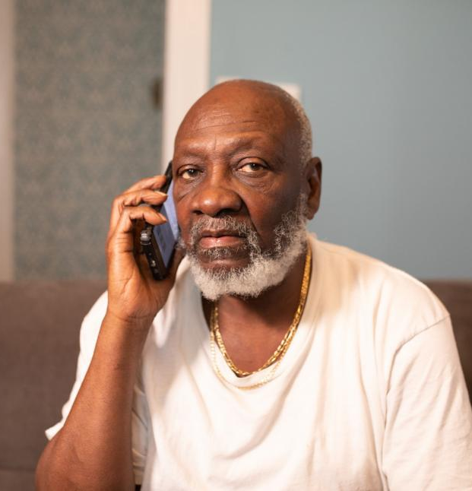
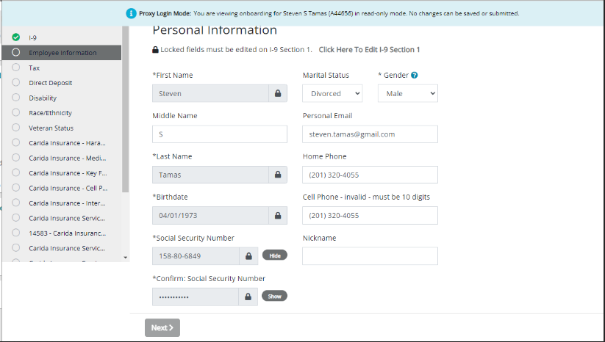
Scenario 11
The employee is not able to pass the i9 Section.
Employee’s Information:
Name: Steven Tamas
Last 4SSN: 9673
DOB: 04/01/1973
How would you proceed?

Slide 26
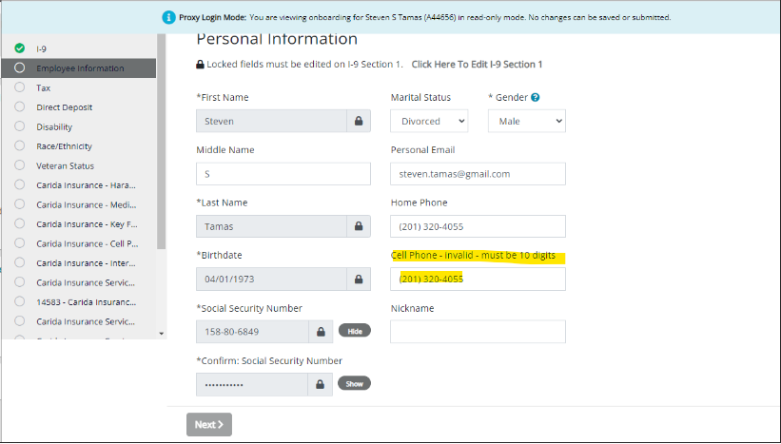
Scenario 11
The employee is not able to pass the i9 Section.
Employee’s Information:
Name: Steven Tamas
Last 4SSN: 9673
DOB: 04/01/1973
Cellphone is invalid, we can remove it and continue as it is not a mandatory field.

Slide 27
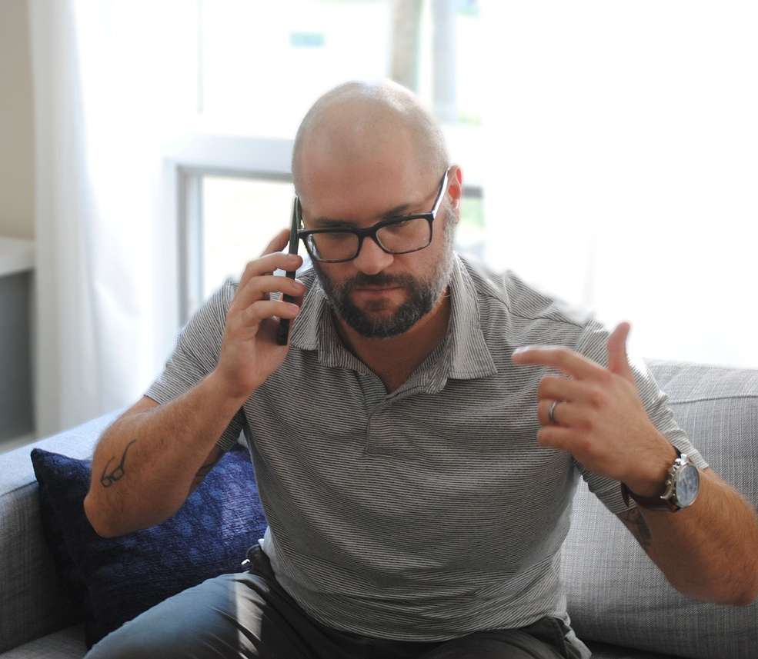

Scenario 12
The employee has a deduction for Garnishment on Payroll 09-08-2023 that he does not recognize.
How would you proceed?
Employee’s Information:
Name: Loren Thomas
Last 4SSN: 5202
DOB: 04/10/1987

Slide 28
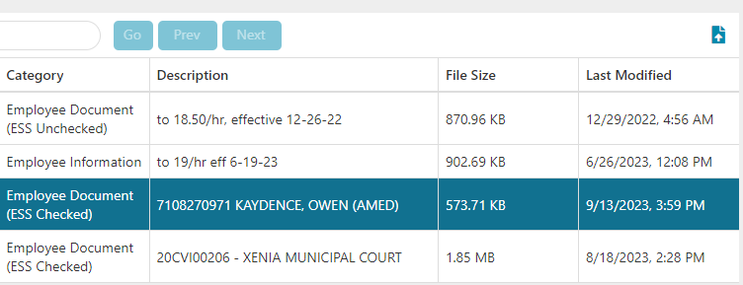
Scenario 12
How would you proceed?
The deduction belongs to a Garnishment order added on:
The employee has a deduction for Garnishment on Payroll 09-08-2023 that he does not recognize.
Employee’s Information:
Name: Loren Thomas
Last 4SSN: 5202
DOB: 04/10/1987
If the employee needs more details we must call Garnishments.

Slide 29


Scenario 13
The employee called in because was not able to cash the check for 8/04/2023, no more details for the request.
Employee’s Information:
Name: Scott Deaires
Last 4SSN: 0746
DOB: 02/16/1992
How would you proceed?

Slide 30
Scenario 13
How would you proceed?
We must ask for details and the reason why he is not able to cash the check, we cannot issue another check without the proper information, the employee can try a different place/bank/branch.
The affidavit should not be sent.
Employee’s Information:
Name: Scott Deaires
Last 4SSN: 0746
DOB: 02/16/1992
The employee called in because was not able to cash the check for 8/04/2023, no more details for the request.

Slide 31
Questions?
Let us know!

