Slide 1
Employee Relations
Training Session – Leave of Absence – STD –LTD In Detail

Slide 2
Leave Of Absence

Slide 3

Leave Of Absence
A leave of absence is time allowed away from work, generally requested by an employee to cover special circumstances occurring in the employee’s life.
An unpaid leave of absence is used when the employee’s time off from work is not covered under an employer’s existing benefits such as sick leave, paid vacation, paid holidays, and paid time off.

Slide 4







Reasons For Leave Of Absence
Serious Health Condition affecting the EE or covered Family member.
Pregnancy / Anticipated Due Date.
Other (must be described in the form)
To Consider…
* Every state has its own rules for all types of leaves
FMLA (Family and Medical Leave Act)
Military
Birth, adoption, or foster placement of a child.

Slide 5

So, What Is Important To Know?
Important tips to considerate
1
2
3
The client notifies the SR about an employee that is about go to on leave (foreseeable leave) or that is out on leave (Unforeseeable leave)
The SR or LOA Team sends the Warm Transfer E-mail to the client, this must be filled out and return to SR/LOA Team.
The LOA team verifies with administration: Qualifications and federal/state laws – LOA Team notifies client and if approved explains how to change status of the EE in PRISM
4
Depending on the type of leave they will work with the Client, so the employee is aware of all the information needed.
ER
CAN
HELP
TOO…
Direct the employee to their WSM when requesting a Leave of Absence
We can explain the general process to the employee
Create a case to track and assist with the employee’s request / questions

Slide 6
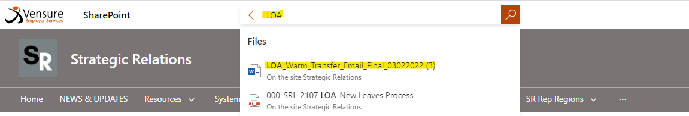
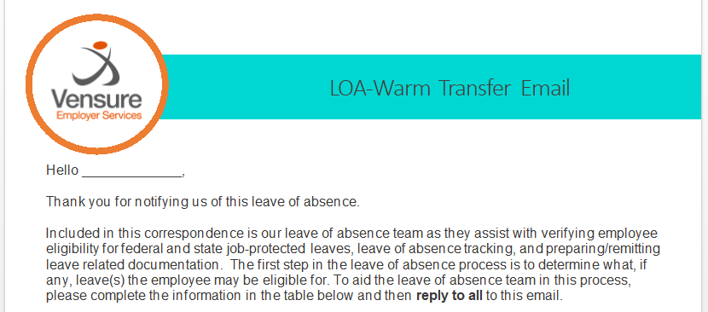
LOA - Warm Transfer Email
Is sent to the Client by the LOA Team, ER must direct the employee to their WSM to start the process.

Slide 7


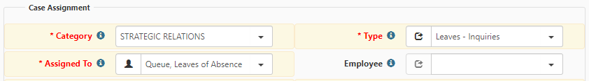
FAQ for Leave Of Absence
Hello! I want to know if I am going to get paid during Leave…
In order to provide that information, we will need to create a Case for Leaves so they can validate the information of the Client and state rules that may apply.
Also, if you want to know the procedure of getting paid for that Leave Time, we can request resolution through a case too.
These are the Case Specifics:

Slide 8
FAQ for Leave Of Absence
Hello! I want to know the status of a Leave of Absence request…
We should refer the employee to his/her worksite manager to confirm the approval status. If they already did , we could create a case to leaves requesting more information.
Keep in mind this is a process handled by the employer and us (Vensure’s LOA Team)
These are the Case Specifics:

Slide 9
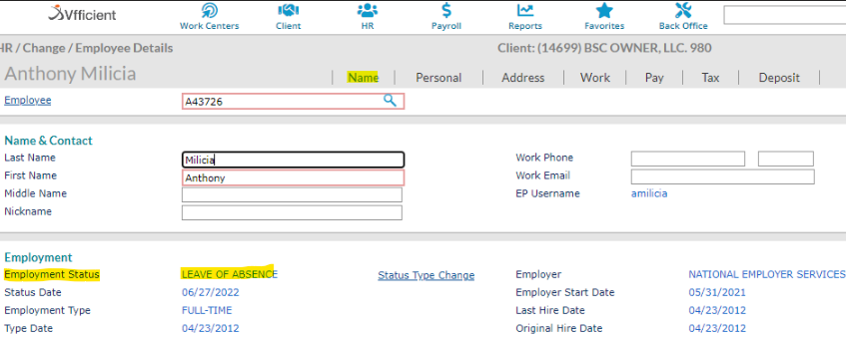
FAQ for Leaves
Hello! I wanted to confirm what is the status of my employment at this moment (during Leave)
Sure, we can confirm that information in the Employee Details tab, under employment type, like this:

Slide 10
STD – LTD Benefit
Short Term Disability – Long Term Disability

Slide 11
STD – LTD Basics
STD – LTD are benefits that are offered to the employee to receive a percentage of their paychecks when having an accident or serious illness That prevents them from working for a Short or Long period of time.
Keep in mind they are optional, and the employee must add them when doing their benefits enrollment.
That is why is important to confirm whether the employee has the benefit or not.

Slide 12
STD – LTD Claim Process
When employees want to use these benefits, they need to file a claim and follow the instructions in the form sent.
We, Employee Relations can send those claim formats. Here is how:
Confirm the name of the plan. (Benefits Overview)
Go to the Master Benefits Plan Link
Look for the STD – LTD Section
Go to Support Collateral
Select the plan (STD or LTD) download and send the form
Advise the EE to follow instructions on the form

Slide 13
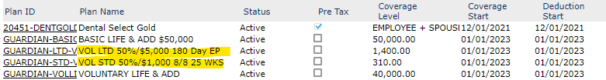
FAQ for STD - LTD
Hello! I suffered an accident last week and I want to confirm if there is something on my benefits that will help in this situation.
Sure, first we should confirm what benefits the employee has active:
We see that the employee has STD and LTD benefits active so we can proceed by giving the information on how to file a claim.
We can also send the information of the plan if the employee wants to know compensations and specifics.

Slide 14

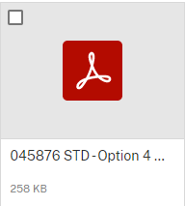

FAQ for STD - LTD
Hello! I recall adding some benefits for STD and LTD, could you please send me the specifics of the plan?
Sure, first we should confirm what benefits the employee has active:
1. Identify the Plan name. 2. Got o Master plan Benefits Page. 3. Select STD and LTD category. 4. Look for the plan that has the same name.
Step 1
Step 4
Steps 2,3

Slide 15


Leaves Requests
Served by
LOA
STD
LTD
Leave of Absence - FMLA
Short Term Disability
Long Term Disability
Granted by law
NON-PAID
Elected by the employee
Paid
Elected by the employee
Paid
EE is not working, not paid, keeps the job.
For FMLA , EE Group Benefits must be active
FMLA can provide up to 12 weeks
EE is not working and uses the benefit to get some income while absent.
EE is not working and uses the benefit to get some income while absent.
>Confirm if EE has the Benefit.
>Send the Claim form
> advise to follow and contact carrier if further questions
>Confirm if EE has the Benefit.
>Send the Claim form
> advise to follow and contact carrier if further questions
EE needs to notify employer (internal Leadership). Employer works with LOA team.
Pays you a portion of your income immediately after an accident
Pays you additional funds for long-term injuries. It takes effect after your short-term insurance runs out.

Slide 16
Do’s & Don’t for Leaves – STD - LTD
Do’s
Don’t
Explain the process of requesting a leave
Create a case to address concerns regarding leaves payments, status, details.
Confirm the current status of an Employee.
Recognize types of leaves
Send Claim form
Assure payments
Provide dates or status of the approval (unless is a case note)
Do not send the Warm email (for LOA)
Create a case without asking proper questions

Slide 17
Practice Time

Slide 18


Practice Time
Hi this is Susan, my co-workers told me that I was able to ask for a Leave but I am not sure what kind of situations it covers, could you explain?

Slide 19

Practice Time
This is Mark, he had an accident a couple of days ago and will be out of work for a couple of days , he wants to know how to go about using his benefits for this situation. Explain the process of filling a Claim for the STD – LTD Benefit

Slide 20

Practice Time
Marie will have a medical intervention where she is going to be hospitalized for a couple of weeks, she wonders what can she do about not losing her job. How would you address this scenario?

Slide 21

Practice Time
Modesto Rivas G64701 (Vfficient) calls in stating that he does not have any information related to his Benefits for Disability (coverages, amount, etc) use the information learned and send the right documents (SBC)

Slide 22

Practice Time
Clara Gardner is calling because she sent a request for leave of absence to her employer and has not received any information, what can we do in this case?

Slide 23

Practice Time
Frederick Ballard R23478 is calling because he already received the Claim format for STD, is wondering where can he send the information. How can we address this scenario?

Slide 24

Practice Time
Angela Submitted her claim for STD 10 days ago and has not received any update. How can we address this case?

Slide 25
Questions?

