Slide 1
Employee Relations
Training Session – Onboarding i9- Taxes Common Errors

Slide 2

Onboarding i9- Taxes Common Errors
In this presentation we will address the following topics:
What is the I-9 used for and legal name?
Common issues on Taxes
Why submitting errors happen?

Slide 3



What is the I-9 used for?
i9
It is used to verify the identity and employment authorization of individuals hired for employment in the United States.
The Employee
(completes section I)
The Employer
(completes section II)
Must properly complete form I-9 for each individual they hire for employment in the United States including citizens and noncitizens.
Must attest to their employment authorization
Present their employer with acceptable documents as evidence of identity and employment authorization.
Examines the documents to determine if they are genuine, then record the document information on the Employee’s I-9 form and make it available for inspection.
Note: Employee must use legal Name

Slide 4

Common issues on I-9
Misspelling of Name / Incorrect SSN
Ensure we have the correct spelling of the EE’s name and SSN in the Workflow Maintenance.
We can make these adjustments for NON-ACTIVE EEs only.
Ask for a screenshot of the I9 page with the SSN on show to verify the issue.
Leave a box blank
Ask the EE if they have, entered “N/A” in all appropriate boxes, and advise the system will not let them continue without that information.
DOB not matching
Ensure we have the correct DOB
Make sure the Employee is using the US date format (m/d/year)

Slide 5


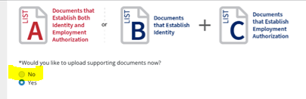
Common issues on I-9
Remember Employees are not allowed to upload documents during the onboarding process. They must present those documents to their Worksite Manager.
Instead, employees can skip this step by clicking :No

Slide 6
Common Issues On Taxes

Slide 7



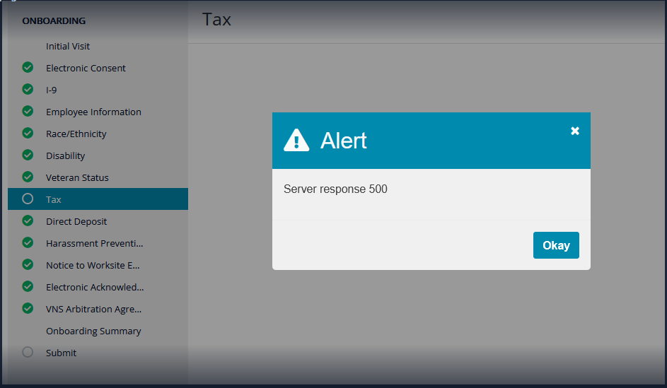
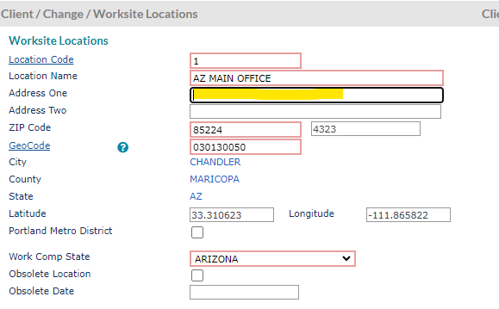
ERROR:Server Response 500
This error occurs because the Worksite location in Prism is missing Address One. This Prism field is required for the onboarding Tax forms to be produced.
We advise the CRM so they can work with the client on getting the proper Worksite location address for the EE and adding it into PRISM.

Slide 8

Employee Is Being Taxed For Two States
This is not an error. It usually happens because the Employee lives and works in two different states
If you live and work in 2 different states, you may be required to pay State taxes in both states.
Check the employee’s resident address and worksite locations. If the Resident and Worksite location are in different states, the employee will be taxed for both states unless they have an exemption for reciprocal agreement states.
For Geocodes issues > create a Jra ticket.

Slide 9
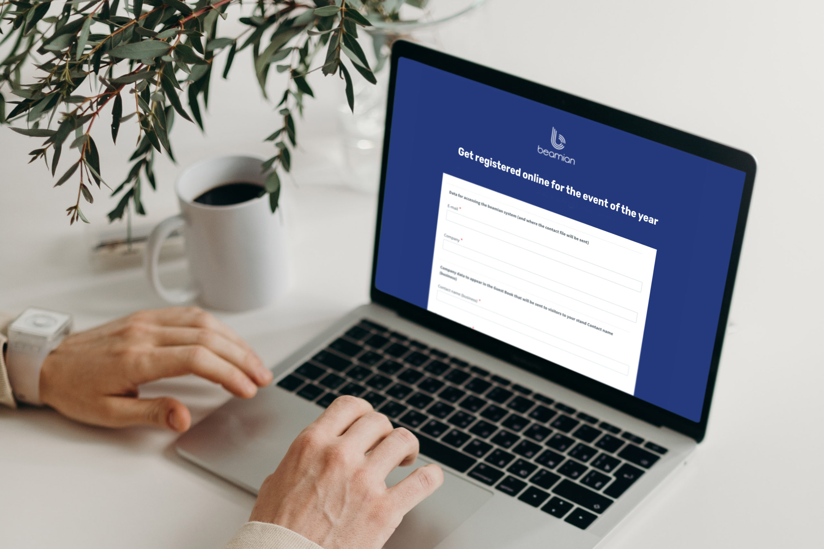
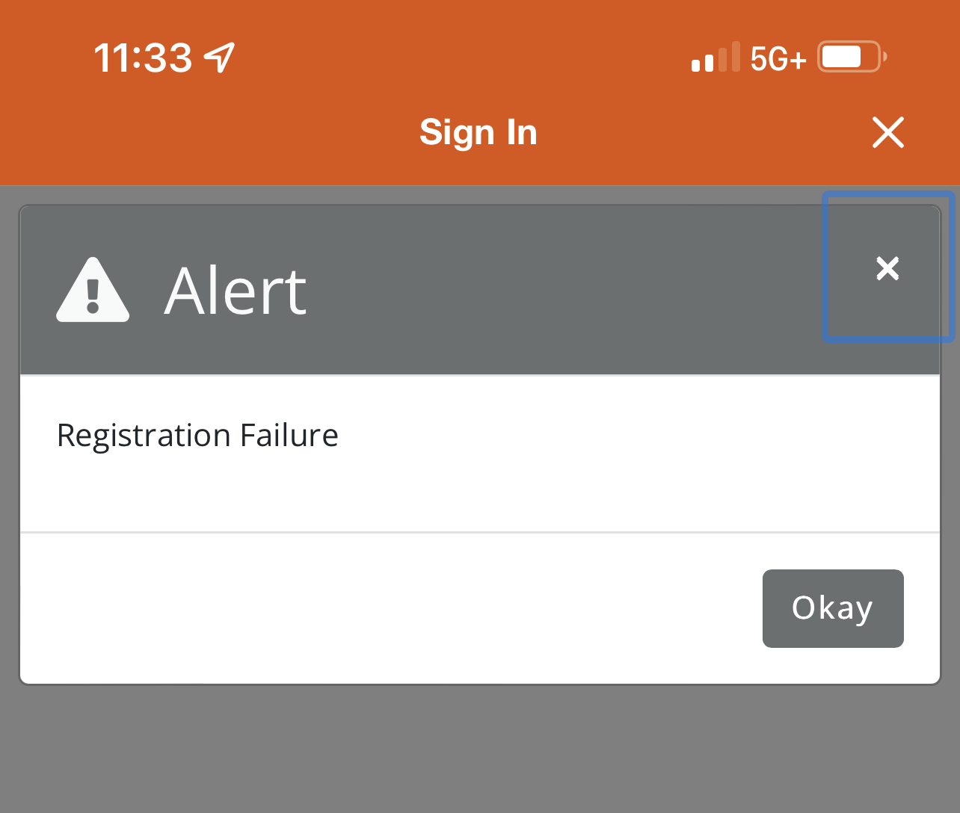
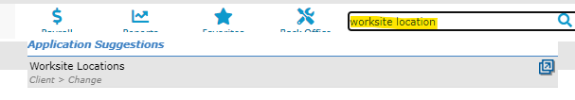
Registration failure
This error occurs when Employees try to submit the taxes portion of the onboarding process.
Make sure the address one is added in the Worksite Location > if everything is correct, ask your leadership in chat

Slide 10
Why Submitting Errors Happen?

Slide 11

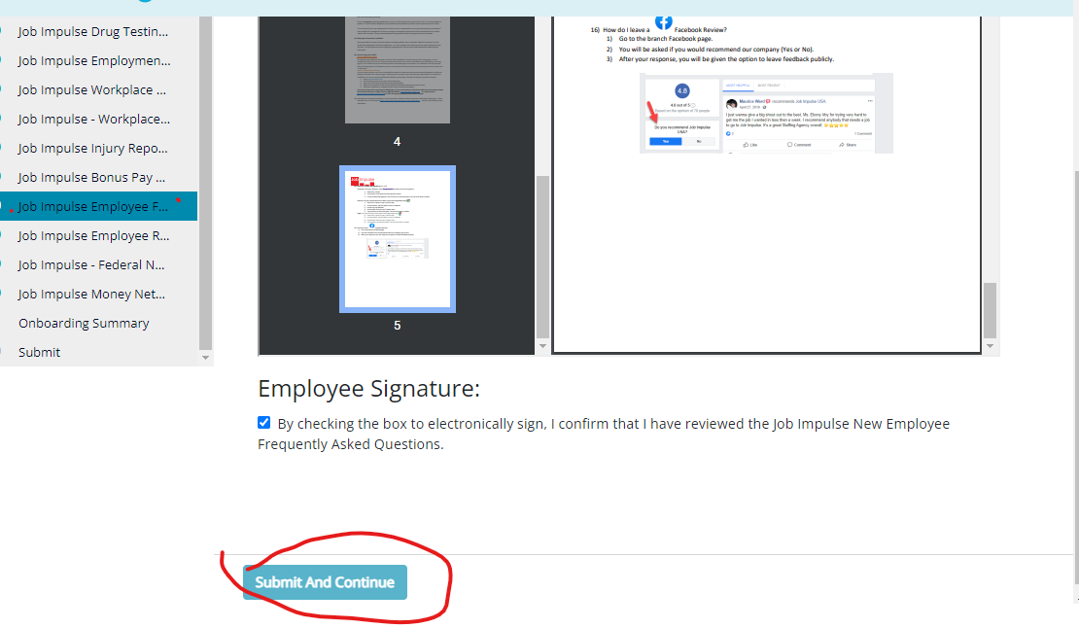
EE’s Cannot Submit Terms And Conditions
This error occurs when employees click the box to capture the electronic signature and submit their paperwork
Employees need to open the pdf and sign with finger, then click agree
EEs Cannot Submit Client’s Forms
We can create a Jira Ticket

Slide 12
Practice Time

Slide 13
Questions?

