Slide 1
Employee Relations
Training Session – Paid Time Off

Slide 2
Paid Time Off

Slide 3


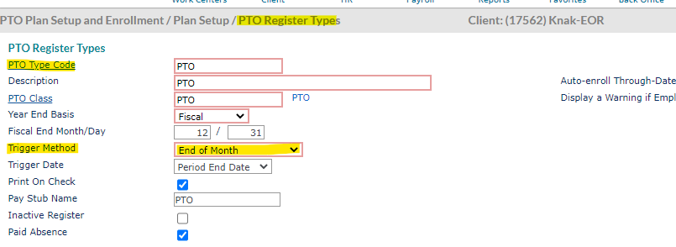
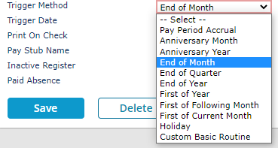
FAQ for Paid Time Off
How are the PTO hours Accrued?
PTO Hours are accrued depending on the plan offered by the Client, They could be monthly, weekly, etc. We can check on the PTO Register types module, Select the plan and check on the rules it has:
If an EE does not have a PTO plan refer them to their WSM for further assistance!

Slide 4
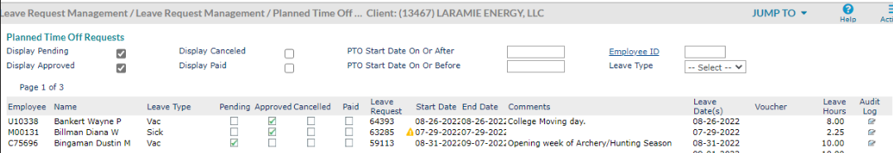
FAQ for Paid Time Off
What happens to the hours accrued when I quit my job, will they be paid?
It all depends on the plan and set up done by the Client, its policies and Laws, therefore a case is a good idea to address this concern in a case to Payroll, the client will determine what to pay.
Could you confirm if my PTO is approved?
We can verify the status of the request by going to Planned Time Off request. This is only for informational purposes

Slide 5
FAQ for Paid Time Off
What happens to the hours accrued? Now my balance is Zero.
The hours I am seeing in the portal do not match with the ones I am supposed to have, what happened?
It all depends on the plan and set up done by the Client, its policies and Laws, therefore a case is a good idea to address this concern in a case to Paid Time Off, the team will let us know, they will also confirm if the balance is accurate or if it is something we can fix.
We should ask and add screenshots into the case, this will help the PTO team to confirm what the employee is stating.

Slide 6


FAQ for Paid Time Off
How can I cancel the PTO time requested?
To address this request, we must take into consideration the status of the request:
REQUEST STATUS
Pending
Approved
Employee can make changes into the ESS, cancel and Re-Schedule a new Time Off Request.
WSM must cancel the request and have the EE to issue another request.

Slide 7
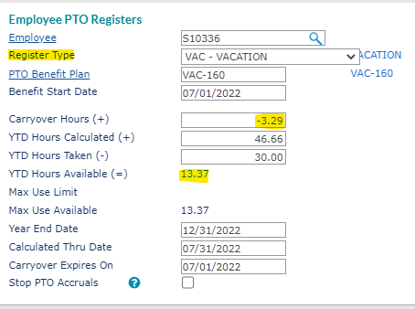
FAQ for Paid Time Off
Let's look at the sections in the Employee PTO register:
Register type: Contains the plan in which the Employee is enrolled into.
Negative Balance: Sometimes is due to an adjustment.
YTD Hours Available: This is the real amount of hour available for the EE. When doing the math, we can see that the negative number of hours shown above were deducted already.
Hours can be amounts with decimals it all depends on the way the plan is set up.

Slide 8
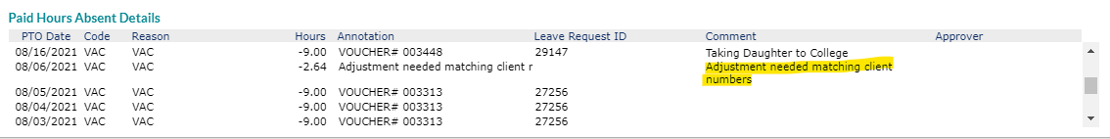
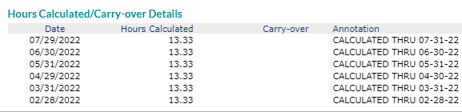
FAQ for Paid Time Off
Lets take a look at the sections in the Employee PTO register:
In the Paid Hours Absent Details we can see the historical of PTO hours taken by the Employee, adjustments and comments that are relevant to the PTO deduction.
Hours Calculated / Carry –Over Details is the section in which we can see how often the EE is accumulating the PTO hours, the pattern seems to be Montlhy

Slide 9
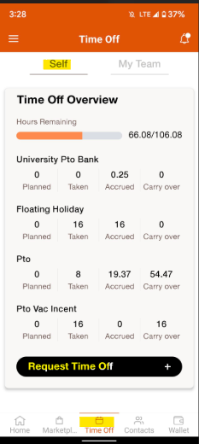
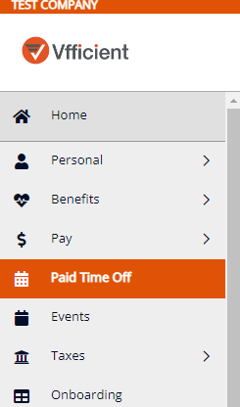

FAQ for Paid Time Off
How can I request PTO in the portal?
From the mobile APP go to Time Off at the bottom > Request Time Off > follow the prompts.
From the web version we go to Paid time off and Request Time off.
Once the request is sent, the WSM or HR in charge will process the request.
We can check the status of that request in the Planned Time Off Request module in PRISM.
ESS MOBILE APP VERSION
ESS PORTAL VERSION

Slide 10
Questions?
Let us know!

