Slide 1
Employee Relations
Payroll – Payments / Checks

Slide 2
Payments

Slide 3


Payroll – Prenotification
Prenotification status
Accounts in prenotification status will not receive payments until they go active (7-10 Business days) in the meantime, the employee will receive a check
We must remind the employee about the waiting period for the account to be active
If the account has been in prenotification status for more than expected, please reach out to the Payroll processor via teams or case

Slide 4
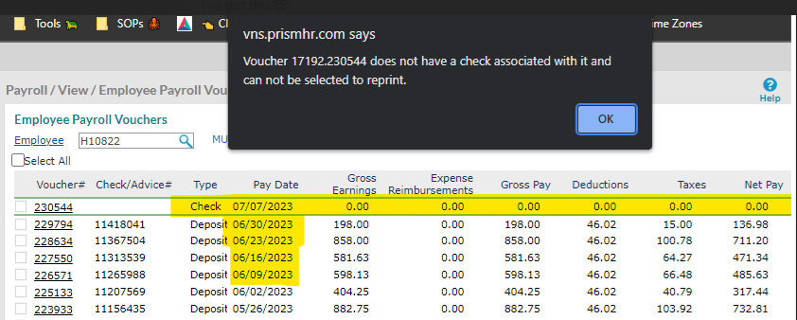
Payroll – Payments
Checks with 0 (Zero) Amount - Unable to download.
This means the Payroll of the EE/Client was not processed; we should refer the employee to the worksite manager for further assistance.

Slide 5




Payroll – Payments
If an employee calls because he/she has not received their pay, review the following:
Confirm there is a voucher produced
Review the ACC# in the Deposit tab and Paystub
If everything seems to be correct, we can advise the employee of the payment getting to their bank acc through the day. If still in doubt, reach out to the payroll processor assigned to the Client via Teams.
*The employee mist confirm the information to us.

Slide 6
Checks

Slide 7




Payroll – Checks
Some important aspects regarding checks:
Shipping
The Client confirms with payroll how the check will be shipped. Normally they are shipped to the Client’s address.
We can review this by opening the Check > Voucher tab
**We can ask for a tracking number/Questions to the Payroll Processor
Lost Checks
The employee must sign and mail back the affidavit form which can be found in our SharePoint Page

Slide 8






Payroll – Missing Payments
Missing Payments
Escalation process when the Employee did not receive the payment Via DD/Checks.
How Was It Processed?
Direct Deposit
Check
In both cases, the Affidavit is different, check on the SP

Slide 9
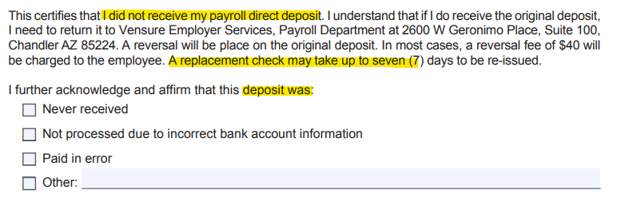
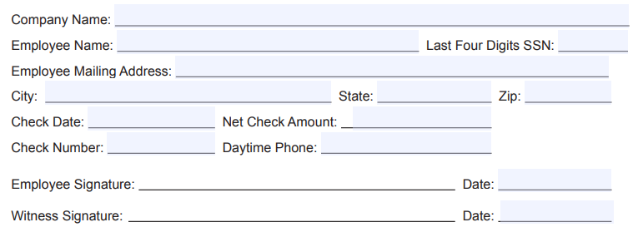
Payroll – Affidavit
Definition: a sworn statement in writing made especially under oath or on affirmation before an authorized magistrate or officer.
Employee/Client information
*This process may take up couple of weeks, depending on different factors.

Slide 10

Payroll – Considerations
Andy Frain Follows different procedures, all payroll request must be addressed by the WSM or Payroll at the company.
Remember to follow the right procedure for Empower Clients
Consult leadership if you still have questions
Reach out to Payroll Processor for assistance via Teams, if not reply, create case.

Slide 11
Practice Time

Slide 12



Payroll – Practice Time
Margarita is calling because she did not receive her payment today (8/4/2023), she states nothing has changed into her account.
This is what you see in PRISM
Deposit Tab
Paystub
Payroll Voucher Tab

Slide 13
Payroll – Practice Time
Margarita is calling because she did not receive her payment today (8/4/2023), she states nothing has changed into her account.
This is what you see in PRISM
Deposit Tab
Paystub
That’s right, we must advise the employee that the payment will get to her account anytime during the day.
Payroll Voucher Tab

Slide 14
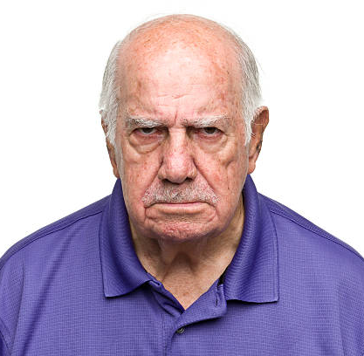
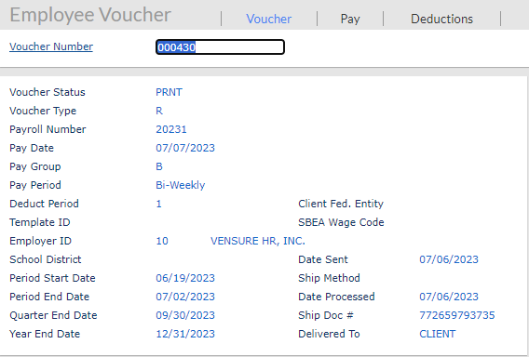
Payroll – Practice Time
Robert Claims he did not receive his check…
This is what you see in PRISM

Slide 15
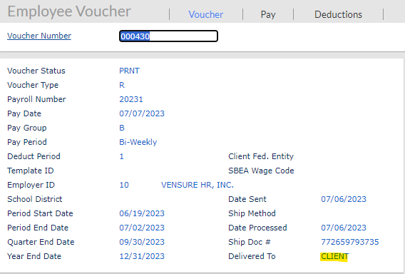
Payroll – Practice Time
Robert Claims he did not receive his check…
This is what you see in PRISM
Correct! According to PRISM, the check was sent to the Client Address, so we can refer the employee to the WSM.
We can always double check with the payroll processor, where the check was sent to and ask for Tracking#
We can also check on Client Details > notes for special instructions

Slide 16
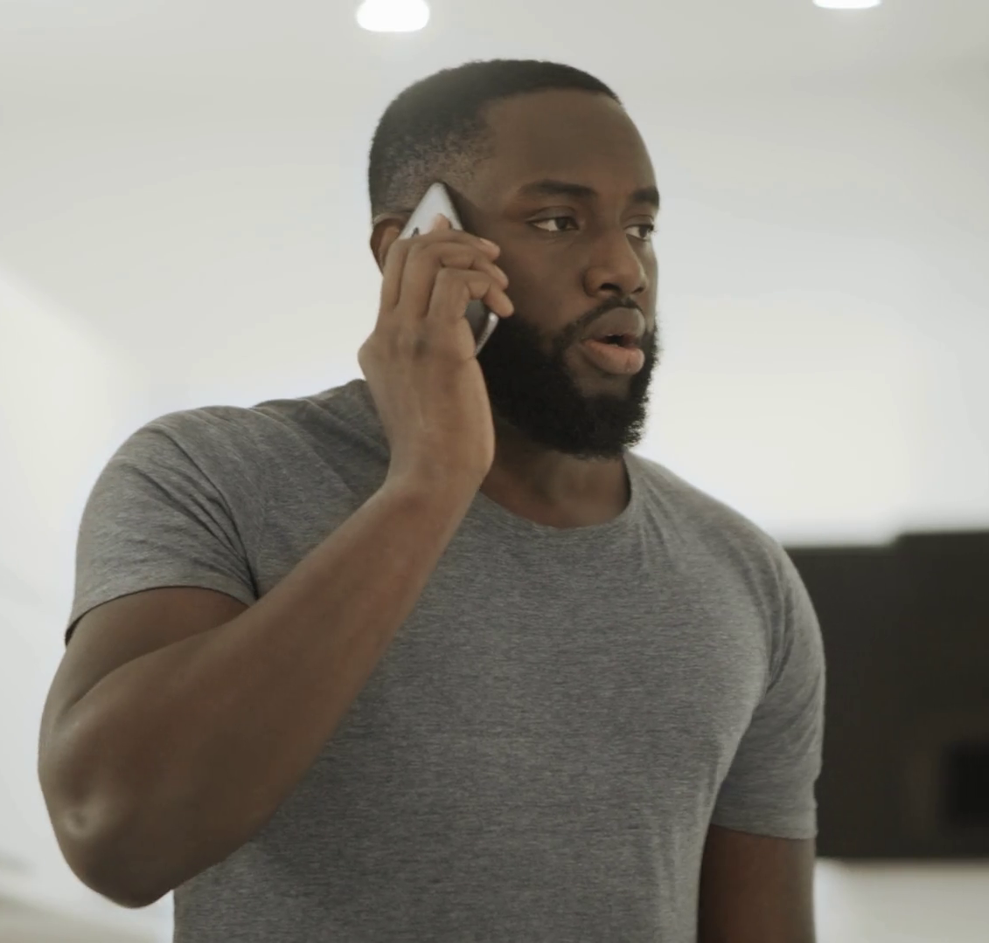
Payroll – Practice Time
Andrew is calling because he never received a check from 6/9/2023. He states he never cashed it.

Slide 17

Payroll – Practice Time
Andrew is calling because he never received a check from 6/9/2023. He states he never cashed it.
This is what you see in PRISM
At this point we can create a case:
We can also send the affidavit form for the employee to fill out and send back
Check

Slide 18

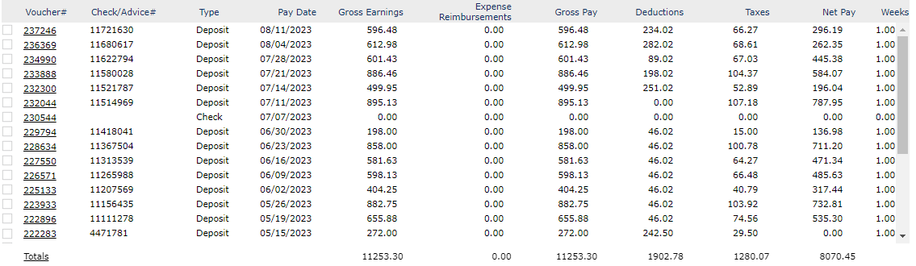
Payroll – Practice Time
Sara is calling because she claims she did not receive a check on July, wants a copy of the voucher. This is what you see…

Slide 19
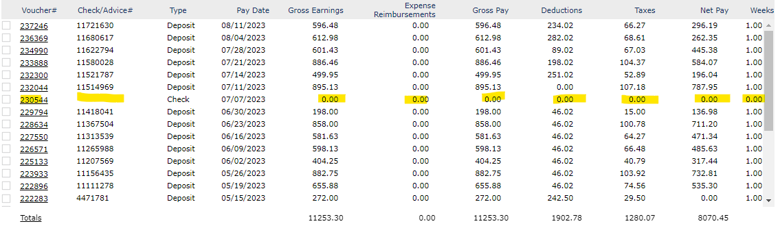
Payroll – Practice Time
Sara is calling because she claims she did not receive a check on July, wants a copy of the voucher. This is what you see…
That check has 0 amount, meaning that we did not process payroll for that date, employee will need to talk to WSM

Slide 20

Payroll – Practice Time
Sam is calling wondering if the Reversal may charge him as he miss typed the account information…

Slide 21
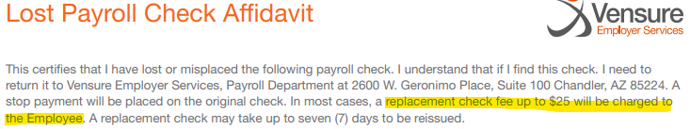
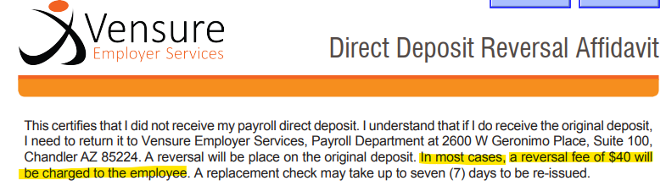
Payroll – Practice Time
Sam is calling wondering if the Reversal may charge him as he miss typed the account information…
Sam may be charged depending on the payment method.
Check the affidavit form for more info.

Slide 22

Payroll – Practice Time
Susan confirmed with the previous rep that she was going to receive a check for this paydate, she has not received it and is asking for a way to locate the check.

Slide 23
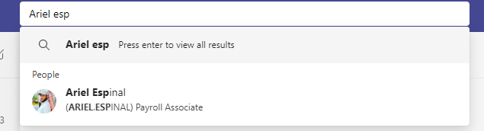
Payroll – Practice Time
Susan confirmed with the previous rep that she was going to receive a check for this paydate, she has not received it and is asking for a way to locate the check.
We can contact the payroll rep assigned (Teams) and confirm if there is a tracking number.

Slide 24

Payroll – Practice Time
Roy added his Direct Deposit 2 days ago, He is getting paid today and does not understand why the payment did not go through. Also, he is wondering what will happen to his money.

Slide 25
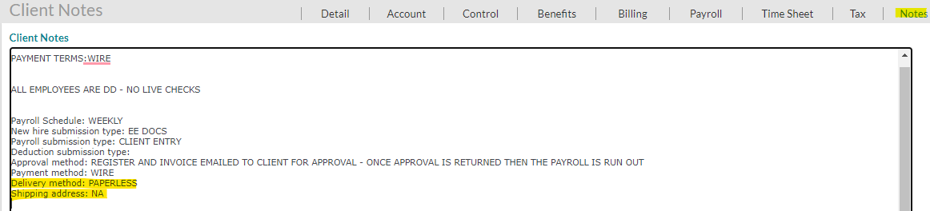
Payroll – Practice Time
Roy added his Direct Deposit 2 days ago, He is getting paid today and does not understand why the payment did not go through. Also, he is wondering what will happen to his money.
We must explain the prenotification status and that the check will be sent to the Client or employee.
For more details we can check the notes into the Client Details Tabs.

Slide 26

Payroll – Practice Time
Janna Called in because she was supposed to get a check last week and never got it, you are instructed to create a case for re-issue. How would you set up the case?
Category
Type
Assigned to

Slide 27
Payroll – Practice Time
Janna Called in because she was supposed to get a check last week and never got it, you are instructed to create a case for re-issue. How would you set up the case?
Category
Remember to send the Affidavit form with the case number on the subject of the email.
Type
Assigned to

Slide 28
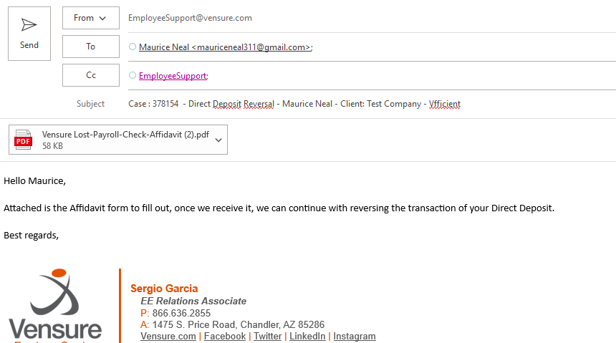
Payroll – Practice Time
Can you spot the error?

Slide 29
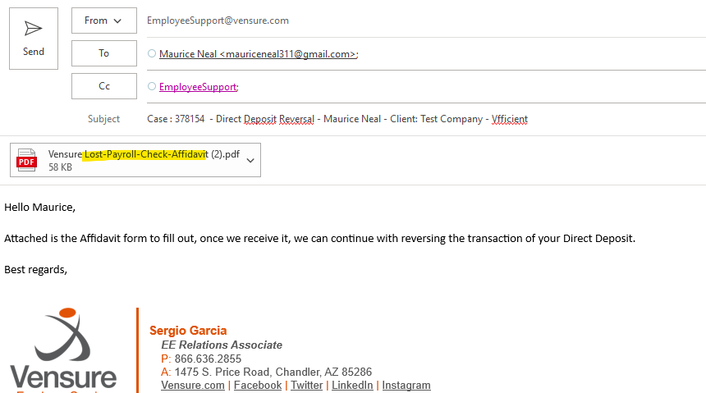
Payroll – Practice Time
Can you spot the error?
Careful, you want to send the proper Affidavit form depending on the Payment method.

Slide 30
Questions?
Let us know!

