Slide 1
Employee Relations
Payroll Vouchers -Training

Slide 2

Payroll Vouchers -The Goal Of This Presentation
During the following presentation we are going to address most common questions regarding Unemployment, at the end of this training the team Will:
Understand in depth the payroll voucher of employees
Have a clear idea of how to address most common questions
Provide confidence to the team and accurate guidance to employees
Have more material to consult when assisting Payroll Voucher questions

Slide 3
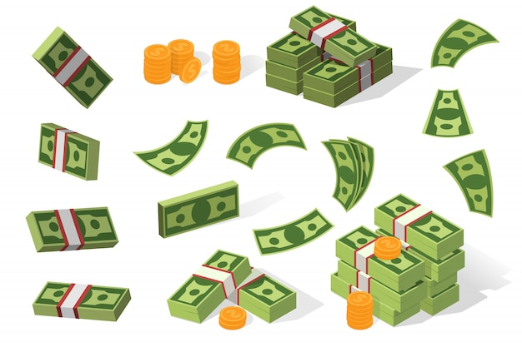
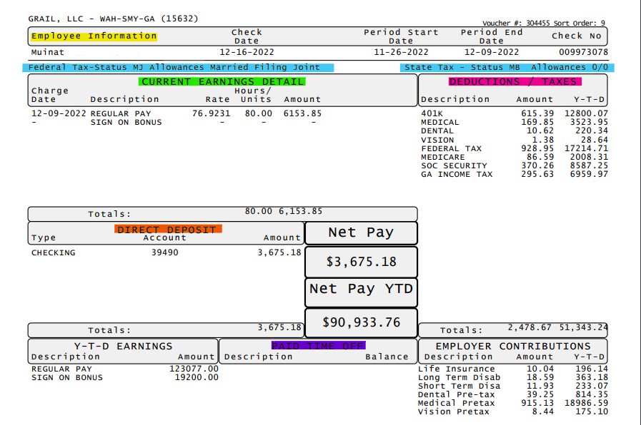
Payroll Vouchers – The Generals
Is easier to dissect the paystubs in sections and link those sections to modules in PRISM:
Yellow section contains information of the EE and Client – Useful to find the profile –Links to Employee details tab
Blue Section contains the Tax set up of the Employee – Useful to identify how the EE is reporting taxes – Links to Tax Module
Green section Contains the money earned by the EE
Red Section contains Deductions- Links to Benefits Overview / Employee FSA Inquiry / Taxes / Deductions / Recurring deductions / Garnishments
Orange Section Contains - Direct Deposit – Bank Accounts – Checks – Links to Deposit Module in PRISM
PTO – PTO Balance – Links to PTO Register Type Module in PRISM

Slide 4

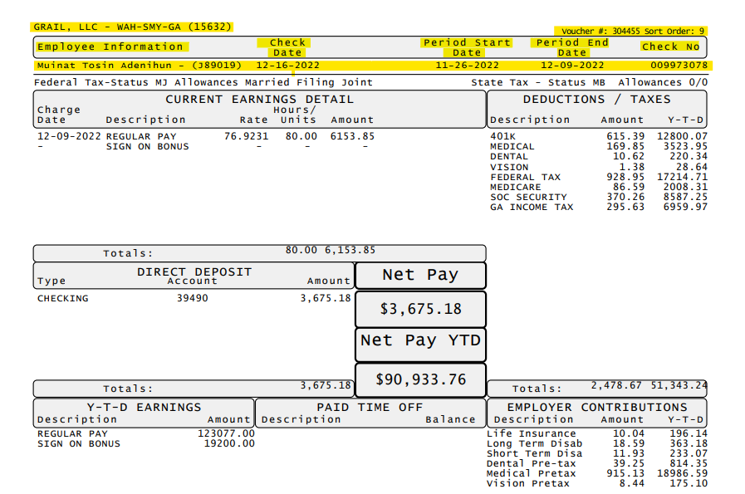

Payroll vouchers & Information Section
You can use the Payroll Voucher to:
I am sorry young boy; I do not have more information to give….
Find the employee's account
Find the Client’s account
Confirm the Pay Period
Find / Confirm Payroll Voucher number
Find / Confirm Check Number
Find / Confirm Employee ID
Try asking for the payroll voucher if you are having a hard time finding an employee.

Slide 5
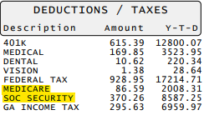
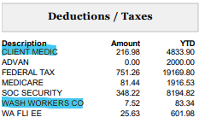
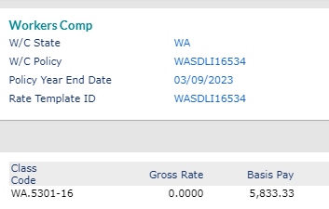
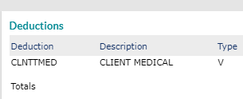
Payroll vouchers & Deductions
Key Points in Deductions
Medicare and Social Security are common deductions, they should appear always.
EE should have Federal Tax and State Tax deductions (Unless they Claim exempt)
Benefits and Garnishments deductions will appear here.
Every month deductions will add up to the YTD amount.
If you see items that are not familiar to you, you can do a small research in the Deductions and Workers Comp tabs in the Payroll Voucher section

Slide 6

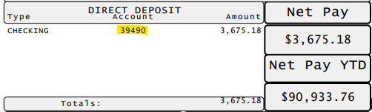
Payroll vouchers & Earnings and Direct Deposit
Key Points in Earnings
If you see items that do not have a quantity on them, they do not affect the EE’s payment., is an old pay code in the EE profile.
Key Points in Direct Deposit
The Bank account # should match with the one on PRISM under Deposit Tab.
Net Pay Value is the total after deductions.
Inactive bank accounts will not appear in this section

Slide 7
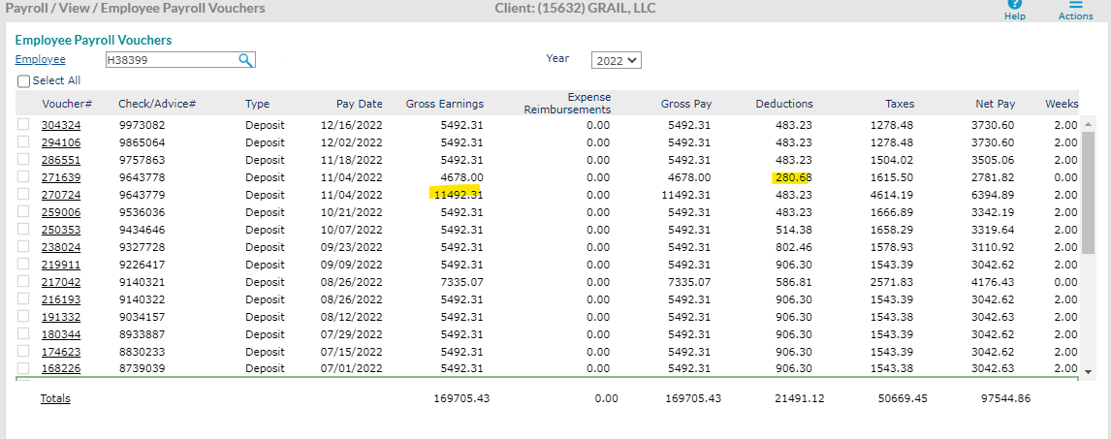
Payroll vouchers & Overview
In the general view of the Payroll vouchers we can identify patterns, high/low amounts of earnings/deductions. Double dated payments are related to bonus payments most of the time.

Slide 8
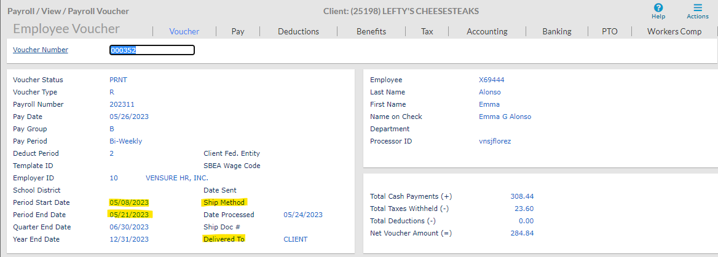
Payroll vouchers & Overview
When you open the Voucher you can also check the Period Start Date/ End Date
When a check is processed and where it was delivered to
Andy Frain Requests regarding payroll must be directed to AF Sups.

Slide 9

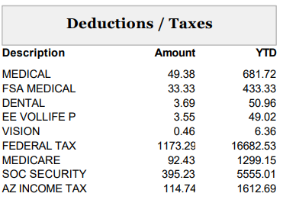
Payroll vouchers & Scenarios
Hi! this is Matthew, I do not understand what are the deductions on my paystub, can you explain a bit better?
Let’s Find out…

Slide 10
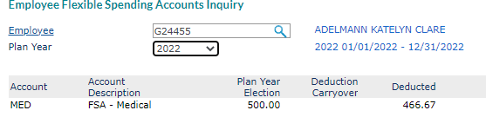
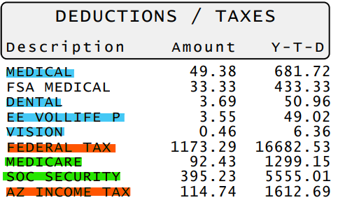
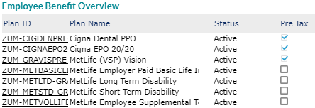
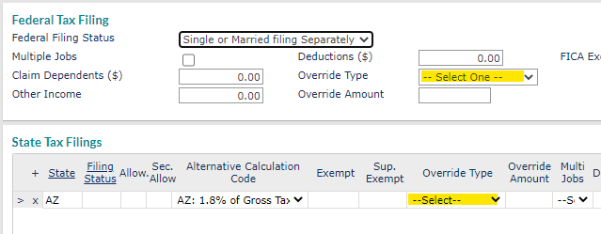
Payroll vouchers & Scenarios
Let’s Find out…
First – We want to identify the basic deductions for Medicare and Soc Security
Second – Federal and State taxes
Third – Locate employee Benefits
We can find the information of those deductions in the Employee Benefits Overview, Tax tab, Employee FSA Inquiry
His this is Matthew, I do not understand what are the deductions on my paystub, can you explain a bit better?

Slide 11


Payroll vouchers & Scenarios
Hello This is Janine, I am checking on my paystub an item that says Sign On Bonus but I have not received any compensation for it, can you check?
Let’s Find out…

Slide 12

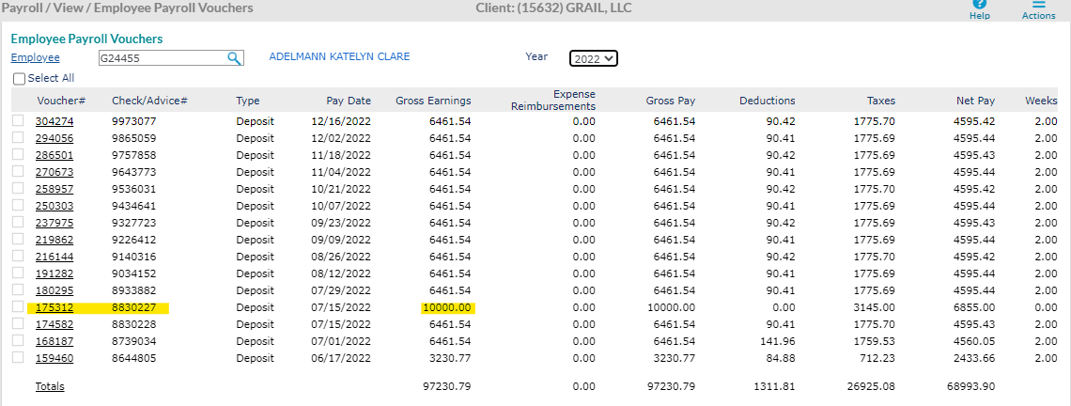
Payroll vouchers & Scenarios
First, we can identify the YTD earnings, here we can see the EE was paid a Sign ON Bonus in the past.
We can confirm to the EE that the item she sees belong to an old payment done back in 7/15/2022 the historical remains there.
Second – By Reviewing the paystubs we can identify an extra payment on 7/15/2022, this is the Sig On Bonus paid previously.
Hello This is Janine, I am checking on my paystub an item that says Sign On Bonus but I have not received any compensation for it, can you check?

Slide 13

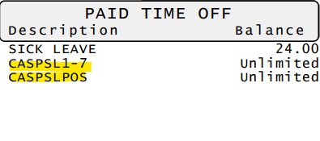
Payroll vouchers & Scenarios
Hello This is Anthony, I am checking on the Paystub for last pay date and I see an item in the PTO section I do not recognize, could you clarify?
Let’s Find out…

Slide 14
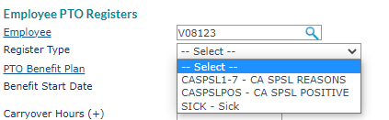
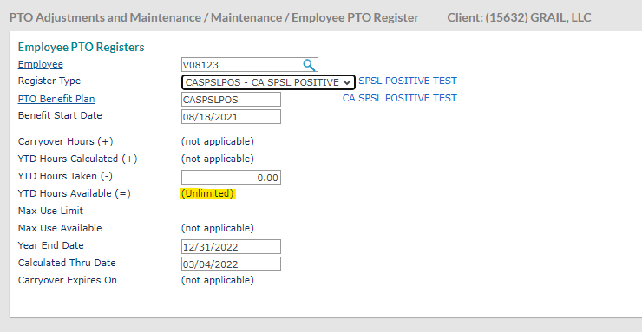
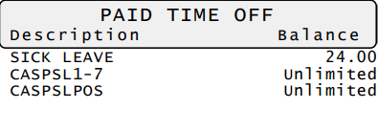
Payroll vouchers & Scenarios
The codes for PTO appear on the paystub too, so our next step would be to go to PTO Register in PRISM and check the PTO codes there.
The set up of these codes are very particular as they do not accrue time , refer the EE to the WSM for further details.
As they match, we conclude that the codes are related to the California State, could be PTO granted to EE in that state when it comes to COVID absences. For more details we can refer the EE to their WSM.
Hello This is Anthony, I am checking on the Paystub for last pay date and I see an item in the PTO section I do not recognize, could you clarify?

Slide 15

Payroll vouchers & Scenarios
Hello This is Gaby, I am checking on the Paystub and I am being charged for Federal taxes when I clearly claimed to be exempt, can you verify?
Let’s Find out…

Slide 16
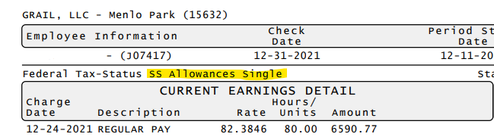
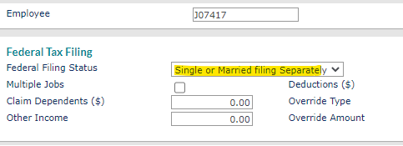
Payroll vouchers & Scenarios
As we can see in the paystub the employee is filling out taxes as Single. We need to confirm this with the information in PRISM
The information in the Tax section matches with the one on the paystub, in this case, we can direct the EE to the ESS for tax update or we can send the form.
Hello This is Gaby, I am checking on the Paystub And I am being charge for Federal taxes when I clearly claimed to be exempt, can you verify?

Slide 17


Payroll vouchers & Scenarios
Hello this is Francine, I am calling because I am missing around USD1000 of my check, I do not know where the money go, can you verify please?
Let’s Find out…

Slide 18
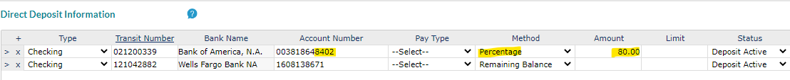
Payroll vouchers & Scenarios
According to what we see in PRISM, the EE has 2 bank accounts so 80% of the money went to a different Account. We can educate the EE about checking the balance on the account ending in 38671.
First, we want to confirm how the money was deposited for that payment. By looking at the voucher we see that the money was deposited in two accounts… we will need to go to PRISM and see the set up.
Hello this is Francine, I am calling because I am missing around USD1000 of my check, I do not know where the money go, can you verify please?

Slide 19
Questions?

