Slide 1
Employee Relations
Training Session – 401k Slavic – EmPower -Retirement Plan Questions

Slide 2
Retirement Plans
401k Slavic / EmPower / Using PRISM

Slide 3

Retirement Plan – Understanding Our Role
Before we can assist, we must know our limitations and understand what we can do and what we must escalate (Retirement Call/Case).
Provide smooth assistance to Employees
Avoid call time and unproductive time during the call (long holds, dead airs, transfers)
Give confidence to associates when assisting these types of requests
Better understanding of the business and improvement opportunities

Slide 4



Retirement Plans
Retirement plans are offered by the clients and the employees are free to choose which plan they want to use.
Vensure retirement plan offered is called Slavic 401k (Carrier).
Vensure retirement plan offered is called Slavic 401k (Carrier).
Vensure is the bridge between providers and employees, both carriers prefer employees using their portals. For escalations, disputes, missing contributions, wrong deductions we can create a case.

Slide 5


So what is important to know?
Important tips to considerate
Identify what is the retirement plan the employee is enrolled in.
Depending on the request we can provide flyers with detailed information.
Retirement plan contributions are always shown in the payroll voucher, is always a good idea to check that.
If you are not sure of the request, ask probing questions.
We can always create a case for complex inquiries.
How to use the system (PRISM) in order to assist accurately.

Slide 6
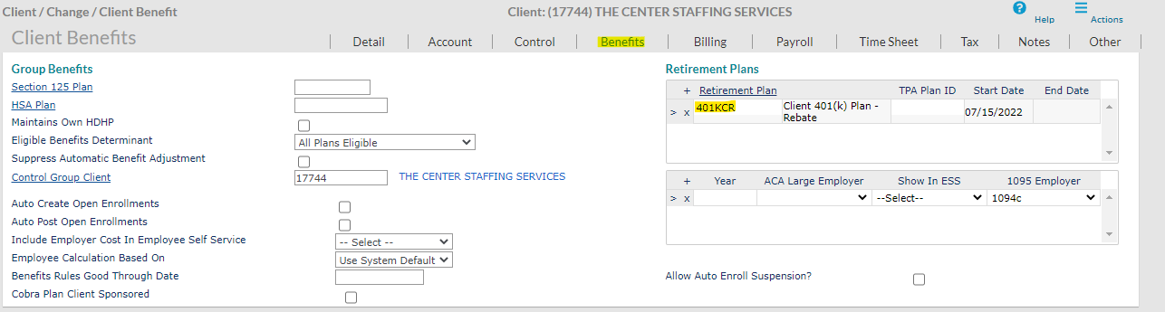

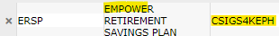
Types Of Retirement Plans
Client 401(k) Plan - Rebate
The Client has their own 401K Plan, we do not have their information. Still, we can help by changing contributions on our end
EmPower clients (not CSIG)
*For these clients we share the regular info for Transamerica. (Flyers on the SP)
EmPower clients (CSIG)
Each Client has their own flyer, consult leadership for more information.
Slavic401K
Slavic401k, We can send flyers or refer employee to their website depending on the request.
**This information is in the Client Details module > the Benefits tab > Retirement Plans

Slide 7
Who can assist?
ER Assist
WSM/ Client
Retirement team / Case
Verify the amount of contribution taken out of a paycheck
Retirement plans offered
EE never enrolled in the plan
Check on the requirement the client has for the employees on the retirement plans (only Slavic)
Change contributions on plans that are not Slavic401k (also we can create case)
Wrong contributions / missing contributions
Opt out of the retirement plan
Account creation / login instructions in Slavic401k - Transamerica
Plan details and explanation of features (only Slavic 401k)
Escalations regarding complex inquiries
**For Transamerica questions, employees will be directed to the web portal for further assistance or call the phone 1-877-717-8858

Slide 8
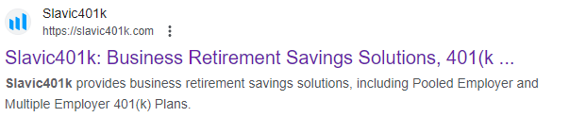
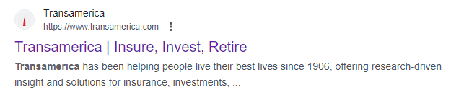
Retirement – Enrollment
Both Enrollments are done in the carriers website / Phone line, and they are not subject to Open Enrollment.
https://www.transamerica.com/portal/home
Or 1-877-717-8858

Slide 9




EmPower – 401k Transamerica
Setting Up Contributions
Once the employees register, they need to go to Manage > Contributions > Calculate to make their elections.
Employees can make changes to their contributions at any time throughout the year.
Contributions are processed Monthly, meaning that the changes performed during the month will be effective on the 1st paycheck of the following month.
Employees can choose between percentage and dollar amount to contribute, these elections are per Pay Period, not annual.
** It is highly advised that after every contribution change made online, it is the employees’ responsibility to log onto the Transamerica website and verify his/her election, verify pay stubs for 401(k) deductions and review every 401(k) quarterly statement.

Slide 10
FAQ
Frequently Asked Questions

Slide 11


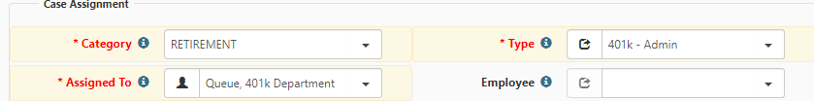
FAQ for Retirement Plans
Hello! I want to know more information about the retirement plans offered
First, we need to identify which plan is being offered by the Client.
If the Client offer Slavic401k we can send the Plan features file located in the SP (Master Benefit plan).
For Transamerica talk to leadership so they can provide the flyer for that specific Client.
Escalation:
*If the WSM was not able to assist with the provider, we can create a case to our 401k Team:

Slide 12
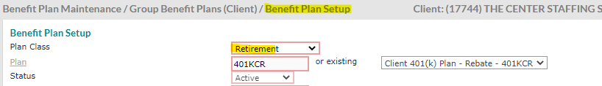

FAQ for Retirement Plans
Hello! When is a Good time to enroll in the retirement plan? Any requirements?
Employees can enroll anytime as long as they comply with the rules that the Client set up for the retirement plan.
We can check these rules on the Benefit Plan Setup Module (For Empower Transamerica use the client Flyers), we do not modify anything this is only for information purposes.
For eligibility criteria in EmPower , have leadership provide the flyer.

Slide 13
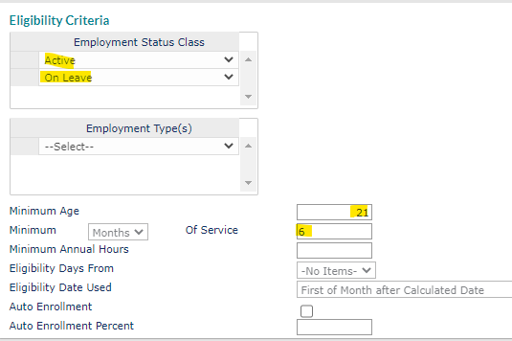
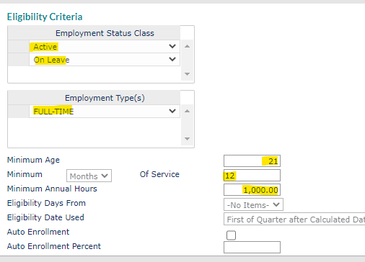
FAQ for Retirement Plans
Here we can see the different requirements between companies, each Client has its own rules when offering retirement plans.

Slide 14
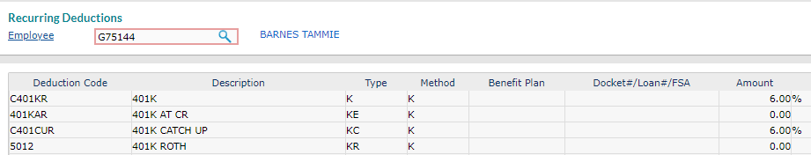
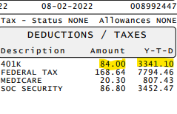
FAQ for Retirement Plans
Hello! The deductions on the retirement plan are not correct or they are missing…
First, lets check on the Paystub, as we know they reflect the deductions of the Employee’s paycheck. We can also verify this on the Deductions section.
In this example, the system is set up to contribute 6% of the Paycheck to the 401k Plan.
6% of $1,400 = $84USD The contributions are ok.

Slide 15
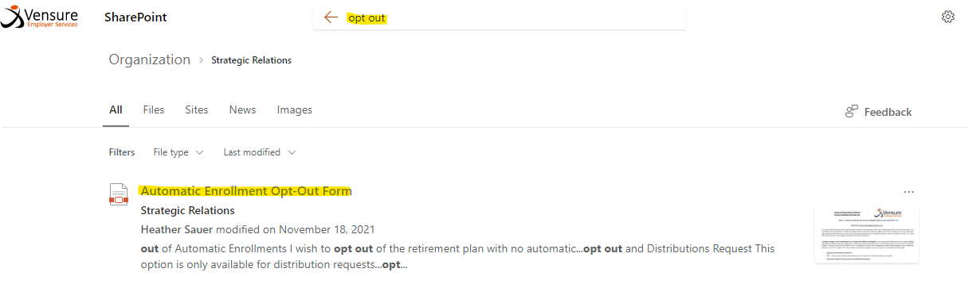
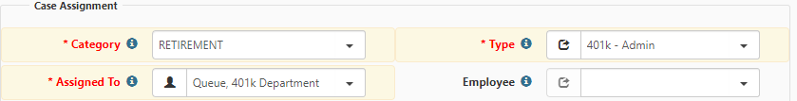
FAQ for Retirement Plans
Hello! I never enrolled into this retirement plan, I need my money back!
We can send the opt out form to the Employee and create a case for the retirement team to process. Do not argue with the employee but ask questions in detail so that everything is well documented in the case. ONLY SLAVIC, Valid for the first 90 days of activation

Slide 16
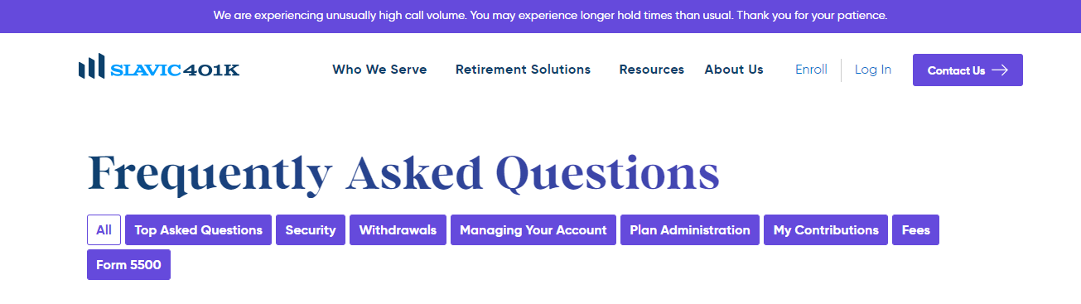
FAQ for Retirement Plans
Hello! I want to change my contribution on the retirement plan, what can I do?
As always, we need to identify which plan is being offered by the Client:
If the plan is not Slavic401k – Our team can Help, we create a case.
If the plan is Slavic401k, we direct the employee to https://slavic401k.com/
If the plan is Transamerica refer employee to the website https://www.transamerica.com/
Check on the Slavic401k website for more details! https://slavic401k.com/frequently-asked-questions/

Slide 17
Ready to Test your Knowledge?
Be preparad!

Slide 18

Test your Knowledge
What is the first thing we must review when employees call regarding their retirement plan?
A. Check if the employee is active
B. Client details – WSM assigned and refer to them.
C. Client details – Benefits tab – Retirement plans
D. Employee details – Payroll Vouchers - deductions
Scoreboard
Not bad – You are fine – Kind of good – Your Rock – What a Beast!

Slide 19
Test your Knowledge
What is the first thing we must review when employees call regarding their retirement plan?
A. Check if the employee is active
B. Client details – WSM assigned and refer to them.
C. Client details – Benefits tab – Retirement plans
D. Employee details – Payroll Vouchers - deductions
Scoreboard
Not bad – You are fine – Kind of good – Your Rock – What a Beast!

Slide 20
Test your Knowledge
Employee Sam calls in, stating that he never enrolled in the plan he wants to be opt out of the plan and get a refund. We should:
A. Refer the employee to the WSM as the client is the one in charge of the retirement plans
B. Create a case to Payroll for the refund and send the opt out form located in the Vensure website.
C. Ask questions to know in detail what happened, send the opt out form found in the Share Point and create a case to retirement.
D. We do not process this transaction, employee must send an email to 401k@vensure.com for assistance.
Scoreboard
Not bad – You are fine – Kind of good – Your Rock – What a Beast!

Slide 21
Test your Knowledge
Employee Sam calls in, stating that he never enrolled in the plan he wants to be opt out of the plan and get a refund. We should:
A. Refer the employee to the WSM as the client is the one in charge of the retirement plans
B. Create a case to Payroll for the refund and send the opt out form located in the Vensure website.
C. Ask questions to know in detail what happened, send the opt out form found in the Share Point and create a case to retirement.
D. We do not process this transaction, employee must send an email to 401k@vensure.com for assistance.
Scoreboard
Not bad – You are fine – Kind of good – Your Rock – What a Beast!

Slide 22
Test your Knowledge
Mark wants to make changes to his contribution amount on his retirement plan, when checking on the system you see he is using Slavic401k, we should:
A. Create a case for the retirement team to assist.
B. Explain that contributions cannot be modified so the employee will have to go to their WSM for further assistance.
C. Direct the employee to the WSM as we change the contribution for plans that are not Slavic401k.
D. Refer Mark to the Slavic401k Website as these modifications can be done on their portal.
Scoreboard
Not bad – You are fine – Kind of good – Your Rock – What a Beast!

Slide 23
Test your Knowledge
Mark wants to make changes to his contribution amount on his retirement plan, when checking on the system you see he is using Slavic401k, we should:
A. Create a case for the retirement team to assist.
B. Explain that contributions cannot be modified so the employee will have to go to their WSM for further assistance.
C. Direct the employee to the WSM as we change the contribution for plans that are not Slavic401k.
D. Refer Mark to the Slavic401k Website as these modifications can be done on their portal.
Scoreboard
Not bad – You are fine – Kind of good – Your Rock – What a Beast!

Slide 24
Test your Knowledge
Susan calls in because she wants to know how much is the contribution amount for her retirement plan…
A. Create a case to Retirement as we do not have access to that information.
B. Reset ESS password for Susan and make sure she has access to her account in the portal she will be able to locate that information.
C. Verify Payroll vouchers – Deductions or download the paystubs and check on the Deductions section
D. Benefits overview – Action Tab – Retirement plans
Scoreboard
Not bad – You are fine – Kind of good – Your Rock – What a Beast!

Slide 25
Test your Knowledge
Susan calls in because she wants to know how much is the contribution amount for her retirement plan…
A. Create a case to Retirement as we do not have access to that information.
B. Reset ESS password for Susan and make sure she has access to her account in the portal she will be able to locate that information.
C. Verify Payroll vouchers – Deductions or download the paystubs and check on the Deductions section
D. Benefits overview – Action Tab – Retirement plans
Scoreboard
Not bad – You are fine – Kind of good – Your Rock – What a Beast!

Slide 26
Test your Knowledge
Hello, this is Sergio from Captain’s Jay, I need to know why am I being deducted for a retirement plan I never enrolled into, you guys are a scam I need my money back!
A. Well Sergio, enrollments are not happening out of nowhere you know? And I do see the deduction active so I am pretty sure you did enroll.
B. Is weird that this happened, but Sergio once the deduction is done we cannot process refunds, you better cancel the plan on the website before next paycheck.
C. We do apologize for this misunderstanding, I will be sending an email with a form , please fill it out and our retirement team will assist from there.
D. First of, we are not a scam Sergio so calm down and fill out the form I am going to send you, here is your ticket number and send the form back to 401k@vensure.com.
Scoreboard
Not bad – You are fine – Kind of good – Your Rock – What a Beast!

Slide 27
Test your Knowledge
Hello, this is Sergio from Captain’s Jay, I need to know why am I being deducted for a retirement plan I never enrolled into, you guys are a scam I need my money back!
A. Well Sergio, enrollments are not happening out of nowhere you know? And I do see the deduction active so I am pretty sure you did enroll.
B. Is weird that this happened, but Sergio once the deduction is done we cannot process refunds, you better cancel the plan on the website before next paycheck.
C. We do apologize for this misunderstanding, I will be sending an email with a form , please fill it out and our retirement team will assist from there.
D. First of, we are not a scam Sergio so calm down and fill out the form I am going to send you, here is your ticket number and send the form back to 401k@vensure.com.
Scoreboard
Not bad – You are fine – Kind of good – Your Rock – What a Beast!

Slide 28
Test your Knowledge
Hello! This is Andrew, I made some changes in my contributions for the 401k on the 11th of August, it's been two weeks, on this paycheck I am being deducted the old amount, what is going on? (Transamerica)
A. Well Andrew, you mistyped something and that is why is not working
B. Changes will take some time to be effective go to your WSM for further information.
C. No worries, Andrew let me open up a case for you and have it fixed right away
D. Andrew, changes will take place on the first paycheck of the following month, that is why.
Scoreboard
Not bad – You are fine – Kind of good – Your Rock – What a Beast!

Slide 29
Test your Knowledge
Hello! This is Andrew, I made some changes in my contributions for the 401k on the 11th of August, it's been two weeks, on this paycheck I am being deducted the old amount, what is going on? (Transamerica)
A. Well Andrew, you mistyped something and that is why is not working
B. Changes will take some time to be effective go to your WSM for further information.
C. No worries, Andrew let me open up a case for you and have it fixed right away
D. Andrew, changes will take place on the first paycheck of the following month, that is why.
Scoreboard
Not bad – You are fine – Kind of good – Your Rock – What a Beast!

Slide 30
Questions?
Let us know!

