Slide 1
Employee Relations
System Tricks / PRISM

Slide 2
System Tricks
Useful information for your daily work

Slide 3

Tips and Tricks
In this presentation you will learn some tips and tricks that will help you when assisting employees, also you Will:
Take the most advantage of the tools
Avoid call time and unproductive time during the call (long holds, dead airs, transfers)
Recognize different sections of the PRISM Tool
Better understanding of the business and improvement opportunities

Slide 4



What We Will Learn…
Finding Difficult Employees
Documents Module
Identify the staff of a Client
Using Vinny
TIPS
&
Wildcard Search
TRICKS
Troubleshooting
Notes Module in PRISM
Worksite Location
W2 Bacth Download
Avitus Help

Slide 5

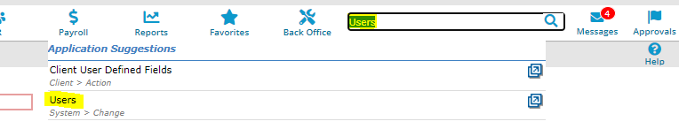
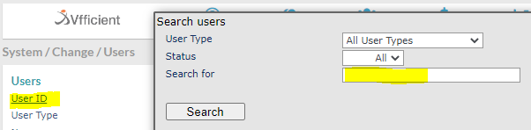
Finding Difficult Employees
TIPS
&
TRICKS
1.
Go to the Users Module
2.
Click on the User ID Hyperlink and use the Search for Field
Tips
Identify the instance first.
Do not use common names
Have the correct spelling.
3.
Try using different information to locate the EE’s Profile such as:
email
Full name
Username (ask if the caller knows it)

Slide 6
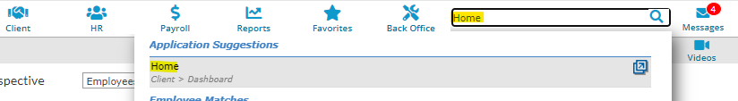
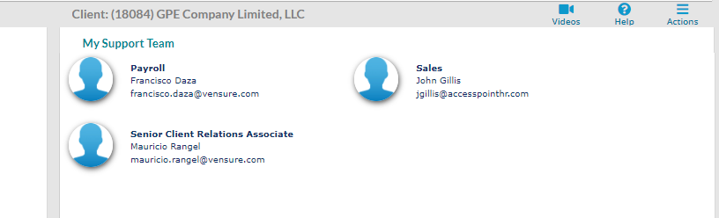
Identify the staff of a Client
TIPS
&
TRICKS
1.
Type Home in the search bar
2.
PRISM Will display the people assigned to that Client, also found in Client details
If you wan to know who is the Payroll Rep, Benefits Rep, CRM, etc. Assigned to a Client…

Slide 7
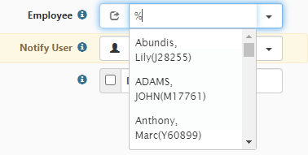
Wildcard Search
TIPS
&
TRICKS
In ClientSpace…
Wildcard Search is a search method in which we can tell the system to find more specific information, simply by adding a % Like this:
Tips
Use it find open cases for an EE
It will bring active and term EEs
Wildcard search uses the information in the subject line of the cases, so is a great idea to follow up the template provided when creating a case:
Have the correct spelling.
EE name/ EEID / Client/ Client ID / Instance / Summary

Slide 8

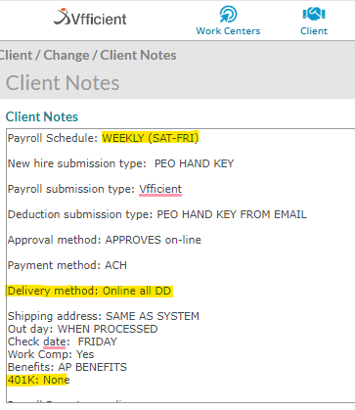
Notes Module in PRISM
TIPS
&
TRICKS
The Notes module in PRISM has important information about the client and specific instructions when assisting them, is always a good idea to review that section
From the notes of this client, we can identify for example that they do not have a 401k Plan *At least with Vensure*
Not all clients have notes but if they do, we should check them out

Slide 9
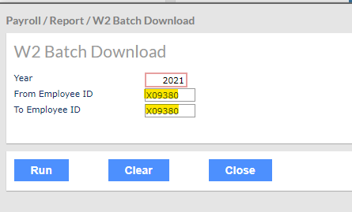
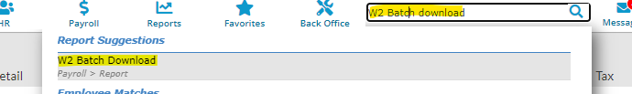
W2 Batch Download
TIPS
&
TRICKS
When an EE requests a W2…
Sometimes we are not able to pull up the W2 record of an employee because it does not appear under the option Reprint W2, try this:
Before creating a case, we might be able to get the W2 for the EE in this way…
Tips
Use the EEID in both fields
Type the Year of the W2
Add the module to favorites.

Slide 10
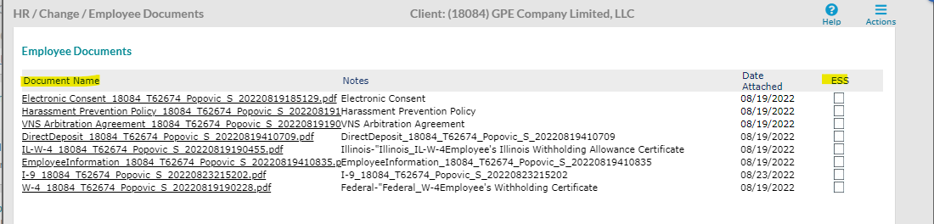
Documents Module
TIPS
&
TRICKS
The Documents Module stores the document of the EE available to download or review, we can also see if the document is available for download in the ESS
If the ESS box is not checked, the system will not display the document for the EE in the ESS.
If the EE requests the document, contact the CRM to send the information
If the ESS is checked, the employee can find the document under Documents in the ESS
Tip

Slide 11
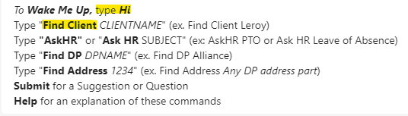

Using Vinny
TIPS
&
TRICKS
Vinny as our best friend
Using Vinny is simple but we have to understand its limitations…
Tips
Confirm the spelling
Try the different words of the Client’s name but do not use common ones, will give a lot of results to choose from (still can be helpful)
use different words
Check for errors

Slide 12


Troubleshooting
TIPS
&
TRICKS
I9 Won’t let me upload my document...
When this error happens, advise the employee of clicking the option to upload later.
Then the EE must provide the documentation to their WSM.
Using Snipping Tool
Use the shortcut Windows + Shift + S
This Will allow you to take an editable screenshot quicker!
Using the Help Button
If you want to know more details about each item in PRISM, click the Help button!

Slide 13

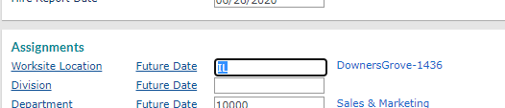
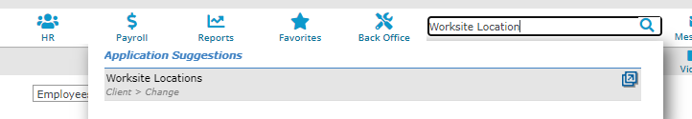
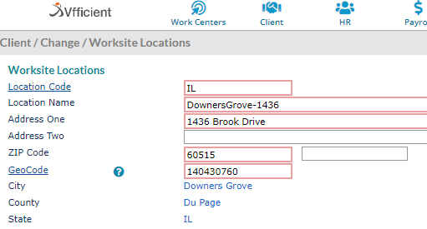
Worksite Location
TIPS
&
TRICKS
The worksite location of the Employee can be useful when trying to figure out where the employee works at (taxes, general information)
1.
2.
3.
4.
Employee Details Tab – Work
Copy the Worksite location code
Search for Worksite Location
Paste the location code!
This is also the reason of the onboarding error in the Taxes Section

Slide 14
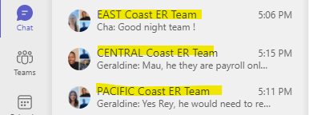
Avitus Help
TIPS
&
TRICKS
Regarding Avitus…
Most of the information should be in our PRISM system, BUT if the caller is requesting a W2 that is not on file and was in Avitus or needs access to the AVGPortal then:
Use the Region Chats
Tips
Supervisors and special team members have Access to the Avitus Files so do not hesitate to ask!
Confirm dates of the files
We can also find old Paystubs
Check for errors

Slide 15
Questions?
Let us know!

