Slide 1
Employee Relations
Training Session – Timekeeping systems

Slide 2





Timekeeping Systems
A timekeeping system is a means of capturing employee hours at the source and then calculating the time worked and time off based on the rules and policies established by the employer. When automated with software, this process is often more efficient and accurate.

Slide 3
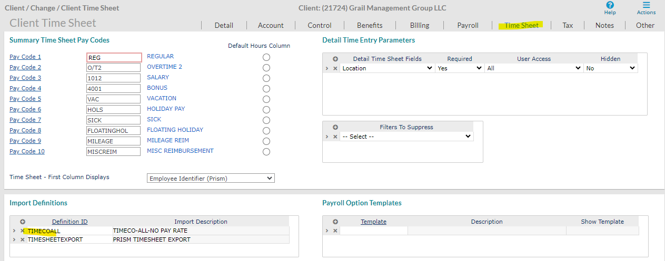
Timekeeping Systems
We can identify the Timekeeping Systems the Client uses by going to
Client Details > Time Sheet > Import Definitions

Slide 4
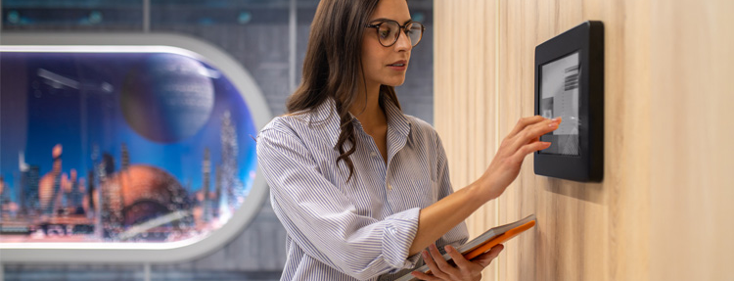


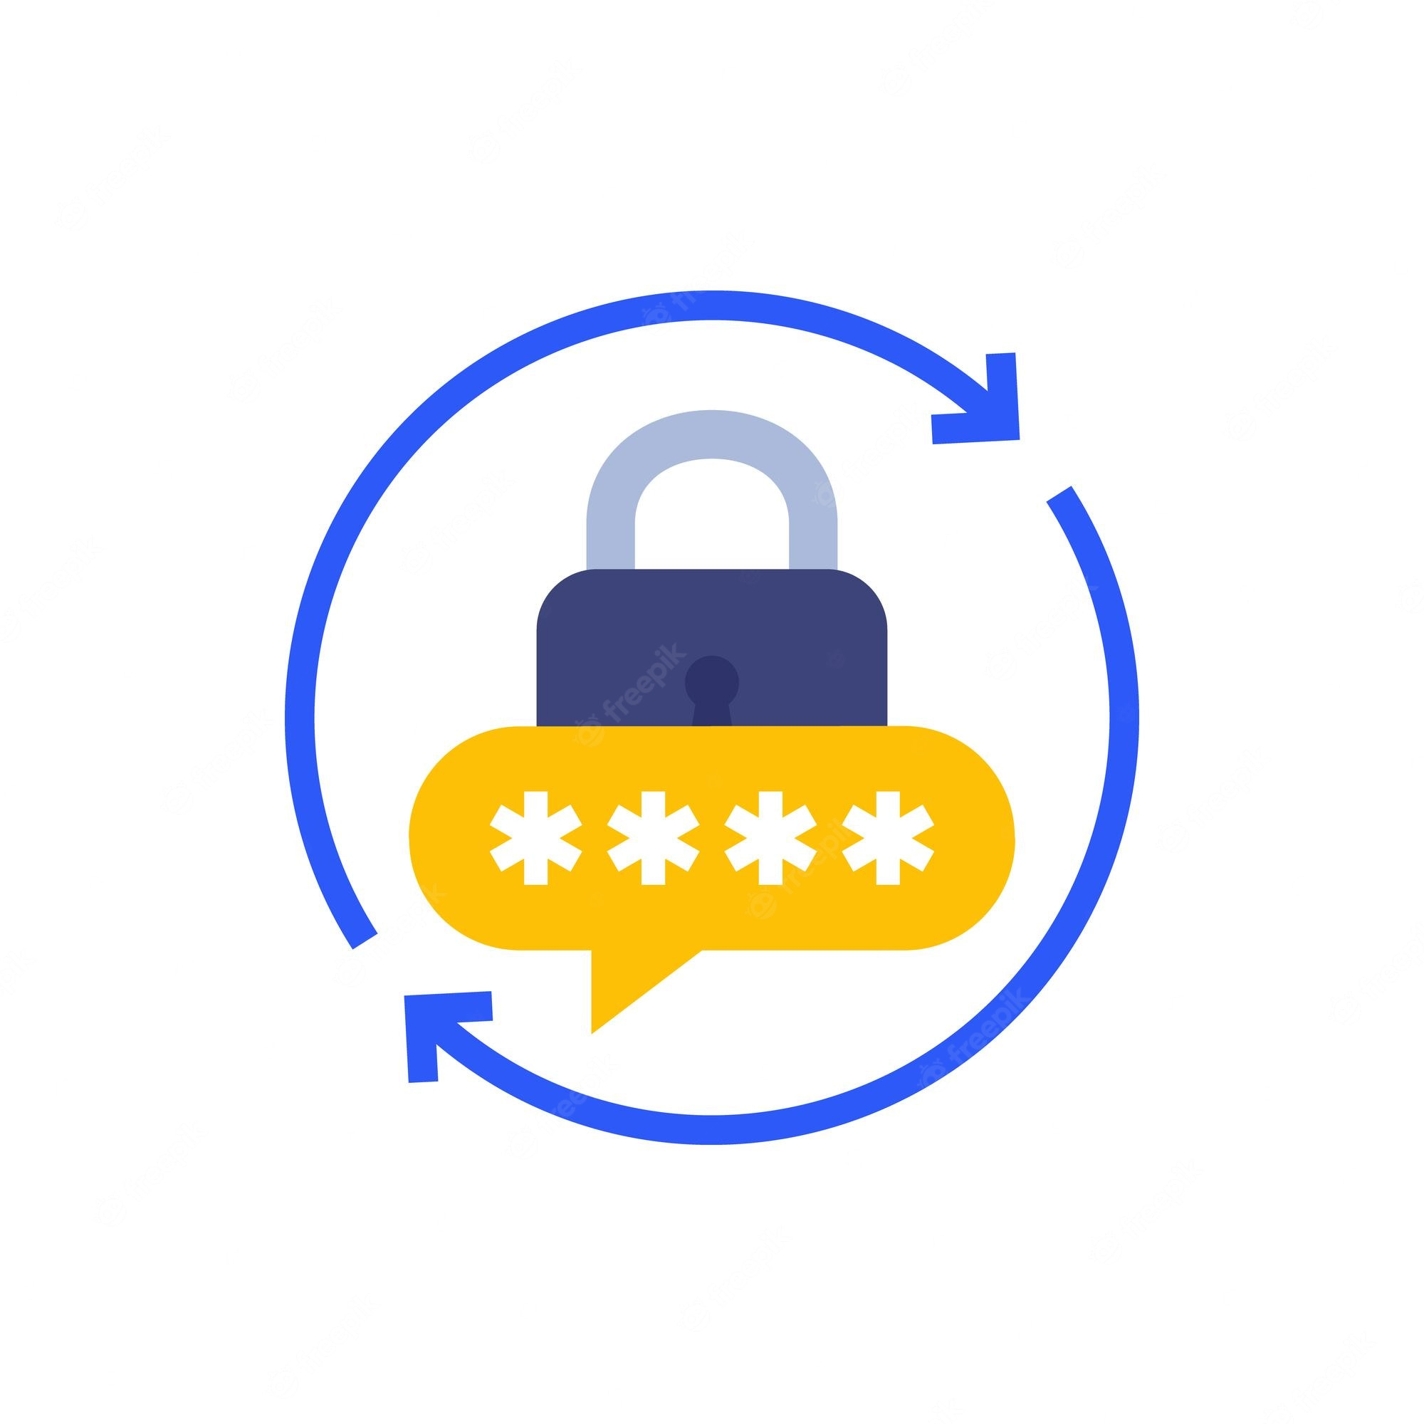

Timekeeping Options
Registration
Login
Password Reset
Clock In/Out
Credentials are created after the employee finishes the onboarding in PRISM.
*Through the ESS
(bypass login)
*Direct Link
*Forgot Password Option
*Email to timekeeping
Add/edit Punches
Add/edit widgets for Punching
Leaves Request
View Schedules

Slide 5



What’s Important To Know?
Employees can Clock IN/Out in a Physical device and the ESS.
Employees may call asking for help because the device is not working or they were not able to punch IN/OUT
In those cases, the WSM can help editing the TimeSheet for the Employee, we can also assist timekeeping@vensure.com

Slide 6

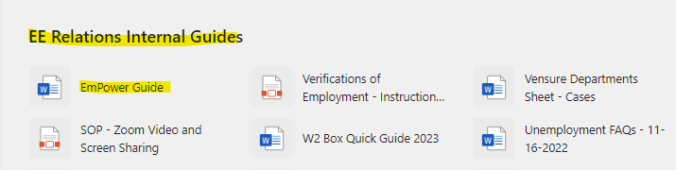

CSIG Clients
Common Sale Investment Group Clients will handle Timekeeping with the Payroll Processor assigned.
This person is listed in the CSIG Empower file, do not forget to use that document when assisting CSIG members.

Slide 7
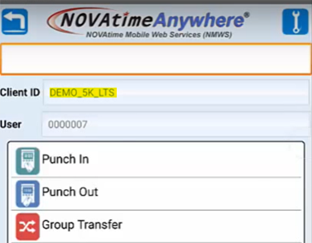
TimeKeeping Cient ID
TimeCo, SwipeClock NOVAtime Users Could be asked for the Client ID when registering for the app.
NOVAtime
Home > Punch In
Employees are supposed to have the Client ID to login, if they do not, please send an email to TimeKeeping for assistance.

Slide 8

What’s Important To Know?
Employees should access the platform via ESS , this menu bar item is labeled, “Time and attendance, Swipeclock or TimeCo.” If they do not have the link, we can request for it to timekeeping@vensure.com
Credentials are created by the Employee upon finishing the Onboarding. TimeKeeping can assist as well: timekeeping@vensure.com
If the employee has Password issues, we can request a reset to timekeeping@vensure.com

Slide 9
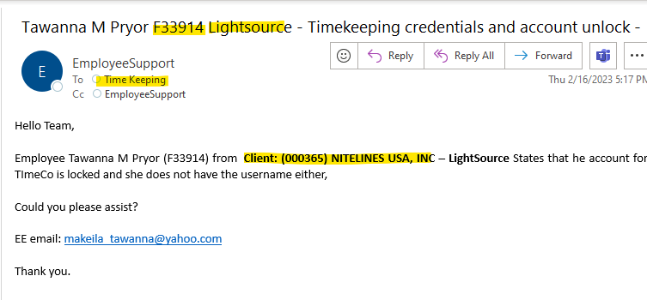
What’s Important To Know?
This is an example of an email we can send to timekeeping for assistance

Slide 10
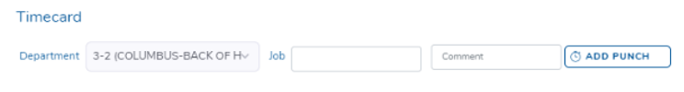

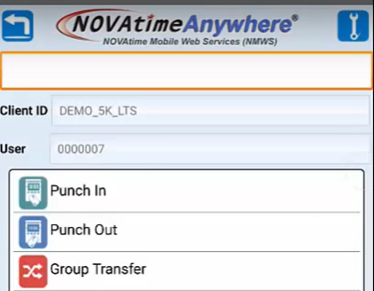
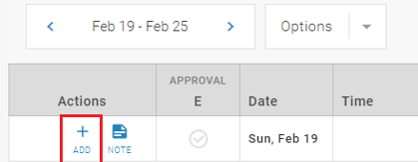
Clock In/Clock Out?
Employees will call asking how to Clock In/Out from work. If you have this question just know that into the timekeeping app they should click the option ADD PUNCH
TimeCo
Timecard > Add Punch
SwipeClock
NOVAtime
Timecard > ADD
Home > Punch In

Slide 11
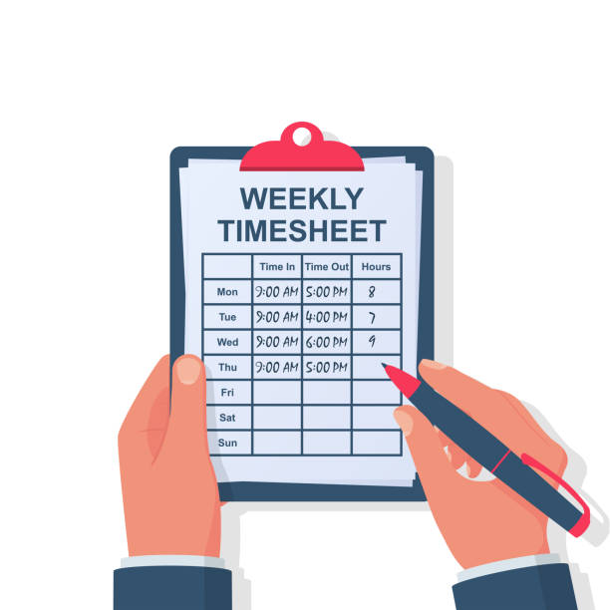
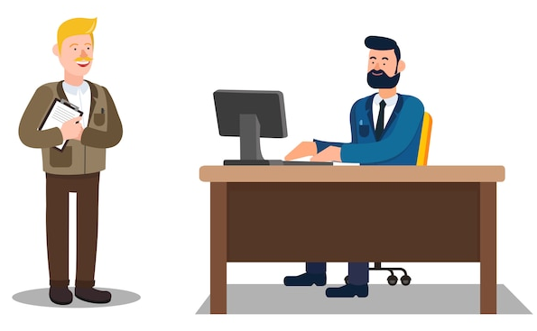
Timecard Edits
Employees can edit their timecards if it is allowed by the client.
NOT All employees are able to make changes to their timecards, we advise the employee to fix any punches in the timecard with their WSM first, if they still have a problem, we can create a case for TLM.

Slide 12

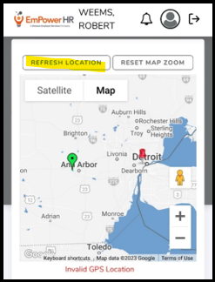

Invalid GPS Location
If the employees receive the Invalid Location error:
1
Guide the employee to Refresh the Location
If it does not work, create a case to TLM for resolution, make sure you add the Location in which they are trying to clock in/out
2

Slide 13
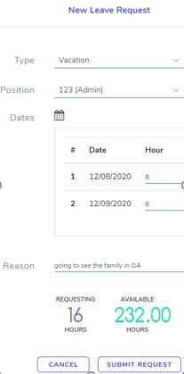

Leaves (PTO) Request
Employees can submit Leaves Request through the Timekeeping Apps
1
Is the same type or request done in the PTO section of the ESS
2
Employees can check the balance, status, cancel or add requests
Use the Planned Time Off Request to identify the status of these requests.

Slide 14
Questions?
Let us know!

