Slide 1
Employee Relations
Transfers – Practical Guide

Slide 2

Transfers – Introduction
As ER associates, we are required to assist employees with our best, as long as we have the tools to do so. For complex inquiries, we can contact different departments within Vensure.
During this training, we will explain the logical path to follow when transferring calls to other departments.
*Remember all transfers must be approved by your supervisor via Teams*

Slide 3





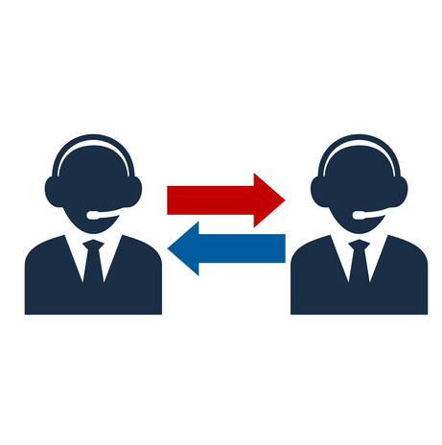

Transfers – Development
Case
Consult with leadership
Transfer
Employee’s Request
SOP Search
WSM
Important: Our goal is to avoid unnecessary transfers.

Slide 4






Transfers – Interactions
Garnishments
Benefits
Coordinator (Client Relations)
Treasury / Check verification line
Payroll (Upon Request)
These departments can talk to employees if needed. Other departments will work with us Via Case.

Slide 5
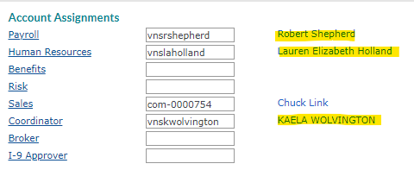



Transfers – Interactions
So, who should I reach out?
Client details > Account > Account Assignments
Each client should have a specific Vensure employee for
Payroll
Human Resources
Benefits
and a coordinator to follow up.
They are our first option, reach out via TEAMS.
Only wait for 2 hold periods of time (4 mins total) if they do not reply, continue with a case and assign it to them.
If no rep, assign to Queue (Example):
Benefits > Queue, Benefits
For EmPower use the
For Andy Frain use

Slide 6
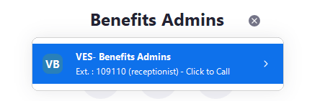

Transfers – Benefits
The best way to communicate with them is Via: Phone - Cases
Call Benefits if
Cases
The carrier states the EE is not active/in the system
Insurance Cards (If applicable)
Employee needs advice on the plans and recommendations that are not in SBCS (CARRIER UNKNOWN)
Dependents update
Benefits Rep not available
The employee has an escalation already and has not been resolved (out of due Date)
Benefits update (Life-Changing Events)
Open enrollment window extension (OE Workflow Type)
For Andy Frain EEs American Worker

Slide 7
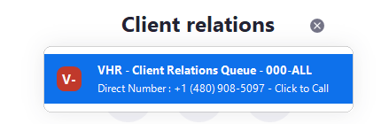
Transfers – Coordinators
The best way to communicate with them is Via: TEAMS – Call - Cases
Teams / Call them if
Case them if
The Caller is a Client / WSM / Owner of the company. Warm Transfer
Coordinators must be subscribed to all cases if possible. They can follow up with the client.
The caller is a client upset, confirm with leadership.
HR concerns/escalations
Client Complain / Feedback
WSM / Client needs help with PRISM (Entering information, reporting, guidance)
WARM TRANSFER ALWAYS

Slide 8
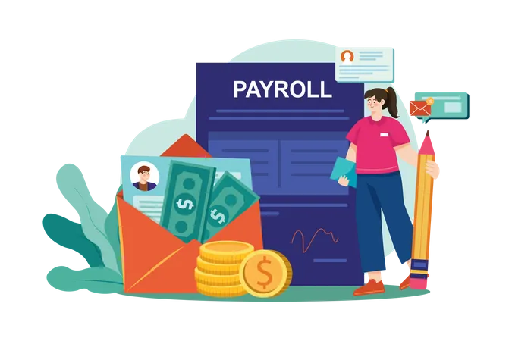
Transfers – Payroll
The best way to communicate with them is Via: TEAMS – Cases- Call Transfer upon request
Case them if
Problems related to payments, wrong amounts (WSM Already confirmed)
Confirm all information involved in payments to employees (Check addresses, deductions, etc)
For Andy Frain Employees refer them to local Supervisor at AF/ WSM
Direct Deposit Set Up, If we cannot do it.

Slide 9
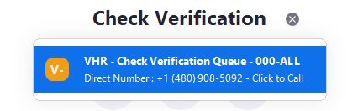
Transfers – Treasury
The best way to communicate with them is Via: Phone – cases
Call /e-mail them if
Case them if
For check verification
If they do not answer
For check Status
For Direct Deposit Trace
Check confirmation (Review Cashing check Issues SOP)
We can connect Banks, Clients, employees

Slide 10
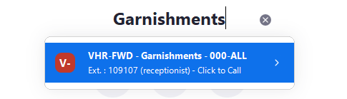
Transfers – Garnishments
The best way to communicate with them is Via: Phone - Cases
Call them if
Case them if
Employee being deducted when the garnishment was already done
After hours/ Request received by email
Employee has specific questions about the garnishment (document in the system)
Garnishment deducted when it was not supposed to
Escalated employees
In Garnishments, calling is our 1st option
Employee received a completion letter of garnishment, still being deducted

Slide 11
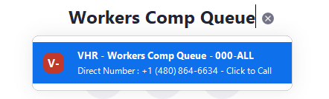
Transfers – Workers Comp
The best way to communicate with them is Via: Phone - Cases
Call Them if
Case them if
Checking on a Claim #
After hours/email
Questions about workers compensation

Slide 12
Practice Time

Slide 13




Transfers – Scenarios
Hi, this is Gary Oldman. I am calling because am not sure if the benefits I elected cover glasses, I also have surgery on March and I want to know if that is covered by my plan. (CARRIER UNKNOWN)
Should We:
To Whom:

Slide 14
Transfers – Scenarios
Hi, this is Gary Oldman. I am calling because am not sure if the benefits I elected cover glasses, I also have surgery on March and I want to know if that is covered by my plan. (CARRIER UNKOWN)
Calling benefits will be our first option as the employee needs details of benefits plans. If he has further questions he can clarify them immediately, better than a case.
We should:
To whom:

Slide 15

Transfers – Scenarios
Hi this is Jackie Moore (WSM) from Healthcare Industries; I am currently working on the payroll for our team and the form is not allowing me to submit anything. Am I doing something wrong?
Should We:
To whom:

Slide 16
Transfers – Scenarios
Hi this is Jackie Moore (WSM) from Healthcare Industries; I am currently working on the payroll for our team and the form is not allowing me to submit anything. Am I doing something wrong?
We Should:
Teams Payroll first*, explain that a Client/Payroll is calling requesting help in PRISM, if available they will take the call.
To whom:
Payroll Assigned
*If payroll is not available – Talk to CRM

Slide 17
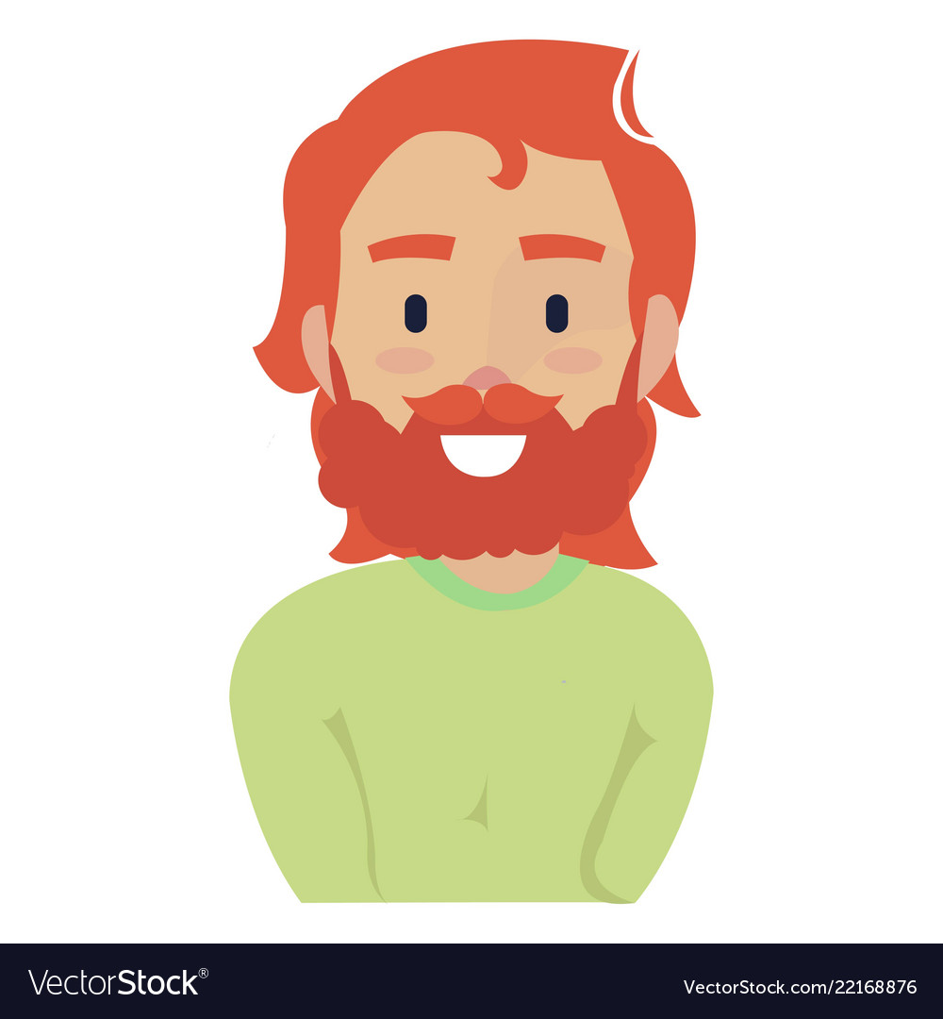
Transfers – Scenarios
Hi, this is Ruben from Magic Plumbers, I always get paid the same amount every 15 days and the deductions are different on each paycheck, Why is this happening, Can you assist? (you already clarified the information to the employee, and something seems to be off.
Should We:
To Whom:

Slide 18
Transfers – Scenarios
Hi, this is Ruben from Magic Plumbers, I always get paid the same amount every 15 days and the deductions are different on each paycheck, Why is this happening, Can you assist? (you already clarified the information to the employee, and something seems to be off.
We should:
To whom:
Teams Payroll, they will have to review the employee’s account in detail.

Slide 19

Transfers – Scenarios
Hi, this is Ruben from Cash-a-check Facility , we want to validate a check information for the employee Mark Ross. It says that the check does not have funds, could you check?
Should We:
To Whom:

Slide 20
Transfers – Scenarios
Hi, this is Ruben from Cash-a-check Facility , we want to validate a check information for the employee Mark Ross. It says that the check does not have funds, could you check?
We should:
To whom:

Slide 21

Transfers – Scenarios
Hello, Riona Brown here, I have got a Garnishment order that I just received, They said I had to call you guys and have it processed. Can you assist?
Should We:
To Whom:

Slide 22
Transfers – Scenarios
Hello, Riona Brown here, I have got a Garnishment order that I just received, They said I had to call you guys and have it processed. Can you assist?
Should We:
To Whom:

Slide 23

Transfers – Scenarios
Hi, This is Victoria Rush, I just received a notification that my Direct Deposit account was updated, but I have not performed any changes on my account. Could you validate what is going on?
You see in the audit option, someone from Vensure changed the DD and is not AF
Should We:
To Whom:

Slide 24
Transfers – Scenarios
Hi, This is Victoria Rush, I just received a notification that my Direct Deposit account was updated, but I have not performed any changes on my account. Could you validate what is going on?
You see in the audit option, someone from Vensure changed the DD and is not AF
Should We:
To Whom:
Teams Payroll processor, we want to know why the information was updated. If they do not respond on time, we can create a case then.

Slide 25
WSM Or Transfer / Cases

Slide 26

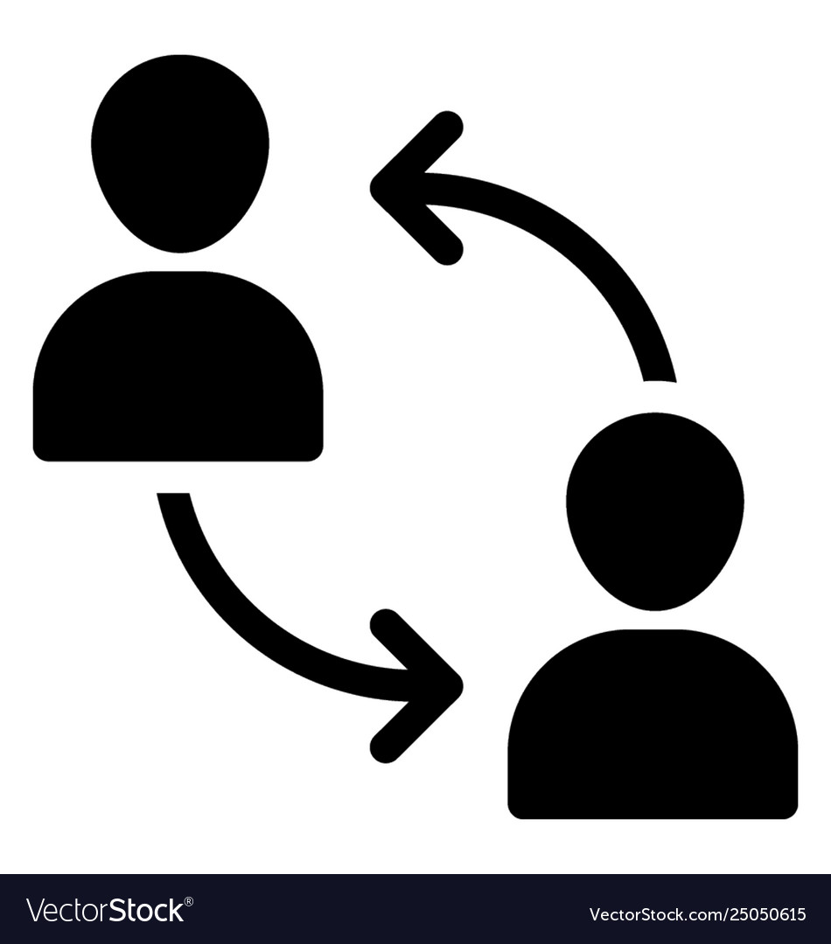
Transfers – WSM or Transfer/Cases?
We refer to the WSM when:
When to transfer / Case:
Employees missing hours / bonus payments /wrong rates
Providing Onboarding documents that are not in PRISM
Support with requests for benefits that are not offered by Vensure (Unknown Carrier)
PTO Missing hours from Payroll (WSM did not report hours).
We cannot locate the employee by any means
New Hire Entry
WSM / client already did their part and needs Vensure to Step in.
Adjustments, Payroll issues, and deductions review as these requests may take some time for review.
Escalations

Slide 27
Practice Time

Slide 28
Transfers – Scenarios
Hi, this is Sheryl Clarkson, I was reviewing my payment and I do not see the bonus I was promised for my referrals (NOT EMPOWER Client), can you assist?
Or
Transfer / Case
WSM

Slide 29
Transfers – Scenarios
Hi, this is Sheryl Clarkson, I was reviewing my payment and I do not see the bonus I was promised for my referrals (NOT EMPOWER Client), can you assist?
Bonus payments are included in the paycheck per the Client’s instructions, Once they confirm the bonus, Payroll can assist.
WSM

Slide 30
Transfers – Scenarios
Hi, this is Douglas, I am calling because I am being a victim of Sexual Harassment in my workplace, I already tried talking to my supervisor but I do not see any progress? (ANDY FRAIN)
Or
Transfer / Case
WSM

Slide 31
Transfers – Scenarios
Hi, this is Douglas, I am calling because I am being a victim of Sexual Harassment in my workplace, I already tried talking to my supervisor but I do not see any progress? (ANDY FRAIN)
For Andy Frain HR requests we must be directed to AF Corporate Number – PRP Hotline
AF Corporate

Slide 32
Transfers – Scenarios
Hi, this is John Spykes, I got hurt recently at the office and went to the ER, they said I had to fill out a report, do you have any idea of what to do?
Or
Transfer / Case
WSM

Slide 33
Transfers – Scenarios
Hi, this is John Spykes, I got hurt recently at the office and went to the ER, they said I had to fill out a report, do you have any idea of what to do?
The employee is referring to the Employee Injury Report which must be filled out by the WSM/ supervisor. Within 24 hrs.
WSM

Slide 34
Questions?

