Slide 1
Employee Relations
Troubleshooting – Jira Tickets

Slide 2

Troubleshooting – Jira tickets
During the following presentation we are going to address most common questions regarding troubleshooting in general and when to open a Jira Ticket. You will:
Identify the most common errors and how to take action
Use the Jira Tickets effectively
Provide confidence to the team and accurate guidance to employees
Have more material to consult when assisting problems related to the ESS

Slide 3


Troubleshooting -The Generals
Sometimes when an employee calls in because is getting errors in the portal, we get confused on how to proceed, where to start and what is the best resolution…
But do not worry!, in this presentation we will show you how to address those scenarios and will provide you with key points to work towards the best resolution!

Slide 4




Troubleshooting -The Generals
First, we must have a clear understanding of the Mobile App and the ESS portal, so recommend that you review in detail the following guides in SP.
To consider:
There is a lot of information into those guides so try to open them and review them as much as you can, in call and whenever you have available time.
If the employee is not sure where he/she is at, direct them where you want them to be.
If possible, provide the links that we have in our SP page, sometimes EEs are trying to access with the wrong link.

Slide 5


Troubleshooting – Be Resourceful
When troubleshooting you need to keep in mind different factors:
What is the EE trying to do and where to find it in our portal/app
What device is the EE using and if they have available other devices to try
What kind of error is the EE having and what SOPs can help us

Slide 6

Troubleshooting – Logical Path
1
First, is the employee following the right path and placing the right information where it should be?
2
Second, you want to identify if the problem is on the EE side or our system.
3
Third, Look for details and read, in most cases the errors explain themselves or gives us a hint on where the problem should be. (SOPs)
4
Replicate the issue: This will help us to verify if the problem is on Vensure or the EE’s side (supervisor approval)
If we get the same problem when doing proxy, create a Jira Ticket as there is nothing the EE or ER can do.

Slide 7
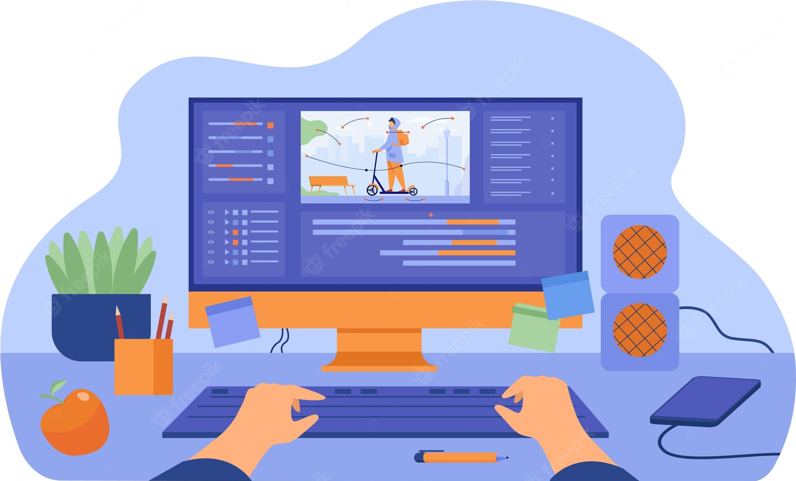
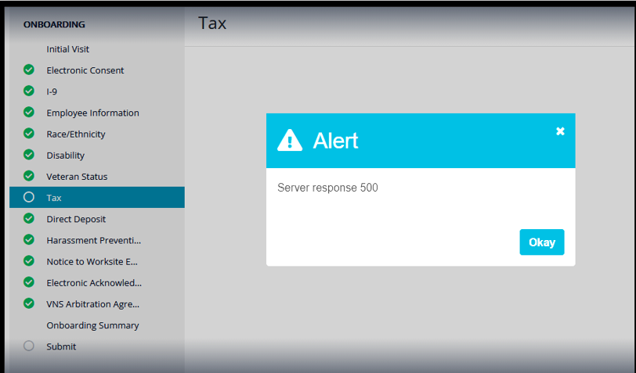
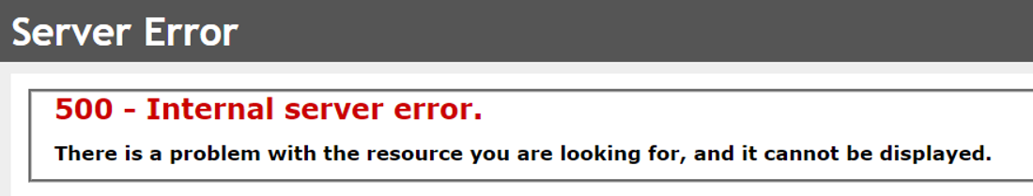
Troubleshooting – Importance Of SS
Screenshots are important because they help us to identify where the EE is located and how to proceed with troubleshooting. See the following example:
For the Error 500 we have the following screenshots
Even though, they look the same, the troubleshooting steps are different:
Error 500 : Is related to the internet connection of the employee and the server, this type of error can be resolved by clearing cookies, checking internet connection.
Error 500 : Is related to the address 1 From the worksite location for the EE missing, this is something we must resolve by contacting the CRM (Onboarding SOP)
Always request SS with all the information visible.

Slide 8
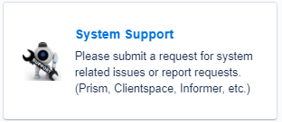
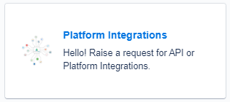
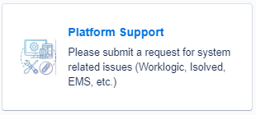
Jira Tickets – ER Options In Jira
Jira tickets are the ultimate step when troubleshooting for errors, we use them when we already took all steps to resolve, and nothing worked. But first let’s recognize the section we use in ER:
Use this category when reporting problems in the ESS
Use this category when reporting problems with the Vfficient Mobile APP
Use this category when requesting information from Old DPs (Avitus)
Add as much detail as you can.
Confirm troubleshooting done
Attach screenshots
Use summary and attach the rest of the information as a comment.
Confirm troubleshooting done
Attach screenshots
Choose Request Report
Be as detailed as possible
W2, Paystubs, reports
All tickets must be shared with your supervisor for follow up

Slide 9
Practice Time

Slide 10
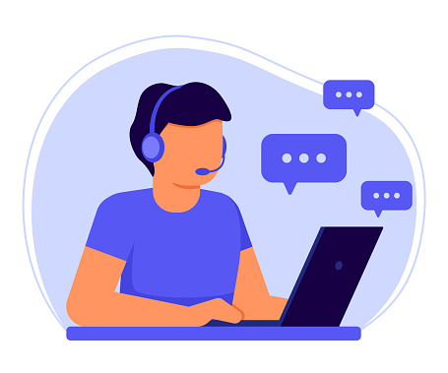
Troubleshooting / Jira– Practice
Take a look at the following scenarios and guess the most effective troubleshooting path…

Slide 11

Troubleshooting / Jira– Practice
Marianne called in because she was trying to login into the portal, but captcha box does not work, what is best route to follow?

Slide 12
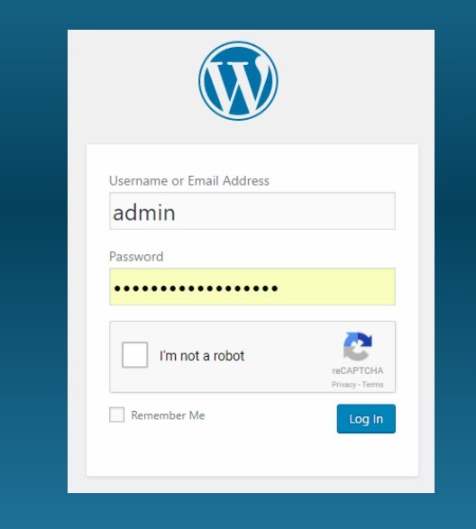


Troubleshooting / Jira– Practice
By reviewing the ESS portal guide, we can tell that it does not ask for a Captcha Check or is not included anywhere in the portal.
We must ask for a Screenshot to identify what type of website the EE is trying to login.
That is not the ESS portal, we must send the right link and confirm access with the employee.

Slide 13

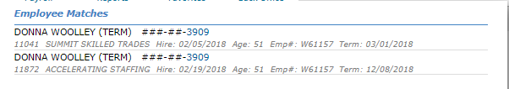
Troubleshooting / Jira– Practice
Donna has called because the portal is giving her an error when registering for an account: “You work for more than 1 employer, please contact employee support at 866 636 2855”

Slide 14
Troubleshooting / Jira– Practice
No need for troubleshooting
In this scenario the employee cannot create another portal account as they have one already created for another company, ER must help the EE by creating the username and password manually.

Slide 15

Troubleshooting / Jira– Practice
Steve is doing the onboarding process, in the i9 section but is not able to click on Next, it looks like he does not have a space to place his DoB, how to Address this problem?

Slide 16
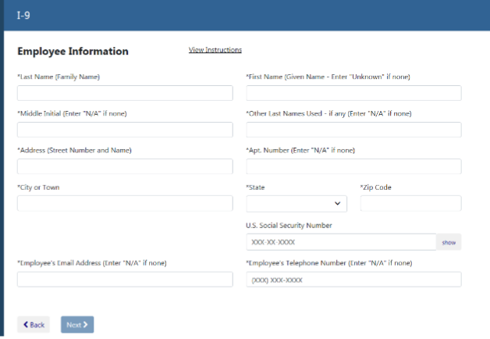
Troubleshooting / Jira– Practice
1. Ask for a SS to verify what the Employee sees.
2. As the box does not appear we want to make sure that the problem is not the browser the EE is using/ APP, clearing cookies and cache and re logging in, would be the next step
3. If the problem persists, we can try to replicate the issue
4. If we get the same problem, we open a Jira ticket > System Support
5. Share it with your Sup for follow up.

Slide 17

Troubleshooting / Jira– Practice
Greta Is having a problem trying to login into the mobile APP and it says wrong username or password, but they work just fine in the web version. How can we address this problem?

Slide 18
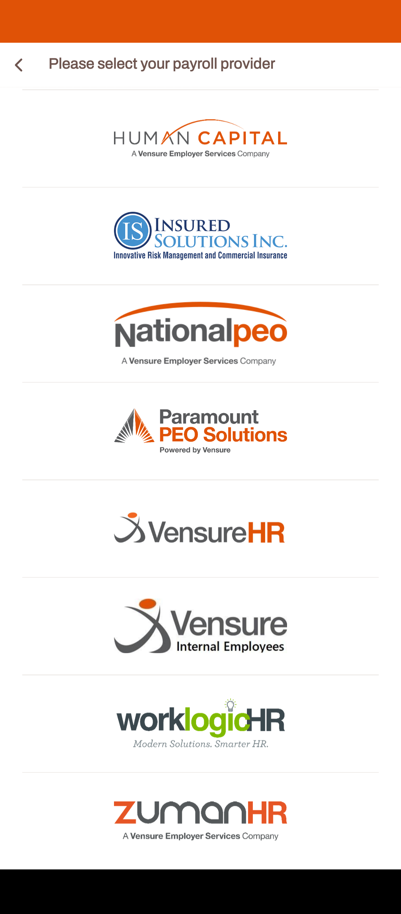

Troubleshooting / Jira– Practice
When assisting employees, we want them to follow the route and steps we use so we are sure they are in the right place and selecting the right options.
When the EE wants to access the account through the APP they must select the option VENSUREHR, otherwise the credentials will not work.
There is no way for us to replicate this problem so if the issues persists, we should create a Jira Ticket > Platform integrations

Slide 19

Troubleshooting / Jira– Practice
Donald lost his password, called ER and got his Password reset. When entering the credentials he gets the error of wrong username and password, What's is the best way to address this scenario?

Slide 20
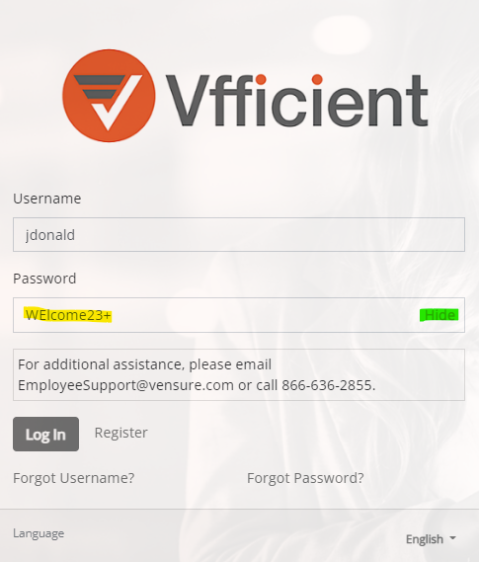
Troubleshooting / Jira– Practice
1. Before we do any password reset, we must try the credentials ourselves.
2. If the credentials work for us, we need to clarify how the employee is accessing the portal (web or app)
3. Direct the employee to hit the Show option to make sure the credentials are the correct ones.
4. We can ask the EE to try a different device as they credentials Work
5. We should not create a Jira ticket for this as the credentials were tested, we must advise the EE to switch devices and check on their side.

Slide 21
Questions?

