Slide 1
Employee Relations
Unemployment -Training

Slide 2

The goal of this presentation
During the following presentation we are going to address most common questions regarding Unemployment, at the end of this training the team Will:
Understand the basics of Unemployment Inquiries
Have a clear idea of how to address most common questions
Provide confidence to the team and accurate guidance to employees
Have more material to consult when assisting Unemployment questions

Slide 3

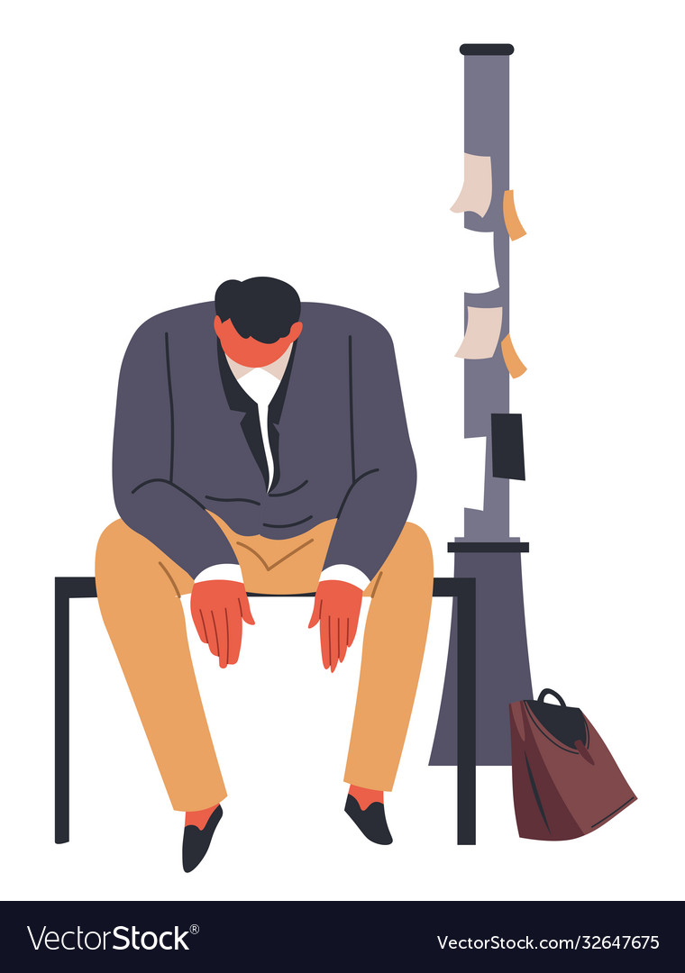
What Are Unemployment Benefits?
Unemployment benefits are paid to individuals who have lost their jobs.
These benefits are intended to provide some level of income while individuals seek new employment.
How employees file for Unemployment Insurance?
Each state administers a separate unemployment insurance program, but all states follow the same guidelines established by federal law.
Employee must contact their state's unemployment insurance program.

Slide 4

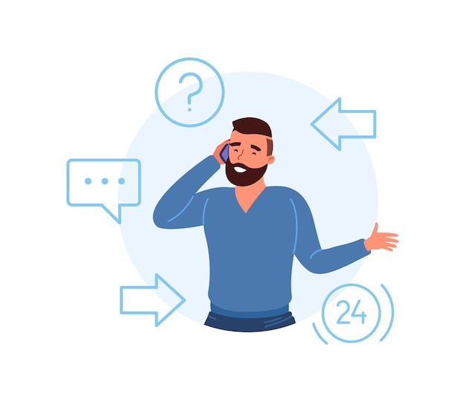


How Can Employees Apply?
Employee must contact their state unemployment insurance program after becoming unemployed.
Employee must file a Claim with the unemployment insurance program of the state.
Employee will have to wait around 2-3 weeks to receive the first benefit Check
Eligibility
*You must have separated from your last job due to a lack of available work.
*Meet work and wage requirements. You must meet your state’s requirements for wages earned or time worked during an established period of time referred to as a **"base period."
*Find details of your own state’s
Criteria
**In most states, this is usually the first four out of the last five completed calendar quarters before the time that your claim is filed

Slide 5
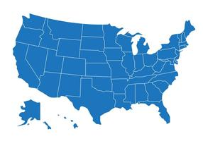


Frequently Asked Questions
How long can an employee collect unemployment benefits?
Benefits last up to a maximum of 20-26 weeks depending on the number of qualifying weeks in the base period. This varies by state.
I’m working but I’m working fewer hours. Am I they eligible for unemployment benefits?
Only Individuals who are partially unemployed due to lack of work may be eligible for unemployment benefits.
Any earnings during the week claimed will reduce the number of benefits paid. Earnings equal to or over the benefit amount will result in no benefits for that week.
If an employee works in one state and lives in another, which state should they file for unemployment benefits under?
Should file for unemployment in the state in which you worked. If you do file in another state your unemployment benefits will be determined by the rules of your former state.

Slide 6


Frequently Asked Questions
What should a person do if they believe someone has filed an unemployment claim fraudulently under their name?
They should immediately call and report it to the state in which the unemployment benefits were filed. Additional information is available on all states unemployment sites to report identity theft.
Am I eligible for unemployment benefits if I’m on Family Medical Leave Act (FMLA) leave?
No. Unemployment benefits are available only if you are unemployed. Employees on FMLA through their employer are not unemployed. Unemployment benefits would not be approved as the employee is not “able and available” for work.
Am I eligible for unemployment benefits when I’ve received a severance?
A severance package provides the claimant time to seek other employment.
The state will allocate the severance and the claimant can collect unemployment benefits once the allocation period has ended.

Slide 7
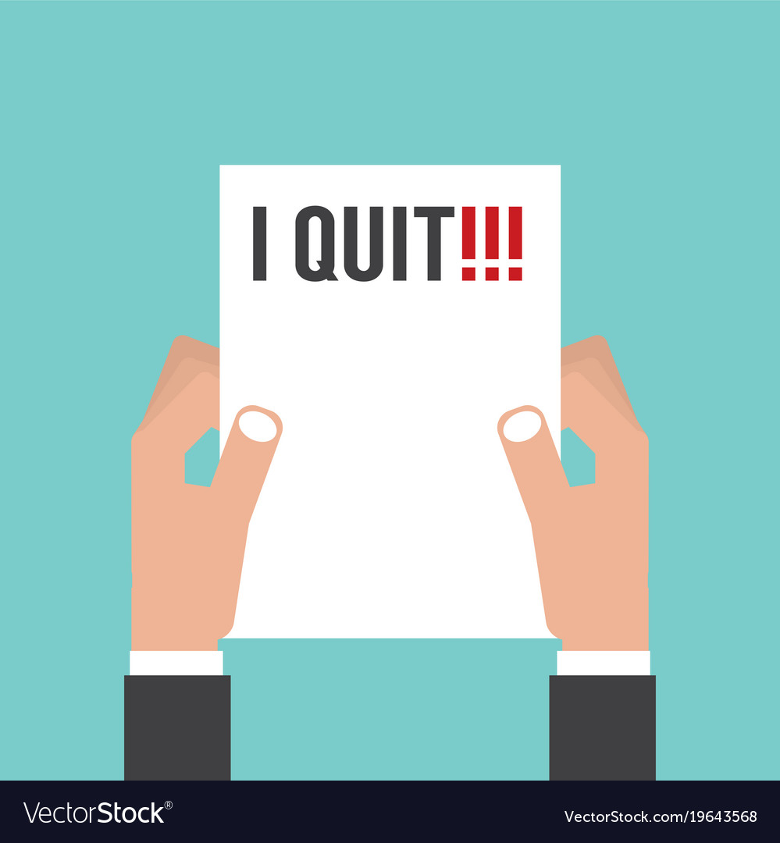


Frequently Asked Questions
If I’ve quit, am I eligible for unemployment benefits?
An employee who quits is typically not eligible for unemployment benefits, however, if they can prove they tried to resolve any issues prior to quitting and the state finds they quit with good cause they can potentially collect unemployment benefits. This does vary by state.
Can an independent contractor who did work for our company has filed for unemployment benefits. Who is liable for any unemployment paid to this individual?
If the independent contractor worked their own scheduled days and hours, and used their own property/equipment, they would not be considered an employee of the company. If they worked the employer’s scheduled hours and utilized company property/equipment you could potentially be a chargeable employer.
What to do if the Unemployment office government agency calls to verify past work hours or pay?
Have them send the request to us and we will forward the email to UC@vensure.com

Slide 8

Be Prepared!
As ER associates, we must provide the general information of unemployment benefits to employees.
Most of questions regarding details of the program and paperwork will be handled by the state’s Unemployment Insurance Program.
CLIENT: One of my employees has been denied unemployment benefits and we did not contest the claim. Can you call the unemployment office and speak on their behalf?
Unfortunately, we are only authorized to represent the employer and cannot represent the claimant in any capacity. The claimant will need to call the unemployment office in the state in which they filed to resolve any issues.

Slide 9
Questions?

