Slide 1
Employee Relations
Training Session – Verification of Employment (VOE)

Slide 2


Verification of Employment
A Verification of employment is a letter that confirms an individual’s employment status.
The letter usually contains: Name of the employer, hire date, employment status, or the termination date if the Employee doesn’t work for the company anymore.
The standard letter doesn’t contain information about the payment unless it is requested.

Slide 3



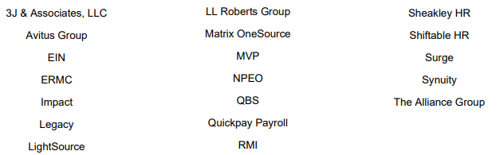


The Work Number
Vensure uses The Work Number services to provide automated verification of employment for Vfficient, OneSource, People, and Empower Prism instances. For other DP’s, the VOE Will be processed manually.
Request goes through The Work Number
Request goes through voe@vensure.com
Note: TWN only works for commercial (agencies) and Social Services (government) Verifications.

Slide 4

Three Different Scenarios
1
ER
An individual wants a VOE for personal purposes…
Send an email to voe@vensure.com with the request.
2
An agency/government entity wants a VOE for an employee…
ER
Send The Work Number information
3
An agency wants a VOE for an employee, but they have files that should be filled out or specific information is needed.
ER
Advise them to send the request to voe@vensure.com
NOTE: Worksite Employees SHOULD NOT reach out VOE team directly.

Slide 5
Practice Time

Slide 6

Practice Time – Scenario 1
Hello! My name is Michael Brown, I work for Huffmaster and I need a verification of employment for personal purposes.

Slide 7

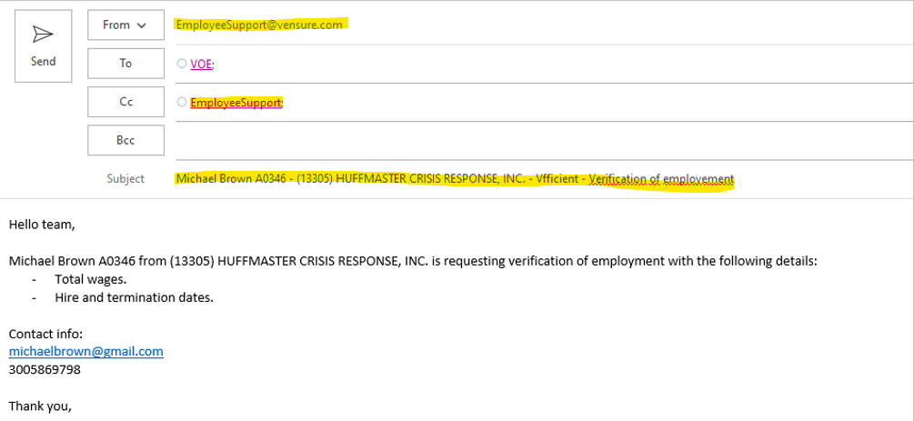
Practice Time – Scenario 1
Hello! My name is Michael Brown, I work for Huffmaster and I need a verification of employment for personal purposes.
In order to help with this request, we will need to get the details and send an email to voe@vensure.com
The email should look like this

Slide 8

Practice Time – Scenario 2
Hello! This a third-party agency and we want a verification of employment for an employee…

Slide 9
Practice Time – Scenario 2
Hello! This a third-party agency and we want a verification of employment for an employee…
First, we need to confirm the Instance I which the client is located, then…
*If the DP is Vfficient, OneSource, People, or Empower > send The Work Number information.
*For other DP’s > Advise them to send the request to voe@vensure.com
Request goes through The Work Number
Request goes through voe@vensure.com
Note: Go to SharePoint to find The Work Number information updated.

Slide 10
Practice Time – Scenario 3
Hello! This a Government entity and we want to verify some information for an employee. We have a file with some specific information that we need…

Slide 11



Practice Time – Scenario 3
Hello! This a Government entity and we want to verify some information for an employee. We have a file with some specific information that we need…
In order to help with this request, we will need to advise them to contact VOE team directly at voe@vensure.com
voe@vensure.com

Slide 12
Questions?

