Slide 1
Employee Relations
Training Session – W4 - Employee’s View Training

Slide 2


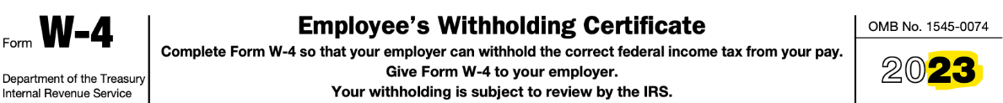
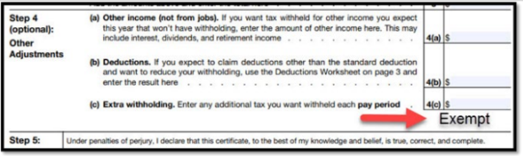
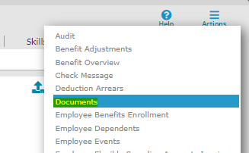
W4 Federal Taxes – What’s Important?
Key Items
W4 Determines what the government can withhold from the employee’s paycheck.
Always verify the Year of the form
Exempt Employees
Check PRISM

Slide 3
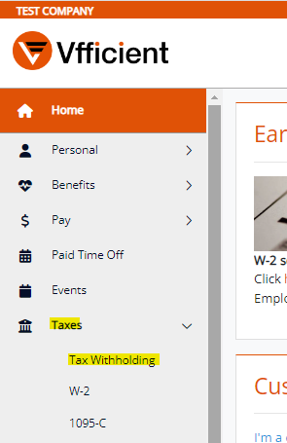
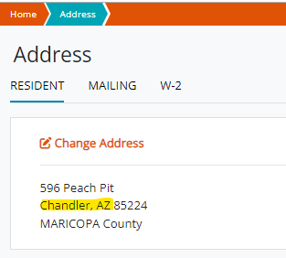

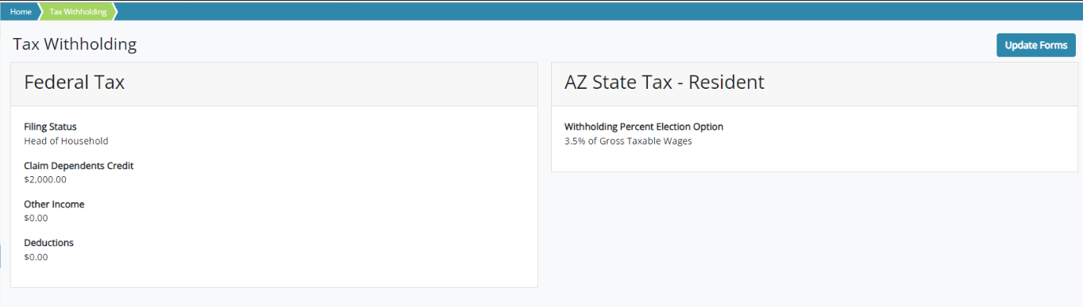
W4 Federal Taxes– What’s Important?
We want to encourage employees to update the form in the ESS as a first option, if not, offer the form.
Employees can update Federal and State tax forms Based on the address they have in PRISM / ESS
Home > Taxes > Tax Withholding
Home > Taxes > Tax Withholding

Slide 4
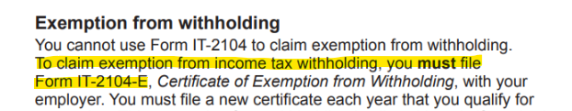
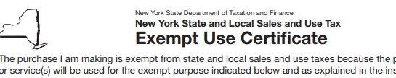


State Tax Exemption
Key Items
In some cases, to claim exempt for state taxes, employees will need to fill out an additional form
Check the instructions of the State Form
Use our SP link to provide these forms
NOTE: This is only for Physical submission of forms

Slide 5




W4 Federal Taxes– What’s Important?
Practical Tips
The information filled out during the onboarding (taxes Portion) is the same one as in the Taxes section in the ESS
Employees read and complete the form, if they have questions on what to place must be consulted with a tax advisor
All Questions in the W4 are shown in the ESS- Electronic Onboarding Guide Located in our SP
Employees cannot update taxes in the APP

Slide 6
Employee’s View
Presentation

Slide 7
W4 - Federal Taxes
Most Common Scenarios

Slide 8


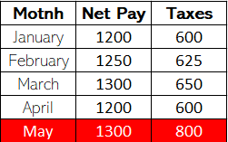


W4 Federal Taxes– Most Common Scenarios
If the employee claims that the amount withheld is incorrect…
Tax withholding is based on the specific information the employee placed in the W4.
We can evaluate previous earning and deductions searching for an abnormal deduction.
Before creating a case, advise the employee to use the withholding calculator in the IRS Website to verify how deductions would look like
Employees can Update anytime their information in the ESS or via email (ER)
Confirm W4 In documents and compare to the set up in PRISM

Slide 9


W4 Federal Taxes– Most Common Scenarios
If the employees insists that the information is incorrect…
Do not argue with the employee, if they insist the deductions are incorrect, offer to create a case after verifying all details provided previously
Confirm with leadership the set up of the case (payroll) and consult the situation if any doubt

Slide 10


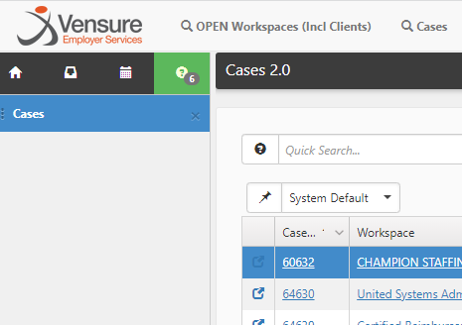



W4 Federal Taxes– Most Common Scenarios
Employee has questions about specific sections of the W4
Be resourceful, use your tools and practical guides to read the section and paraphrase what is being asked
We cannot advise on what to place
Is the employee’s responsibility to reach out for professional advise if needed.
Our Tax department do not take these questions either, Vensure does not offer a service for tax consulting.

Slide 11
Questions?

