Slide 1
Employee Relations
Training Session – Zayzoon and Daily Pay

Slide 2

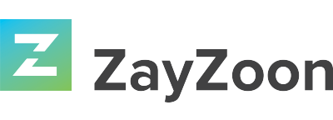

Wages On-Demand
During this training we will target most common questions regarding these two platforms of Wages On-Demand
What is ZayZoon?
What is DailyPay?
How To Sign Up.
Frequently Asked Questions

Slide 3

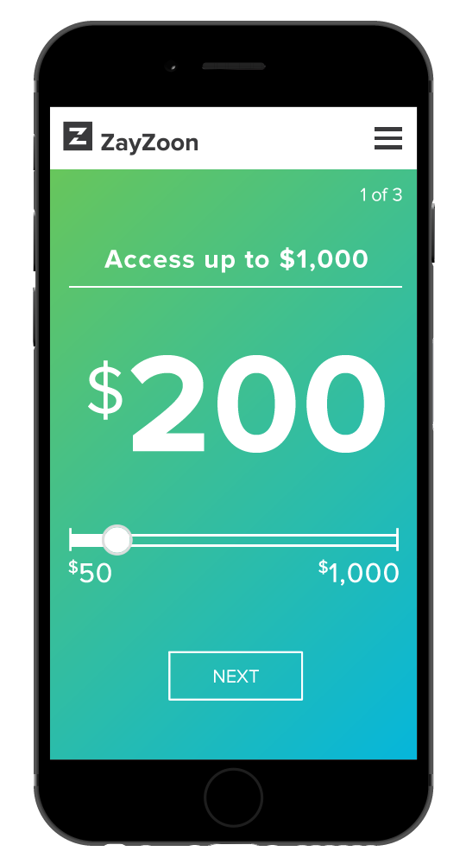

ZayZoon’s Earned Wage Access helps bridge the gap between paydays. Access to the wages when needed with ZayZoon and avoid unnecessary late fees, payday loans, or overdraft fees.
It is not a loan
Charges $5 fee at most for an employee
to access up to $200 per day.
Employees can send funds to their payout method of choice, instantly.
It is not for every client; they can decide if they opt-in and out

Slide 4

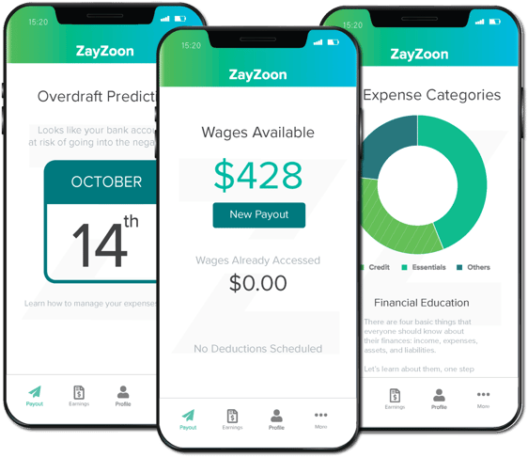
Important Information
It is not a payday loan because it does not charge interest and does not place debt on the employee. Employees are given access to their already-earned wages.
Employees are notified of the service through email, by marketing material provided by their employer, or in their payroll self-service portal.
Employees must have a bank account to utilize ZayZoon. If an employee does not have a bank account, Vensure can set them up with a pay card instead.
Employees can process multiple transactions of up to $200 (per day) at a time to access additional funds. However, they can only take up to 50% of their net earned wages, to a maximum of $1,000 per pay period.

Slide 5
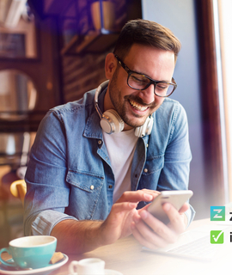
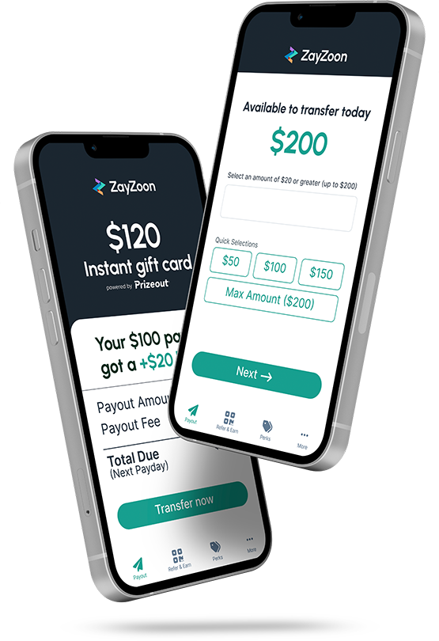
Important Information
ZayZoon is linked to Vfficient and has Access to each Client’s Payroll records. They will look at the average hours/gross Payroll for the Employee to formulate the information.
Payouts are automatically repaid through the payroll direct deposit on the employee’s next payday. No added work from the employer is needed for this. This is 100% facilitated through ZayZoon’s integration with payroll.

Slide 6
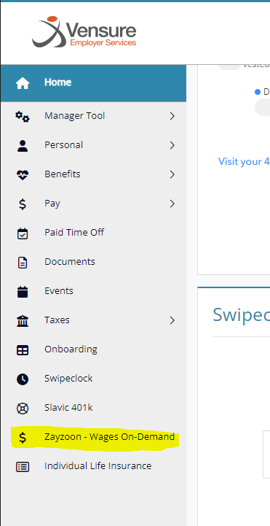

Case Creation
How To Sign Up
All that is needed for sign-up is for an employee to upload a picture of government-issued ID and debit card information or bank account information for funds transfer.
Employees must go to the ESS > Left Panel > ZayZoon – Wages On- Demand
If the Employee got the notification that can use ZayZoon and is getting an error when trying to use it, we can create a case for the Product Management team.

Slide 7

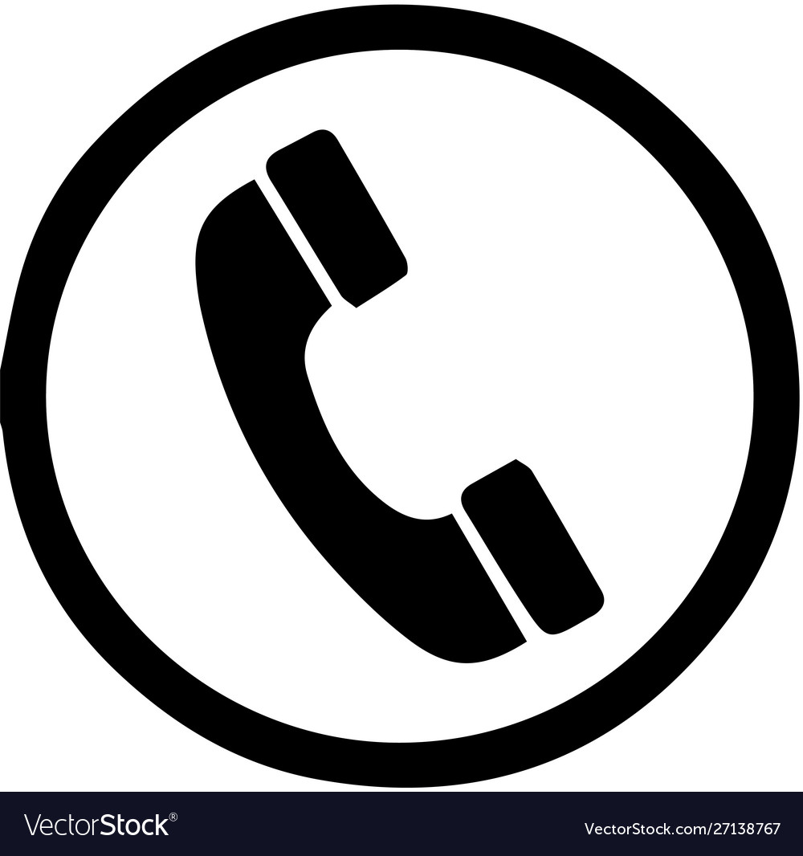

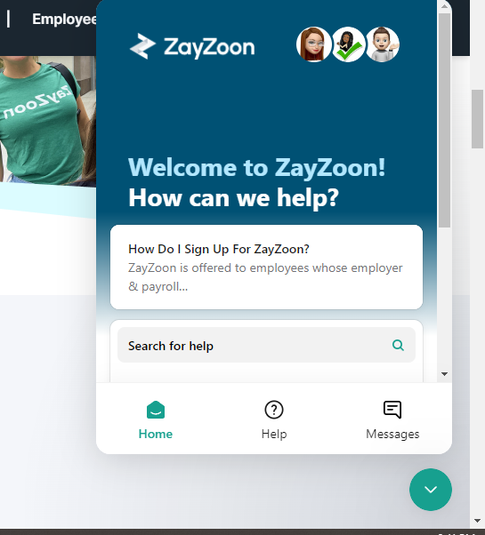
Contact Info
ZayZoon offers customer support through their mobile app or at support@zayzoon.com
Mon to Fri: 8:00 AM to 8:00 PM (MT)
Sat & Sun: 10:00 AM to 6:00 PM (MT)
They also offer live chat assistance through their website

Slide 8

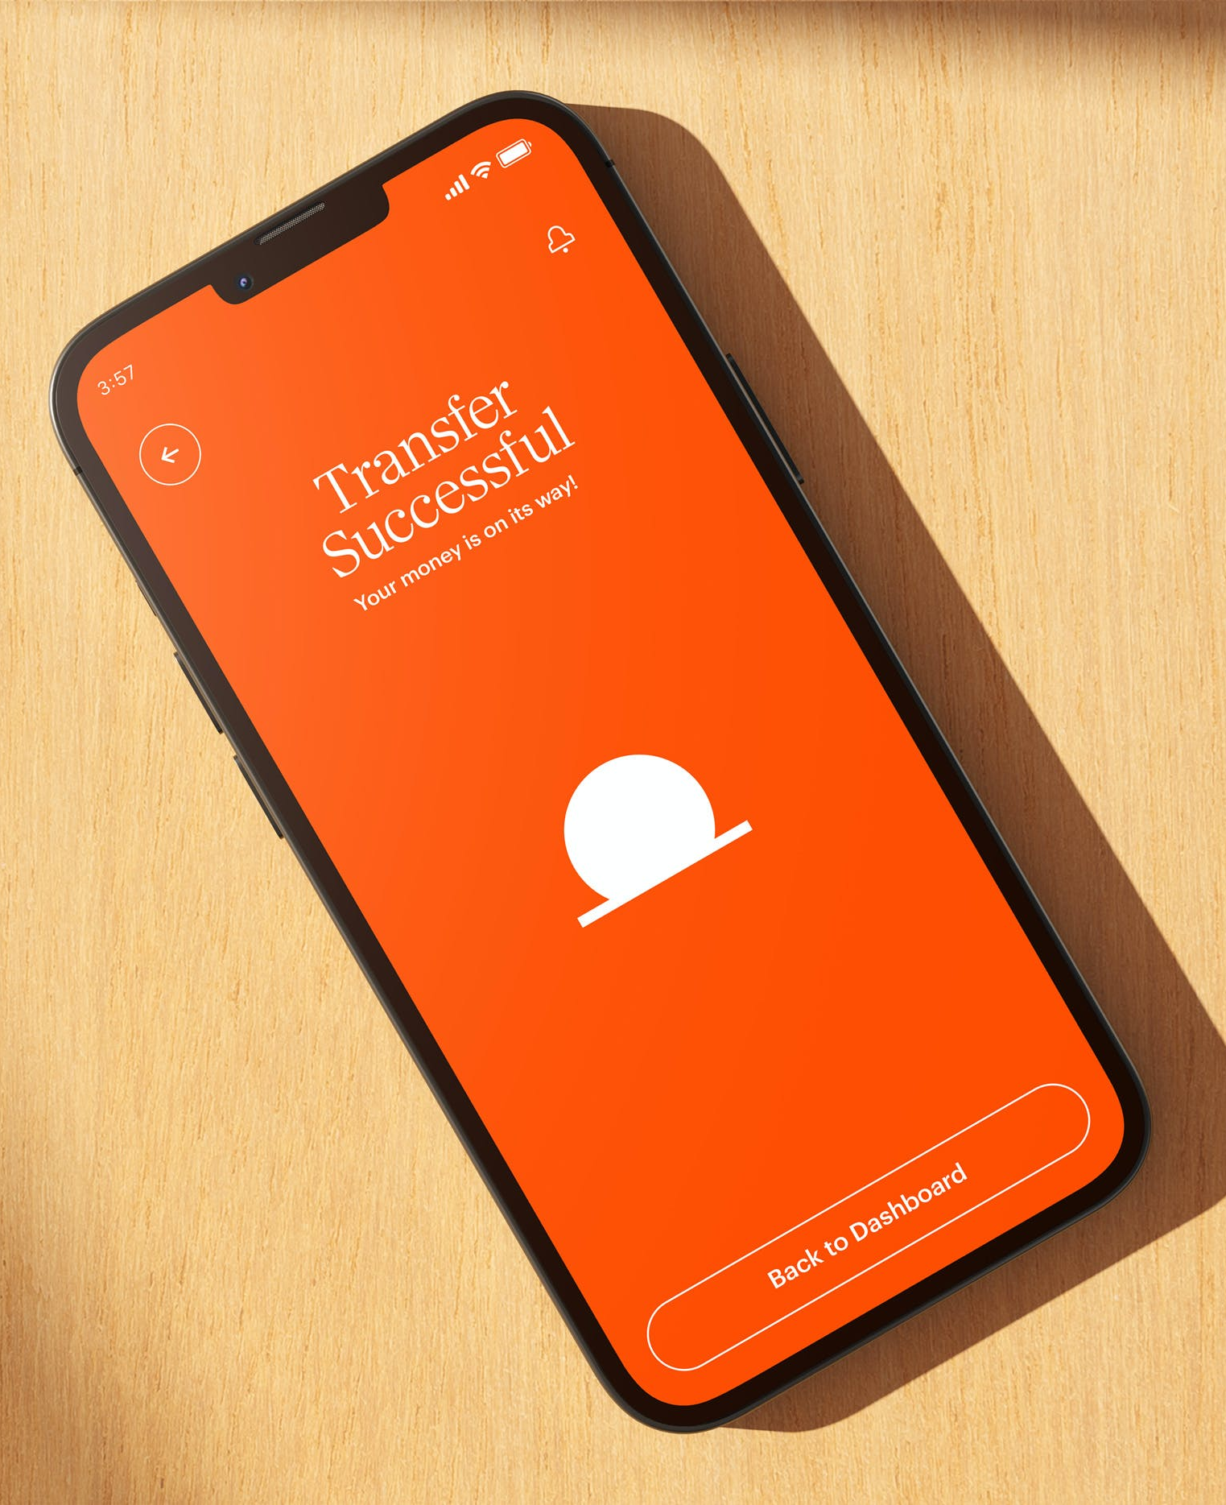

Important Information
Gives employees access to their earned pay before the traditional, scheduled payday. With an on-demand pay benefit, employers can provide greater financial wellness support for employees, leading to happier and more productive employees.
When an EE signs up for this service the Payroll Processor must set up the DD for the funds of EE is paying back. They are processed every Friday and the EE may call wondering why their DD was changed.
For further questions, advise Employees we do not administer the service and to contact DailyPay.
CONTACT INFO:
https://www.dailypay.com/
866.432.0472

Slide 9
Questions?

